Slide 1
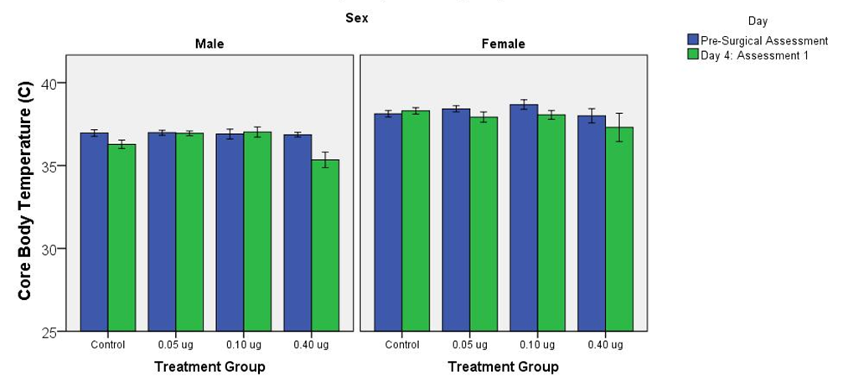
Supplementary Figure S5

