Slide 1
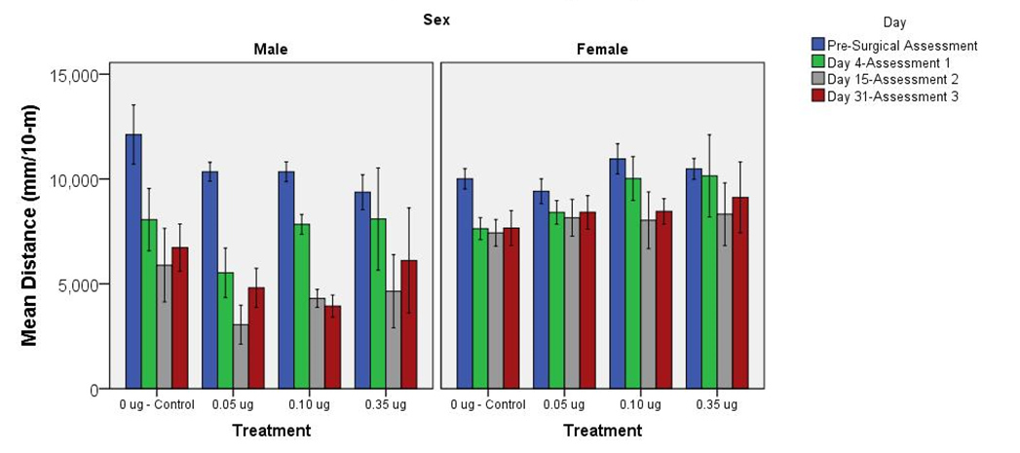
Supplementary Figure S6

