Slide 1
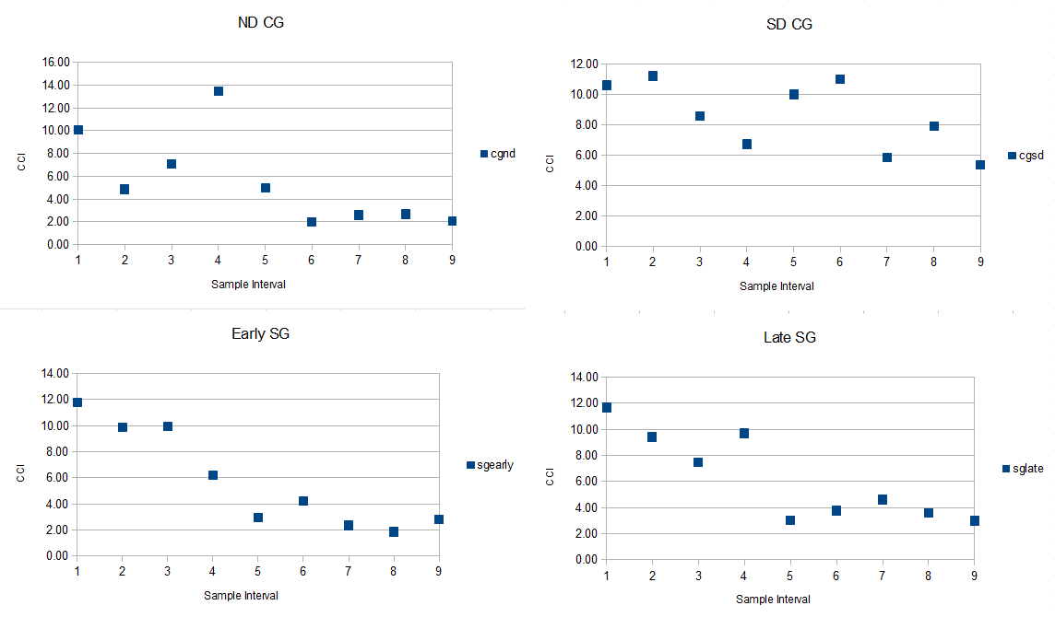
Pre-senescence and post-senescence stages of SG and PCG based on chlorophyll data
Before 3rd week of August
Pre-Senescence
Post-Senescence
Winter
Last week of September
Spring
Pre-Senescence
Post-Senescence
Pre-Senescence
Post-Senescence
Notes:
Supplementary figure 1: Pre- and post-senescence period, was determined by measuring the chlorophyll content. Red arrow indicates the mid line between pre and post senescence period, determined based on chlorophyll content measurement. Sample interval indicates number of week and CCI indicates relative amount of chlorophyll content in that particular weight.

Slide 2
β-Ketoadepyl CoA thiolase
Cysteine protease
β-oxidation
Proteolysis
Aconitase hydratase
Succinate dehydrogenase
TCA cycle
Glyoxylate cycle &Gluconeogenesis
Increased Hexose content
Signal for early floral development, and early senescence
Sucrose phosphate synthase
Upregulation in conversion of starch and glucose to sucrose
Source to sink translocation
upregulation
Notes:
Supplementary figure 2: Proposed model of sugar metabolism towards Hexoses and sucrose formation during the senescence process which signals for early floral development, translocation of sugars from source to sink, and early senescence. We found upregulation of 5 proteins shown above, during the process of senescence whereas 3-proteins: β-Ketoadepyl CoA thiolase, Cysteine protease, and Sucrose phosphate synthase were constitutively downregulated in late senescing PCG compared to early senescing when analyzed before the senescence.

Slide 3
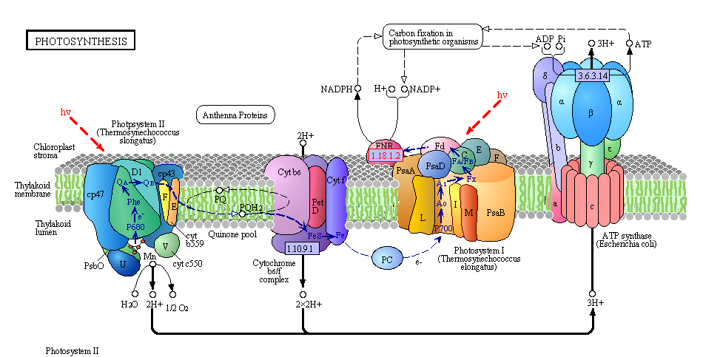
Upregulation
Notes:
Supplementary figure 3: Constitutive overexpression of three proteins, in “late senescing cultivar” of PCG compared to “early senescing” cultivar, that are involved in photosystems splitting the water and fixing the carbon. Three proteins upregulated were Oxygen evolving enhancer protein of photosystem II, Ferrodoxin-NADP-reductase, and α-subunit & β-subunit of ATP synthase. Fig of photosynthesis reproduced from KEGG reference pathway (http://www.genome.jp/kegg/pathway/map/map00195.html)

Slide 4
INPUT: 3CO2+H2O
Ribulose-5-phosphate
Ribulose-1,5-bisphosphate
3-Phosphoglycerate (3-PGA)
RUBISCO
1,3-Bisphosphoglycerate
Sedoheptulose-7-phosphate
Xylulose-5-phosphate
2
3
Glyceraldehyde-3-phosphate (G3P)
OUTPUT: (a G3P molecule)
Sedoheptulose-1,7-bisphosphate
Erythrose-4-phosphate
Fructose-6-phosphate
Fructose-1,6-bisphosphate
Dihydroxyacetone phosphate (DAHP)
2
1
Overexpression
Notes:
Supplementary figure 4 : Constitutively overexpressed proteins in “late senescing” cultivar of PCG compared to “early senescing” cultivar, that catalyze various steps in Calvin cycle. Overexpression of 3 enzymes that catalyze the vital rate limiting steps are marked with red arrows. Three different enzymes upregulated are :
1= Fructose bishphsphate aldolase; 2=Transketolase; 3=Sedoheptulose-1,7-bisphosphatase

Slide 5
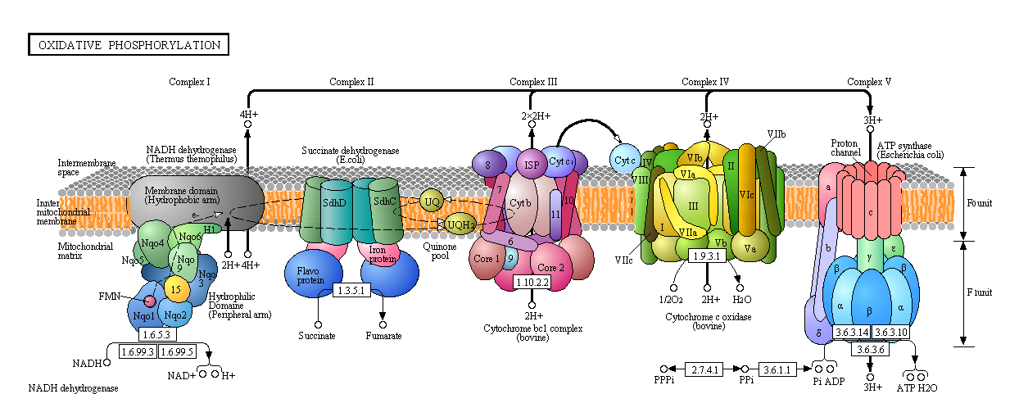
ROS
upregulation
Notes:
Supplementary figure 5 : Oxidative phosphorylation pathway showing upregulation of complex II, and complex IV as observed in our study. Upregulation of complexes in oxidative phosphorylation may contribute to increase the ROS level, thus signaling the expression of senescence associated genes. Constitutive upregulation of complex IV was observed in “early senescing” cultivar of PCG compared to “late senescing” cultivar. Upregulation of components in oxidative phosphorylation contributes to produce ROS and signal for expression of senescence associated genes. Fig of oxidative phosphorylation reproduced from KEGG pathway (http://www.genome.jp/kegg/pathway/map/map00190.html)

