Slide 1
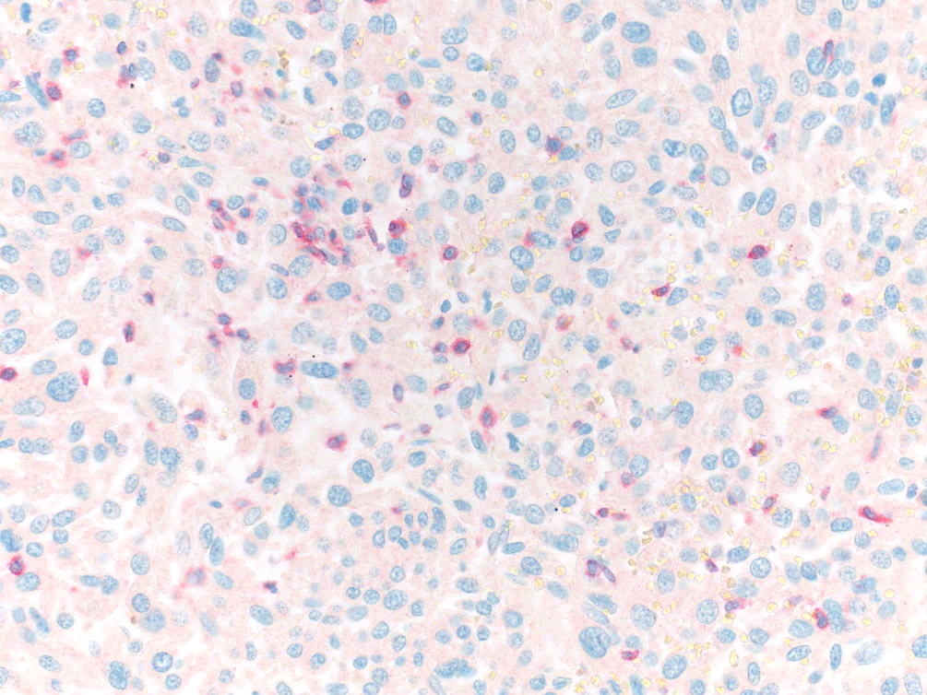
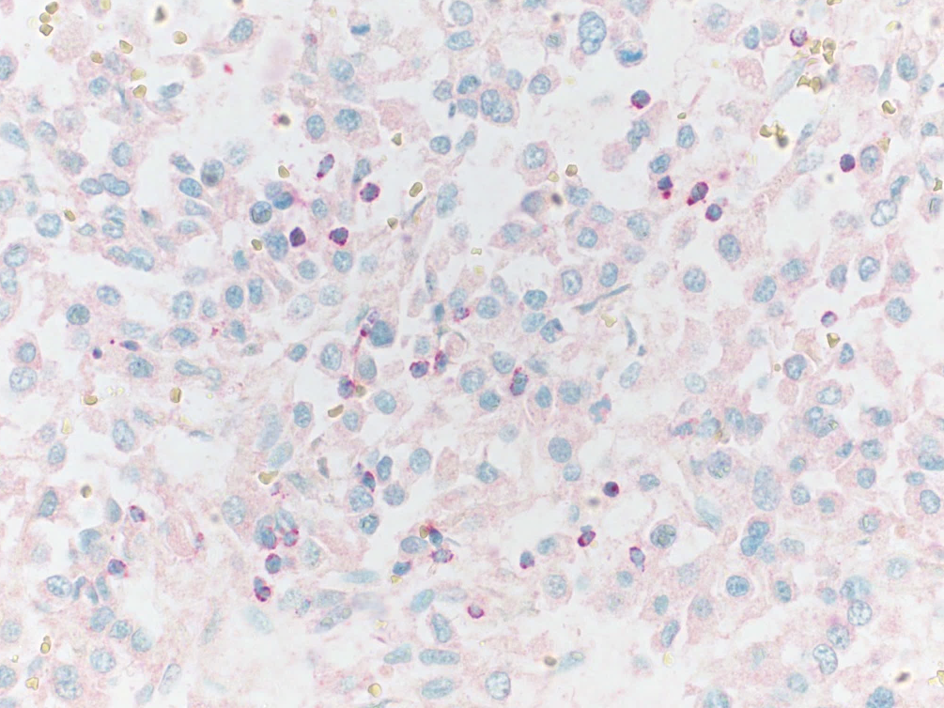
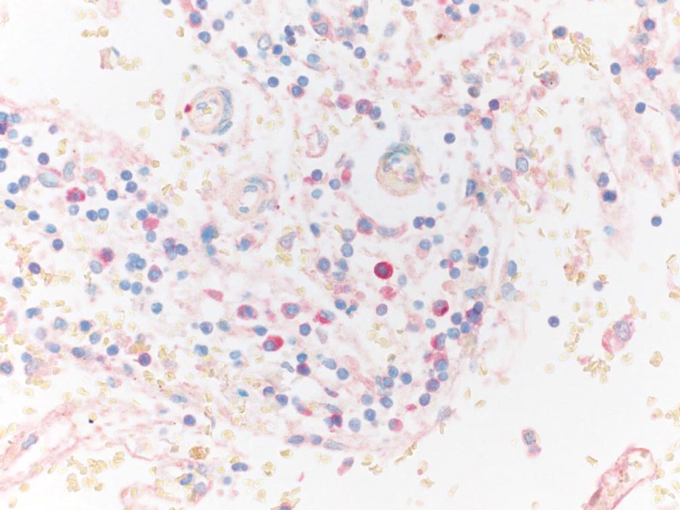
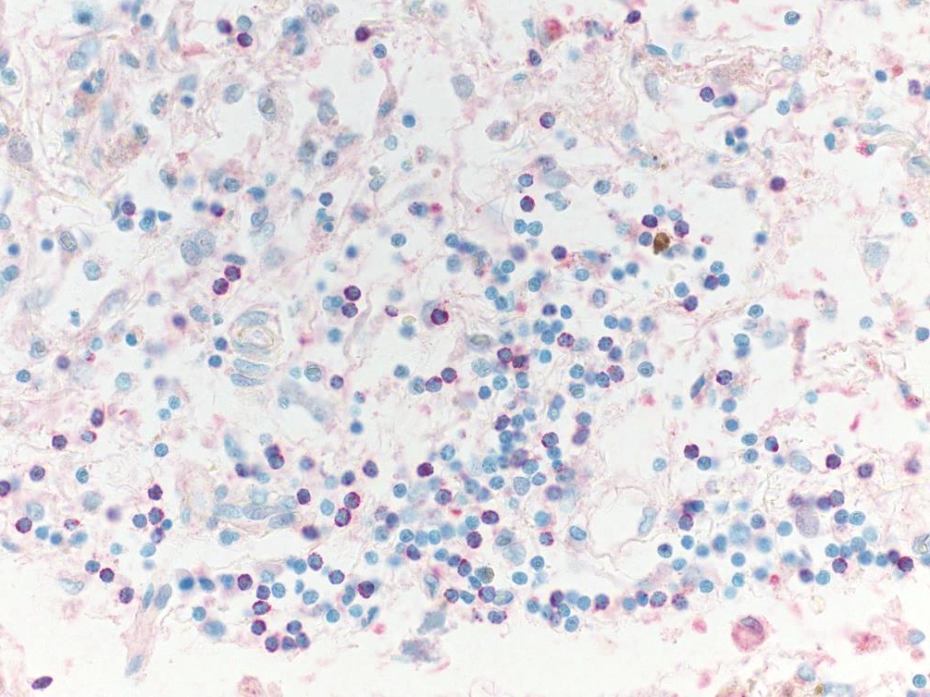
A
B
PD-1
100 µm
TIA1
100 µm
C
D
PD-1
100 µm
TIA1
100 µm
FIGURE S1

