Slide 1
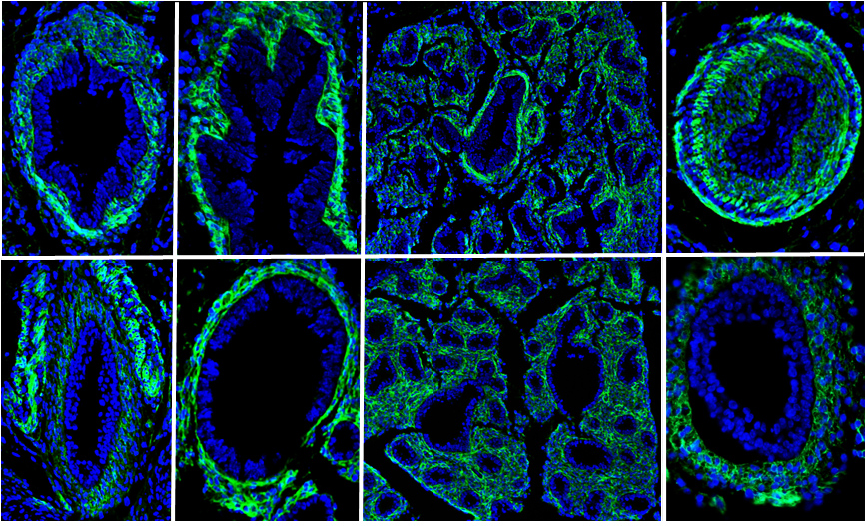

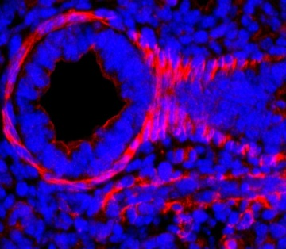
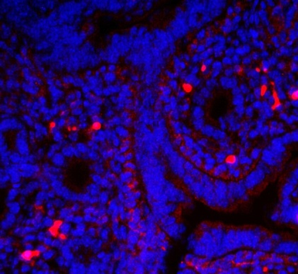
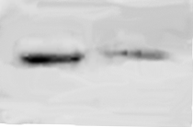
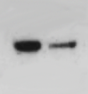
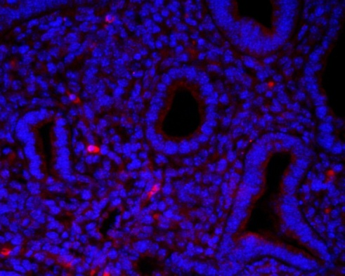
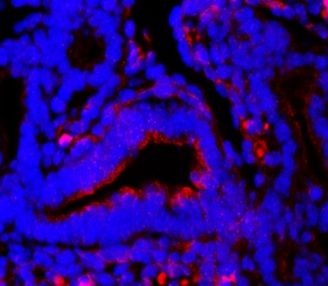
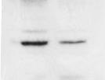
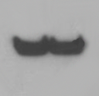
Additional file 1
A
B
C
D
Alk5
Floxed
allele
E
Alk5^{flox/+}
Alk5^{+/+}
Alk5^{flox/flox}
(bp)
LoxP
LoxP
500
neo
400
Exon III
Exon IV
Flox
300
X Dermo1-Cre
Cre excised
allele
Wt
200
LoxP
G
H
Exon IV
E15.5
F
Control
Alk5^{Dermo1}
Control
ALK5
p-SMAD2
ALK5
PAI-1
I
J
PAI-1
Alk5^{Dermo1}
β-ACTIN

