Slide 1
Supplementary Figure 1.
Color Key
6.5
9.3
12.1
LUMINAL-EPITHELIAL-ANDROGEN
TRGC2 /// TRGV9 /// LOC442532 /// LOC442670 /// TARP
GATA2 | HOXB13 | CREB3L4 | TMEFF2 | CRISPLD1 | TNFRSF10B | SPDEF | ALDH1A3 | PLA2G7
STEAP2 | KLK3 | ARHGAP6 | EHF | FOXA1 | SLC44A4 | PI15 | HOXA13 | TMPRSS2
KLK2 | ACPP | LATS2 | SLC4A4 | TACSTD2 | PSMAL | ZBTB16 | SFTPA2 | SLC45A3
STEAP1 | TMEPAI | LOC51334 | ADRB2 | RB1 | TRGC2 | AKR1C3 | UGT2B15 | NKX3-1
CYP1B1 | AR | CYP39A1 | AMACR | HPN | YAP1 | STEAP4 | FOLH1
NEURAL DEVELOPMENT
SLITRK6 | DLX5 | ROBO1 | NEGR1 | FYN | PCSK1 | INSM1 | ASCL1 | HEY1 | NEF3
NCAM1 | OTX2 | ID4 | NRTN | ELAVL4 | SIX3 | KSR | TUBB-PARALOG | PRL | TPH1
KIF1A | DLL3 | NAV2 | ASPM | DDC | NEFL | DPYSL3 | CHGB | ENO2 | PROX1
ISL1 | ADCY1 | NEUROD1 | EPHA4 | FXYD6 | LHX2 | SNCAIP | MAP1B | DLX6 | RNF182
SEMA6D | GAD1 | TRIM9 | KCND2 | NRCAM | FOXO6 | VMP | SH3GL2 | GPSM2 | BAALC
CELL CYCLE-PROLIFERATION
MYBL1 | PTTG1 | UBE2T | CCNB1 | PTTG3 | CCNE1 | HELLS | CCNE2
E2F8 | KIF1A | KIF2C | UBE2C | CDT1 | E2F1 | TOP2A | CENPF
CCNA1 | GTSE1 | CDCA8 | MYBL2 | ANLN | CCNF | CDC2 | GADD45A
CDKN2A | UBE2S | NUSAP1 | MNS1 | CCNB2 | CENPA | MCM10 | RRM2
BUB1 | UHRF1 | CDKN3 | CDC25C | CDC34 | FBXO5 | CDC7 | FOXM1
CDC20 | STK6 | ESPL1 | DNMT1 | CEP1 | MAD2L1 | MCM6 | GAD1
KIF20A | CDC25B | NEK2 | CDC25A | CDKN1B | FOXO6 | MPHOSPH9 | PLK1
KIF11 | CCNA2 | CDC45L | CDCA2 | CDCA5 | BRCA1 | RBBP8 | CDCA4
KIF23 | GTSE1 /// LOC440834
CDK6 | CDC2L6 | CINP | HSMPP8 | ANAPC1 | ANAPC5 | NUMA1 | SPHAR
NEK6 | CCNG2 | CCND1 | AURKAIP1
ADENO
SCPC
Notes:
Supplementary Figure 1. Supervised hierarchical clustering of differentially expressed genes between typical CRPC PDX (“ADENO”) and CRPC PDX with small cell carcinoma morphology (“SCPC”). RMA processed and log2 transformed gene expression data were used to generate the heatmap. This heatmap includes genes that are in the following three categories: (1) Luminal epithelial androgen, (2) Neuronal function pathway, and (3) cell cycle proliferation. Each row represents one gene, and each column represents one sample. Data is not scaled on either row or column level. The genes are ordered first by the three categories. Within each category, genes are ordered increasingly by the fold change between typical and small cell samples. Samples were clustered with distance matrix computed by Euclidean distance measure and complete linkage rule.

Slide 2
Supplementary Figure 2.
Notes:
Supplementary Figure 2. Morphologic spectrum of tumors of patients with the aggressive variant phenotype in the primary (A-D) and metastatic tumor sites (E-H). Tumors include adenocarcinomas (A,E,G), poorly differentiated carcinomas (B,F) and tumors with neuroendocrine differentiation (C,D,H). D and H show small cell features. Hematoxylin and Eosin, 200 x

Slide 3
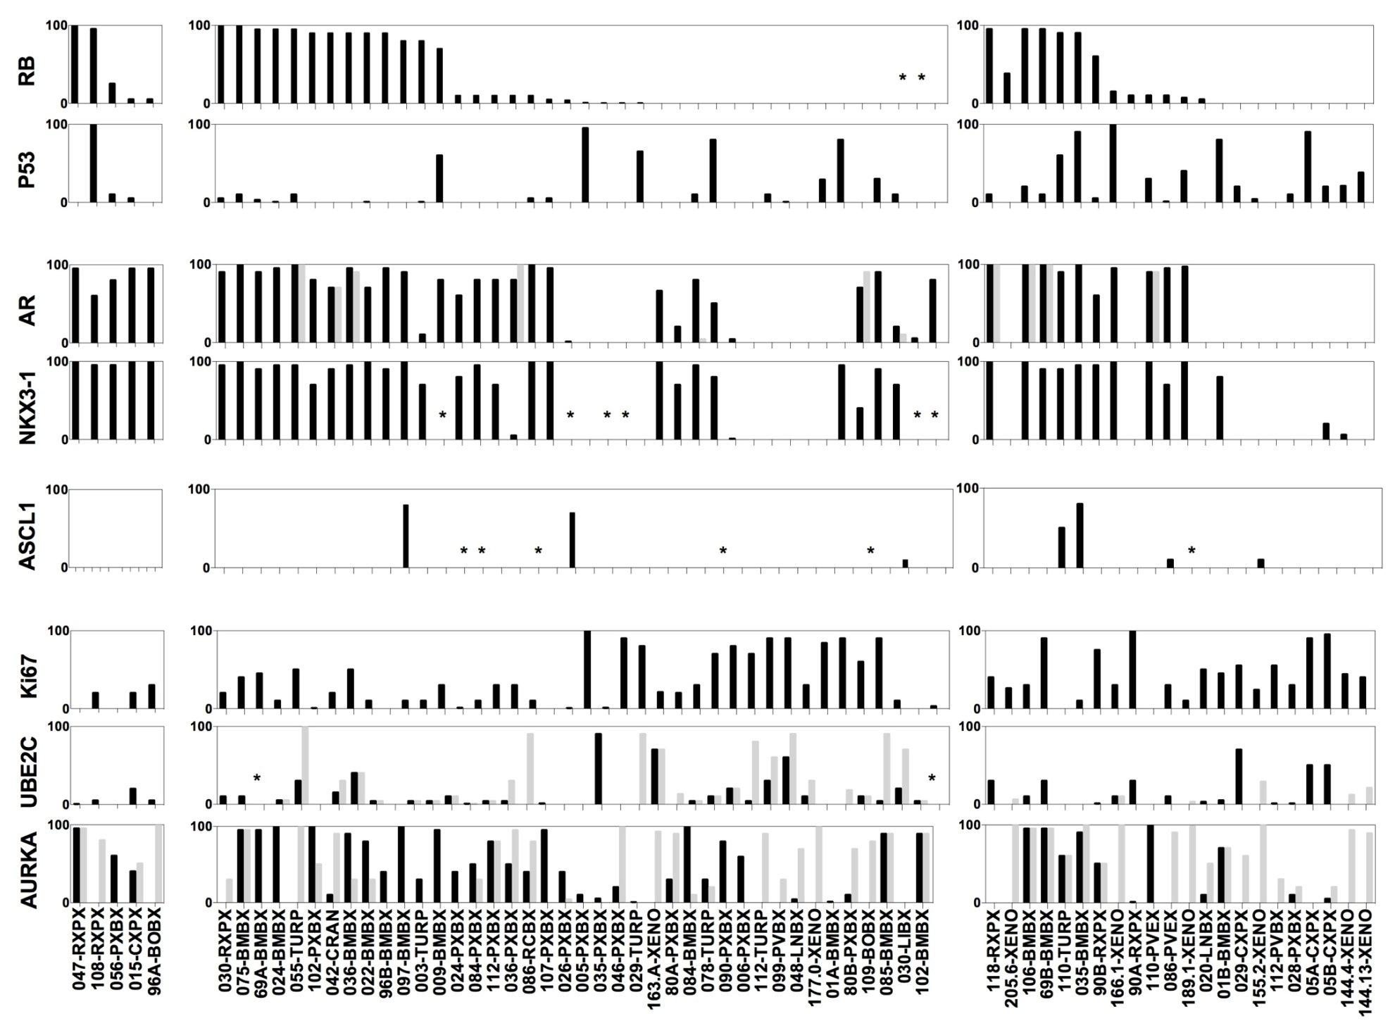
Supplementary Figure 3.
EARLY
BASELINE
POST-CHEMOTHERAPY
Notes:
Supplementary Figure 3. Immunohistochemical analysis of all 59 available NCT00514540 samples and 8 PDX lines. Labeling indices (% of cells staining positive for the marker listed on the y-axis, LI) for RB1, Tp53, AR, NKX3-1, AURKA, UBE2C and Ki67 in Early (more than 13 months prior to registration), Baseline (between -13 and +1 months from registration) and Post-chemotherapy (more than 1 month after registration and chemotherapy). Black bars depict nuclear staining. For AR, AURKA and UBE2C cytoplasmic stains are shown in light grey. Abbreviations: RB, retinoblastoma 1; p53, tumor suppressor Tp53; NKX3-1, NK3 homeobox 1; AURKA, aurora kinase A; UBE2C, ubiquitin conjugating enzyme 2C; Ki67, antigen identified by monoclonal antibody Ki-67.

Slide 4
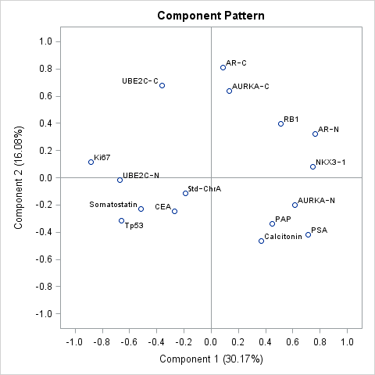
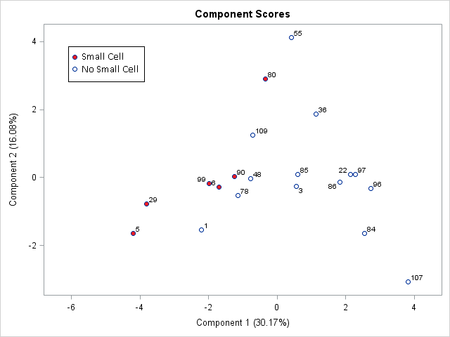
Supplementary Figure 4.
A.
B.
Notes:
Supplementary Figure 4. Principal component analysis of a16-serum-and-IHC-tumor-marker set in “Baseline” samples from 21 patients. (A) Loading plot for the first and second principal components. (B) Score plot showing the scores for each patient on principal components 1 and 2. The patients who had small cell morphology on biopsy are labelled in red.

Slide 5
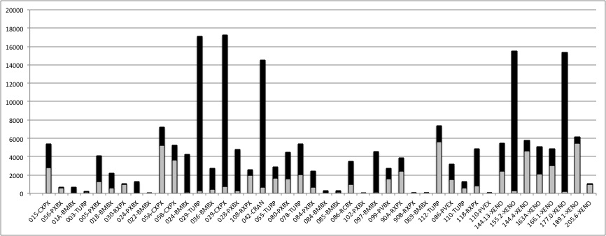
Supplementary Figure 5.
Notes:
Supplementary Figure 5. Total number of copy number alterations per sample. Copy number losses are in shaded in grey. Copy number gains are shaded in black. Numbers indicate accession number on the protocol or PDX line. Letters indicate site of origin. Abbreviations: RB, retinoblastoma 1; p53, tumor suppressor Tp53; NKX3-1, NK3 homeobox 1; AURKA, aurora kinase A; UBE2C, ubiquitin conjugating enzyme 2C; Ki67, antigen identified by monoclonal antibody Ki-67; RXPX, radical prostatectomy; BMBX, bone marrow biopsy; TURP, transurethral resection of prostate; CRAN, craniotomy; RCBX, rectal biopsy; XENO, xenograft; PVBX, pelvic mass biopsy; LNBX, lymph node biopsy; BOBX, bone biopsy; LIBX, liver biopsy.

Slide 6
Supplementary Figure 6.
A.
B.
C.
D.
Notes:
Supplementary Figure 6. mRNA levels of genes of interest. (A) Representative genes from published RB-loss signatures. (B) AR and markers of luminal epithelial prostate differentiation. (C) REST and markers implicated in neural development.

Slide 7
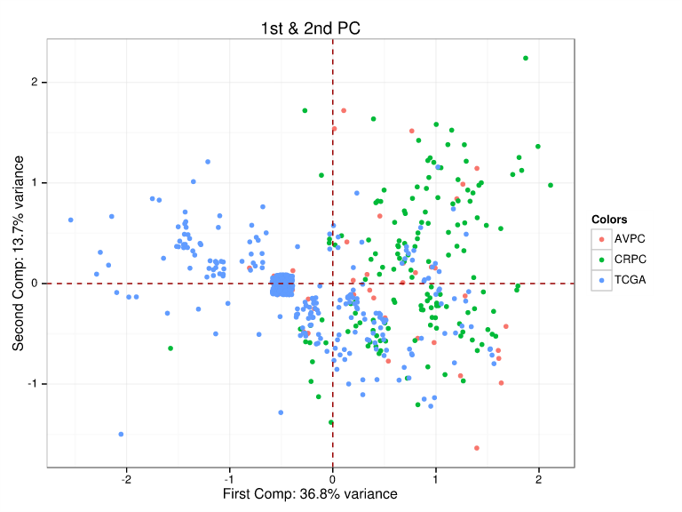
Supplementary Figure 7.
Notes:
Supplementary Figure 7. Principal component analysis of a 10-CNA-marker set in TCGA, unsupervised CRPC and AVPC samples.

