Slide 1
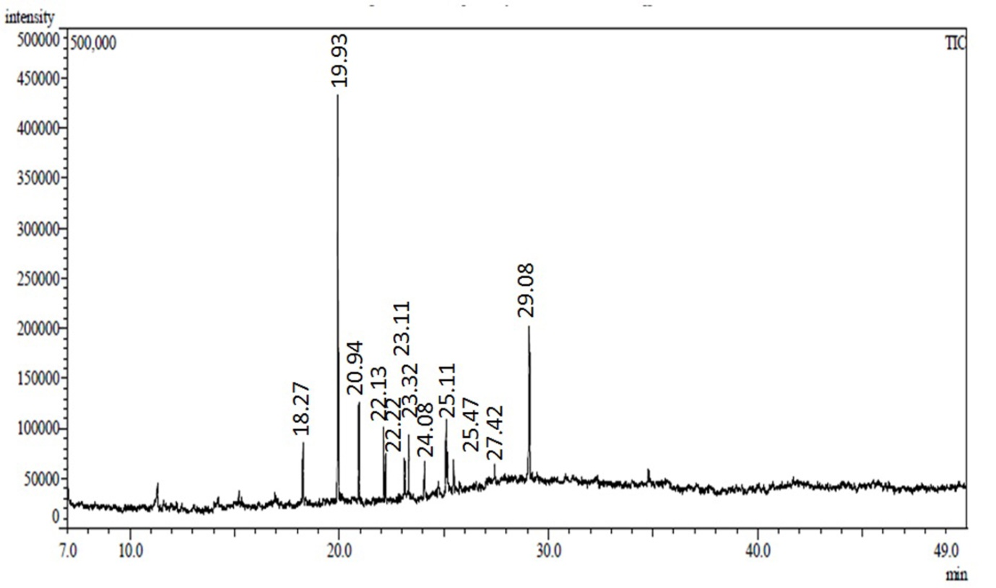
FIGURE S1 | GC-MS analysis of the ethyl acetate extracted antimicrobial metabolite (EA-PB-52) from Nocardia sp. PB-52

