Slide 1
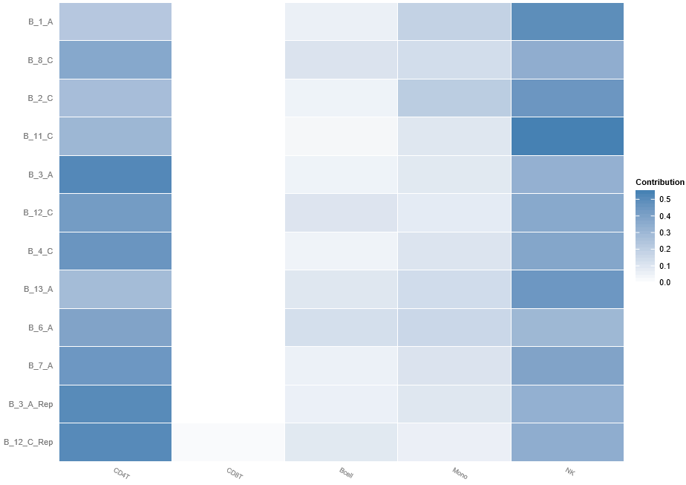
S2 Fig. Contribution of various cell types in PBMC samples

