Slide 1
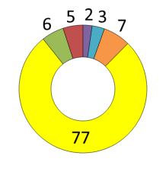
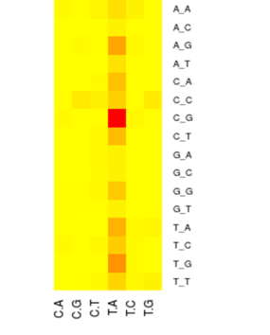
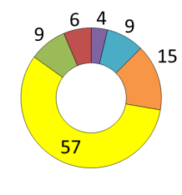
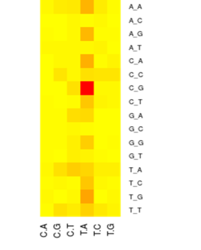
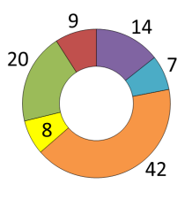
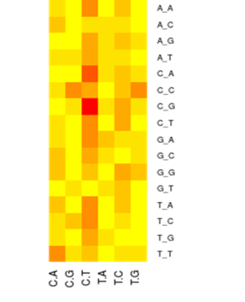
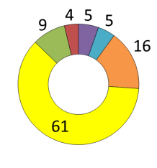
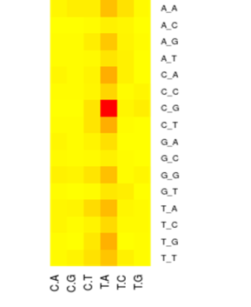
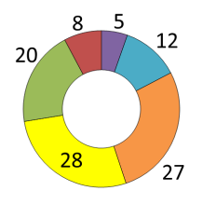
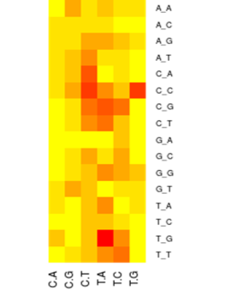
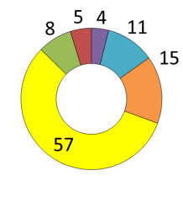
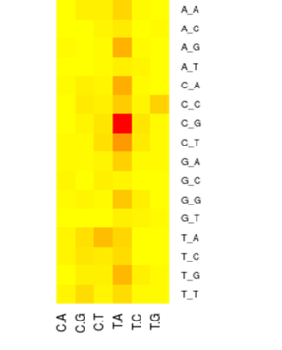
Fig. S3
A
EN-01
B
EN-02
A_A
A_A
A_C
A_C
% of
476
C>A
A_G
% of
425
C>A
A_G
C>G
A_T
C>G
A_T
C>T
C_A
C>T
C_A
T>A
C_C
T>A
C_C
T>C
C_G
T>C
C_G
Renal pelvis
T>G
C_T
Renal pelvis
T>G
C_T
SB=3.5 p=1E-12
G_A
SB=2.9 p=9.5E-12
G_A
G_C
G_C
G_G
G_G
G_T
G_T
T_A
425
T_A
A_A
A_A
476
T_C
T_C
A_C
A_C
T_G
T_G
A_G
A_G
% of
132
C>A
T_T
% of
559
C>A
T_T
C>G
A_T
C>G
A_T
132
C>T
C_A
559
C>T
C_A
T>A
C_C
T>A
C_C
T>C
C_G
T>C
C_G
T>G
C_T
T>G
C_T
SB=0.7 p=1
G_A
SB=3.3 p=1.E-12
G_A
167
G_C
330
G_C
G_G
G_G
G_T
G_T
T_A
T_A
T_C
T_C
A_A
A_A
T_G
T_G
A_C
A_C
T_T
T_T
Bladder
% of 167
C>A
A_G
Ureter
% of
330
C>A
A_G
C>G
A_T
C>G
A_T
C>T
C_A
C>T
C_A
T>A
C_C
T>A
C_C
T>C
C_G
T>C
C_G
T>G
C_T
T>G
C_T
SB=2.8 p=0.09
G_A
SB=3.1 p=4.3E-10
G_A
G_C
G_C
G_G
G_G
G_T
G_T
T_A
T_A
T_C
T_C
C:G>A:T
C:G>G:C
C:G>T:A
T:A>A:T
T:A>C:G
T:A>G:C
T_G
T_G
T_T
T_T

