Slide 1
Maps of homozygosity status for the three pigs lines SLA^{bb}, SLA^{cc} and SLA^{dd}.
Each figure shows a snapshot of the level of homozygosity for a given chromosome.
Each row contains one individual’s colour-coded SNP genotype.
Locations of SNPs within each chromosome run in ascending numerical order from left to right.
S1 Figure

Slide 2
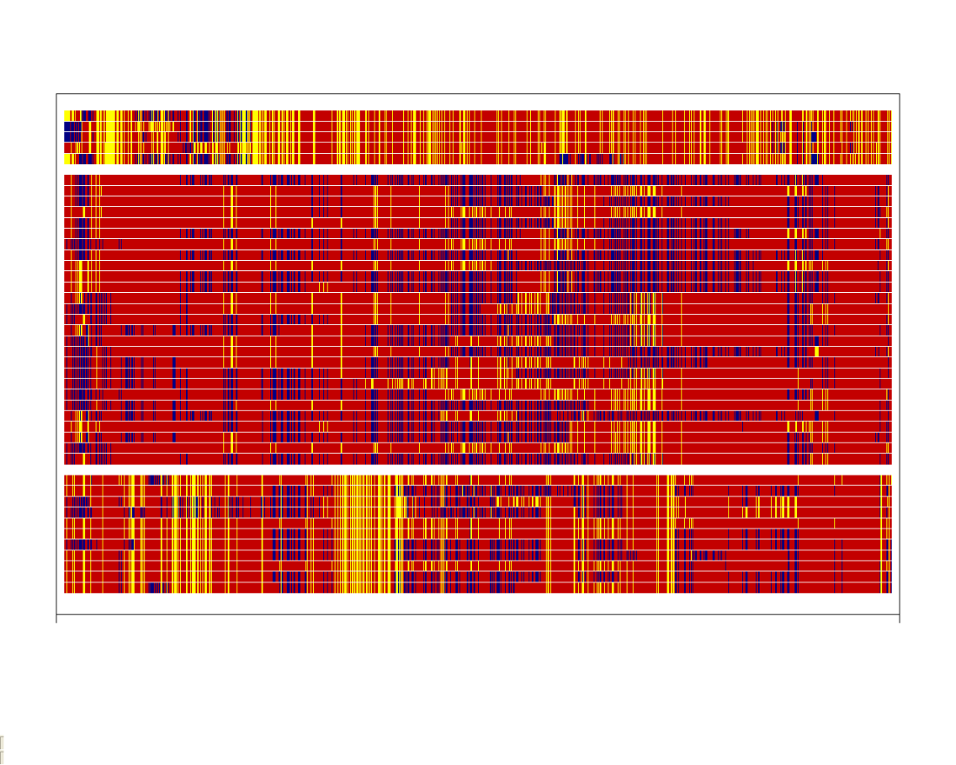
Chromosome 1
SLA^{bb} (n=5)
SLA^{cc} (n=27)
SLA^{dd} (n=11)
Homozygous for major allele
Heterozygous
Homozygous for minor allele

Slide 3
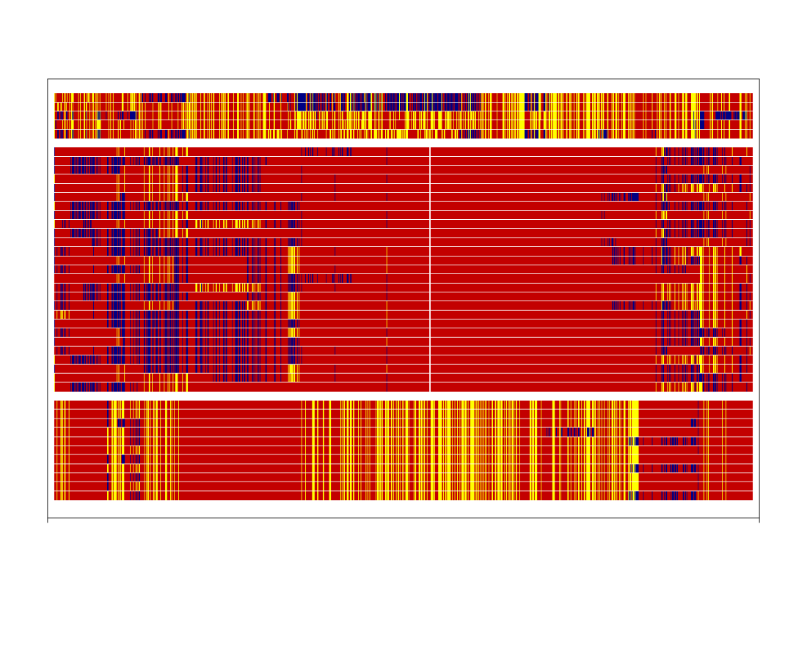
Chromosome 2
SLA^{bb} (n=5)
SLA^{cc} (n=27)
SLA^{dd} (n=11)
Homozygous for major allele
Heterozygous
Homozygous for minor allele

Slide 4
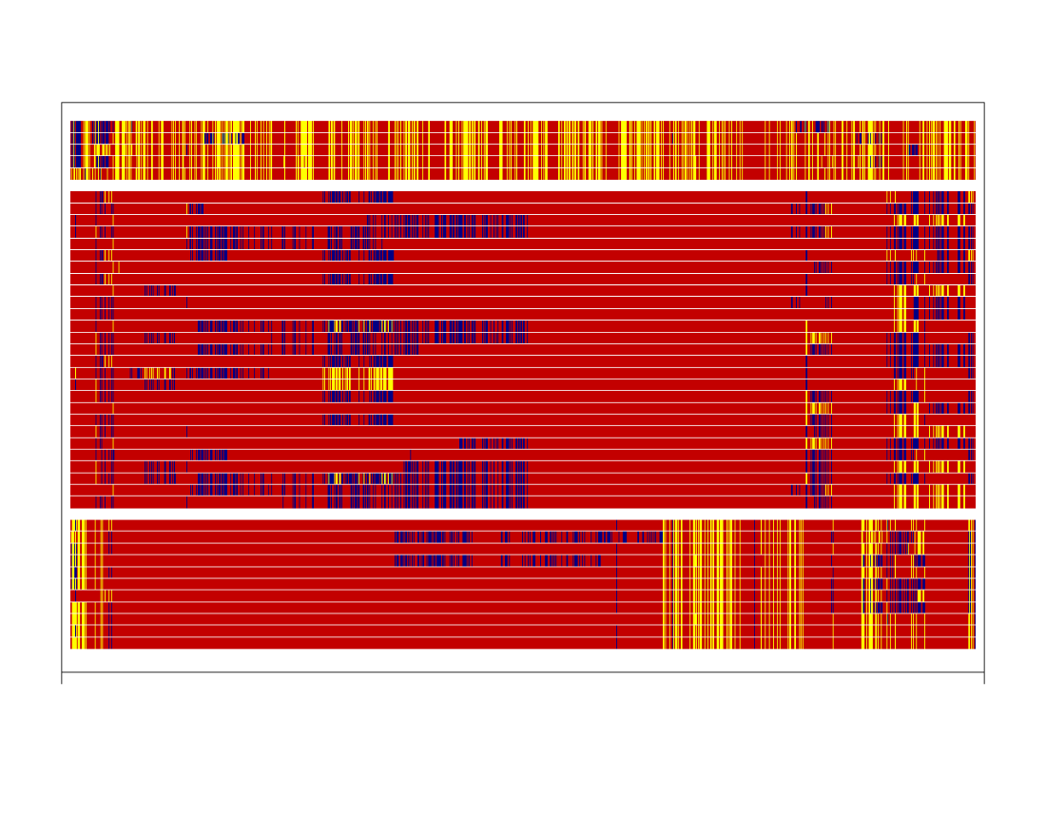
Chromosome 3
SLA^{bb} (n=5)
SLA^{cc} (n=27)
SLA^{dd} (n=11)
Homozygous for major allele
Heterozygous
Homozygous for minor allele

Slide 5
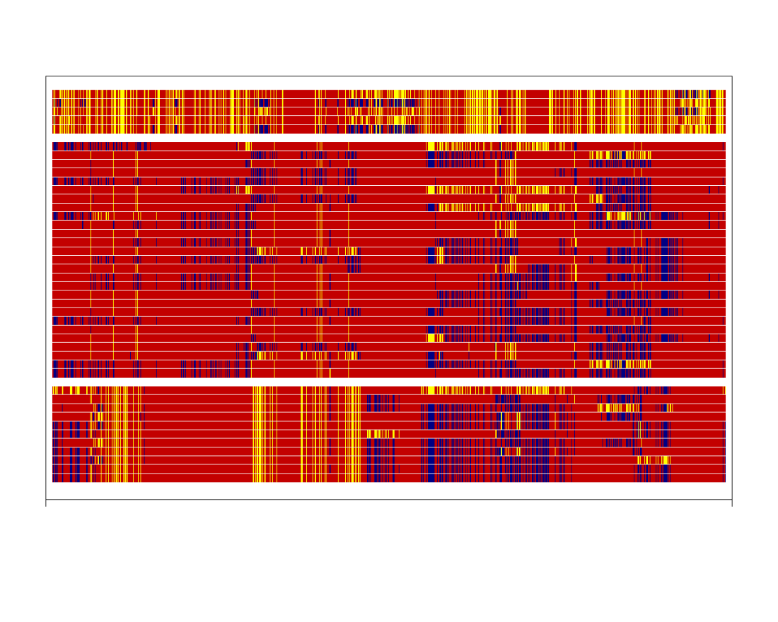
Chromosome 4
SLA^{bb} (n=5)
SLA^{cc} (n=27)
SLA^{dd} (n=11)
Homozygous for major allele
Heterozygous
Homozygous for minor allele

Slide 6
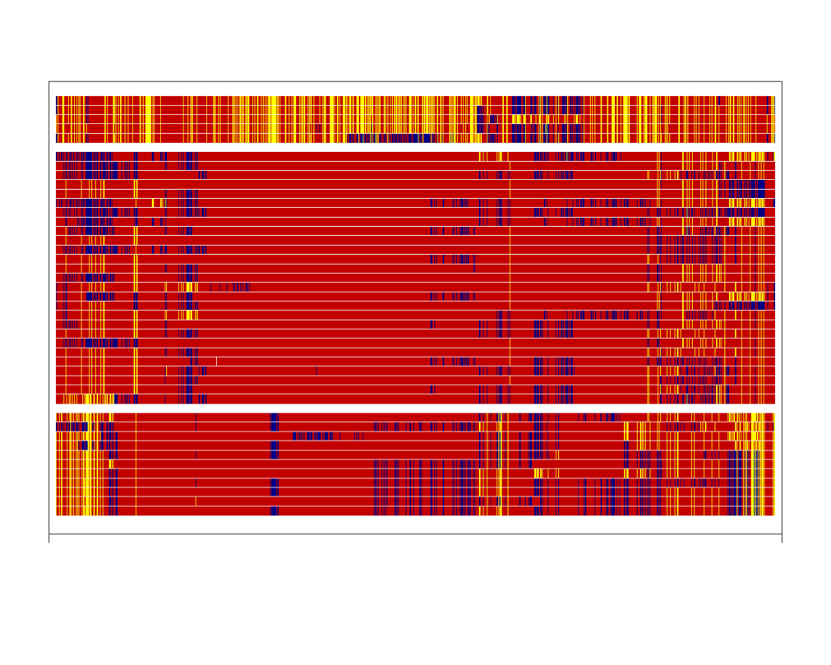
Chromosome 5
SLA^{bb} (n=5)
SLA^{cc} (n=27)
SLA^{dd} (n=11)
Homozygous for major allele
Heterozygous
Homozygous for minor allele

Slide 7
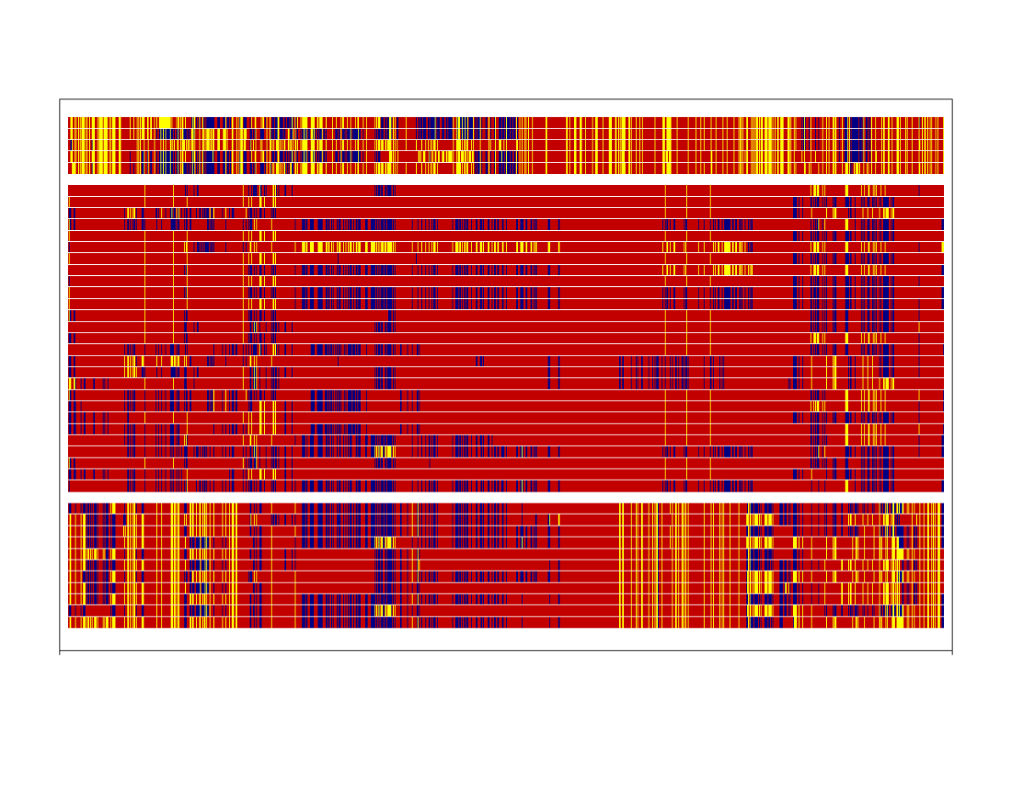
Chromosome 6
SLA^{bb} (n=5)
SLA^{cc} (n=27)
SLA^{dd} (n=11)
Homozygous for major allele
Heterozygous
Homozygous for minor allele

Slide 8
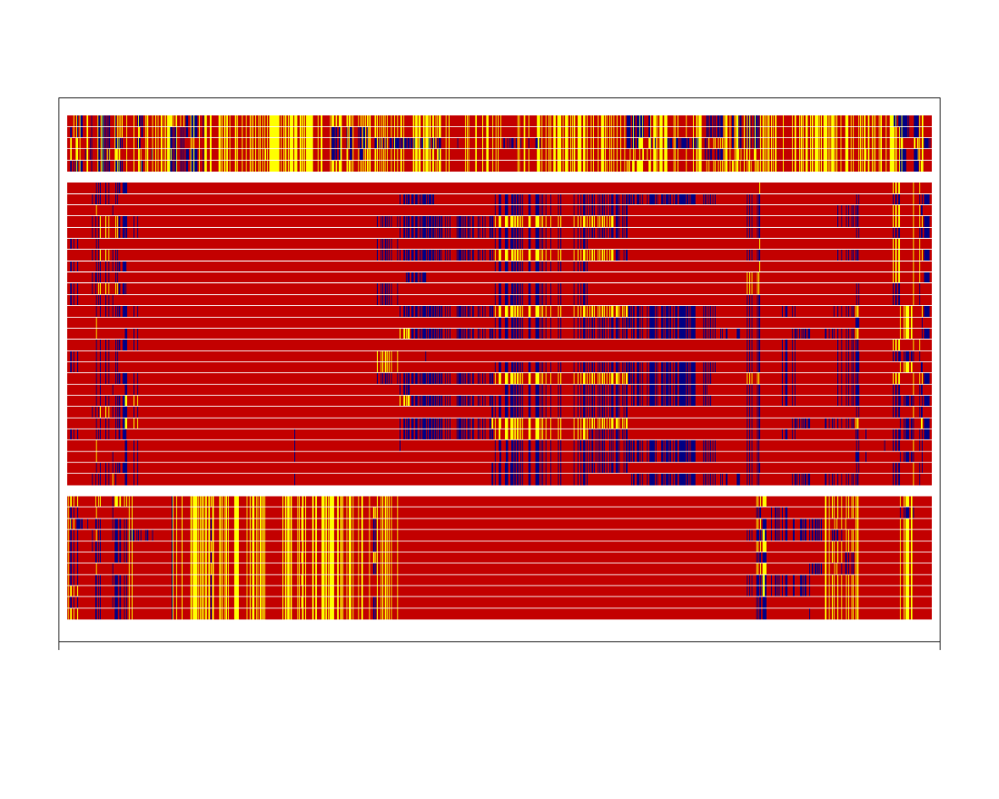
Chromosome 7
*
SLA^{bb} (n=5)
SLA^{cc} (n=27)
SLA^{dd} (n=11)
Homozygous for major allele
Heterozygous
Homozygous for minor allele
* Approximate position of the MHC

Slide 9
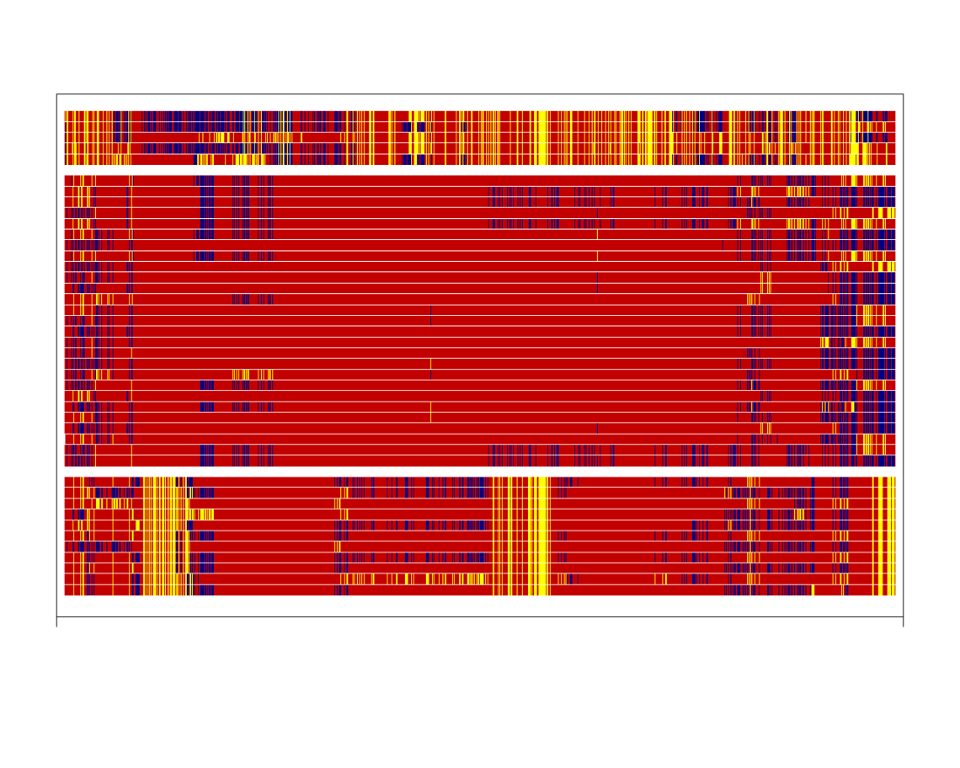
Chromosome 8
SLA^{bb} (n=5)
SLA^{cc} (n=27)
SLA^{dd} (n=11)
Homozygous for major allele
Heterozygous
Homozygous for minor allele

Slide 10
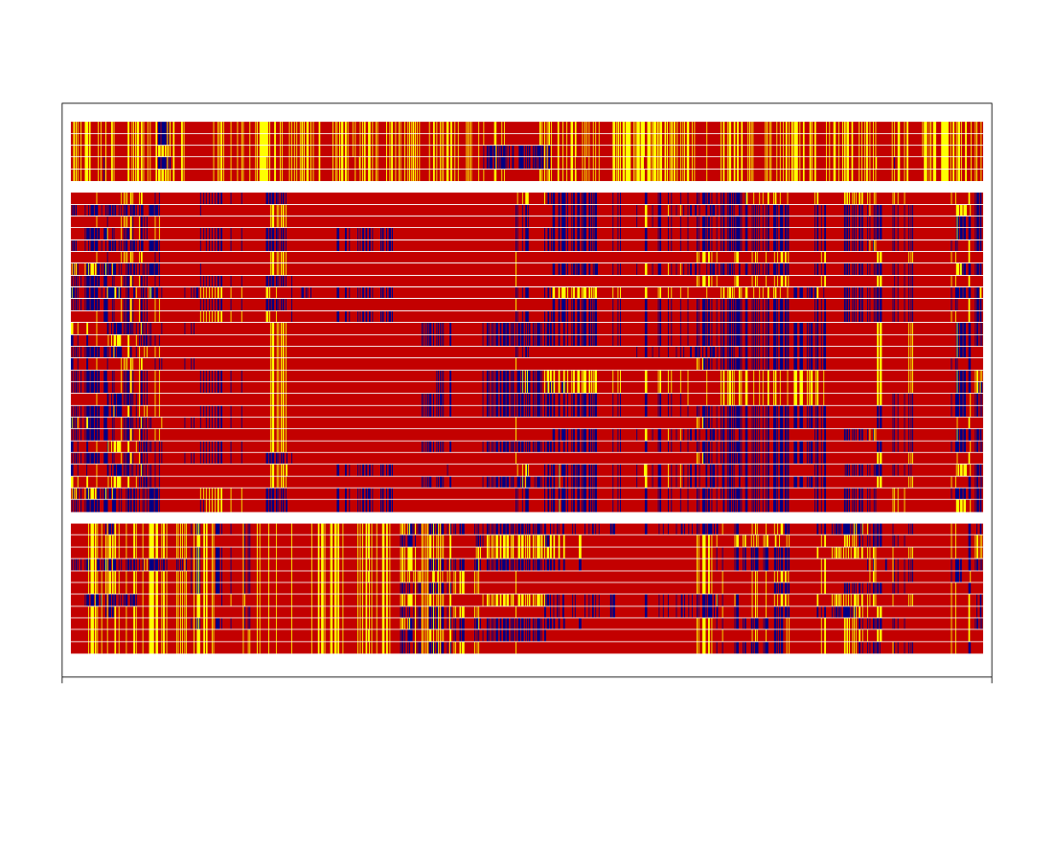
Chromosome 9
SLA^{bb} (n=5)
SLA^{cc} (n=27)
SLA^{dd} (n=11)
Homozygous for major allele
Heterozygous
Homozygous for minor allele

Slide 11
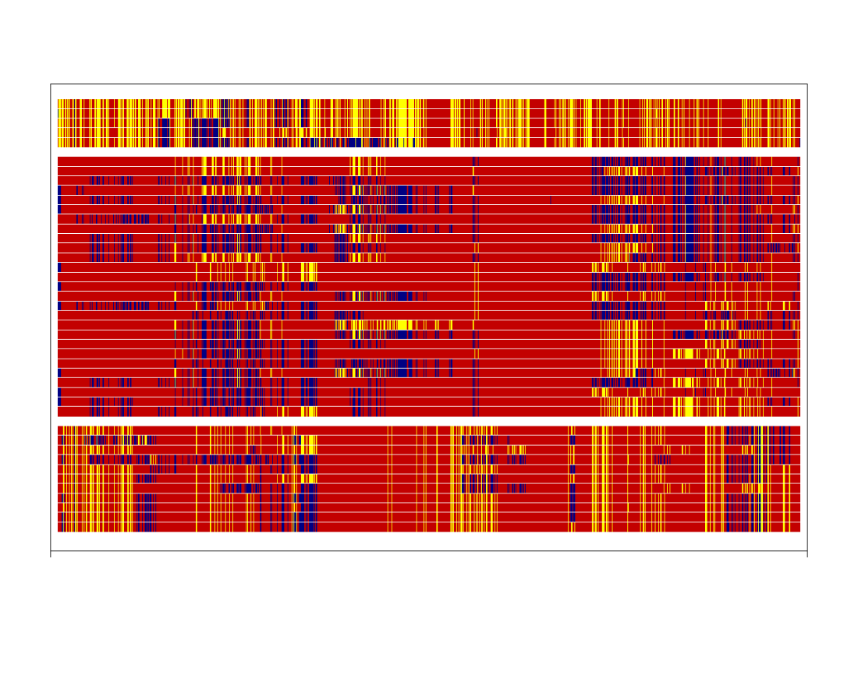
Chromosome 10
SLA^{bb} (n=5)
SLA^{cc} (n=27)
SLA^{dd} (n=11)
Homozygous for major allele
Heterozygous
Homozygous for minor allele

Slide 12
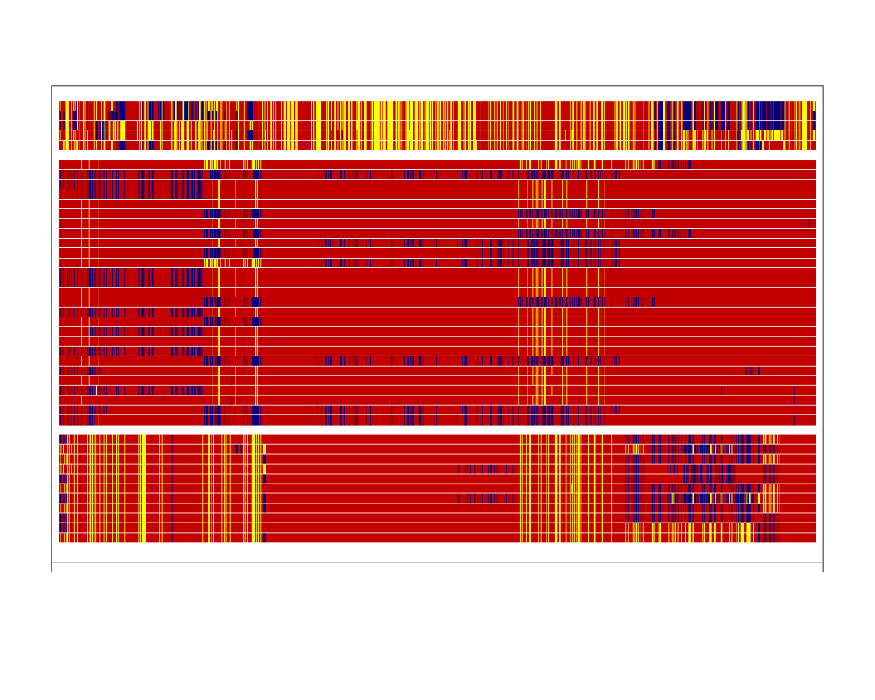
Chromosome 11
SLA^{bb} (n=5)
SLA^{cc} (n=27)
SLA^{dd} (n=11)
Homozygous for major allele
Heterozygous
Homozygous for minor allele

Slide 13
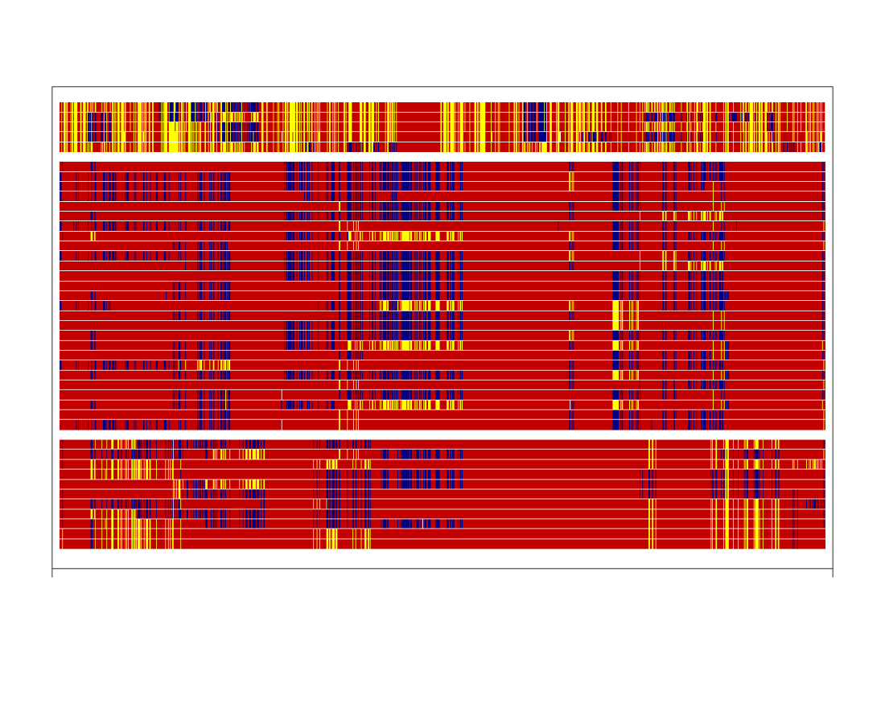
Chromosome 12
SLA^{bb} (n=5)
SLA^{cc} (n=27)
SLA^{dd} (n=11)
Homozygous for major allele
Heterozygous
Homozygous for minor allele

Slide 14
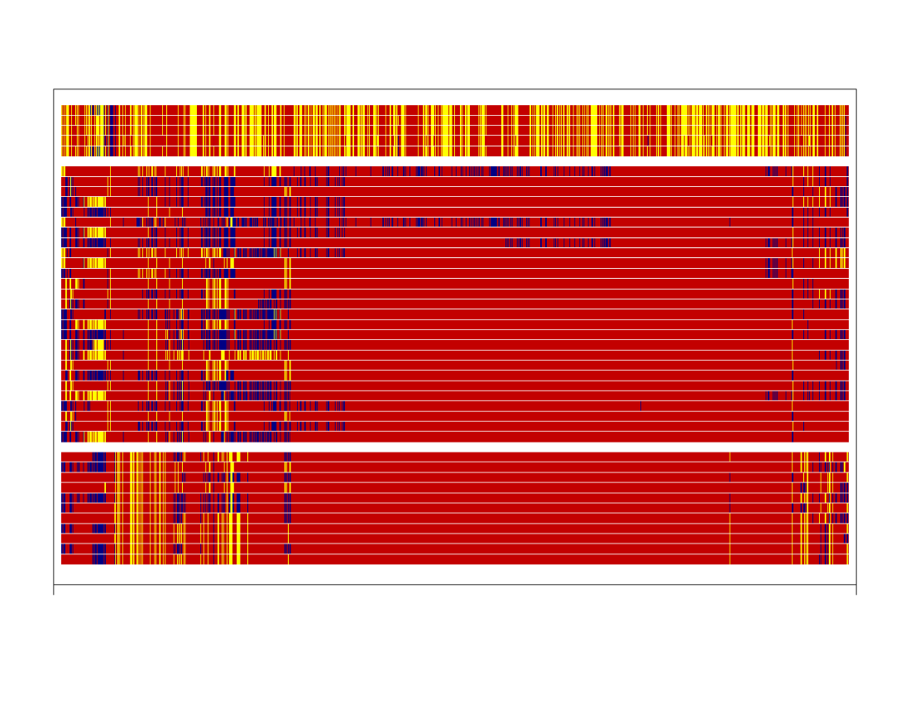
Chromosome 13
SLA^{bb} (n=5)
SLA^{cc} (n=27)
SLA^{dd} (n=11)
Homozygous for major allele
Heterozygous
Homozygous for minor allele

Slide 15
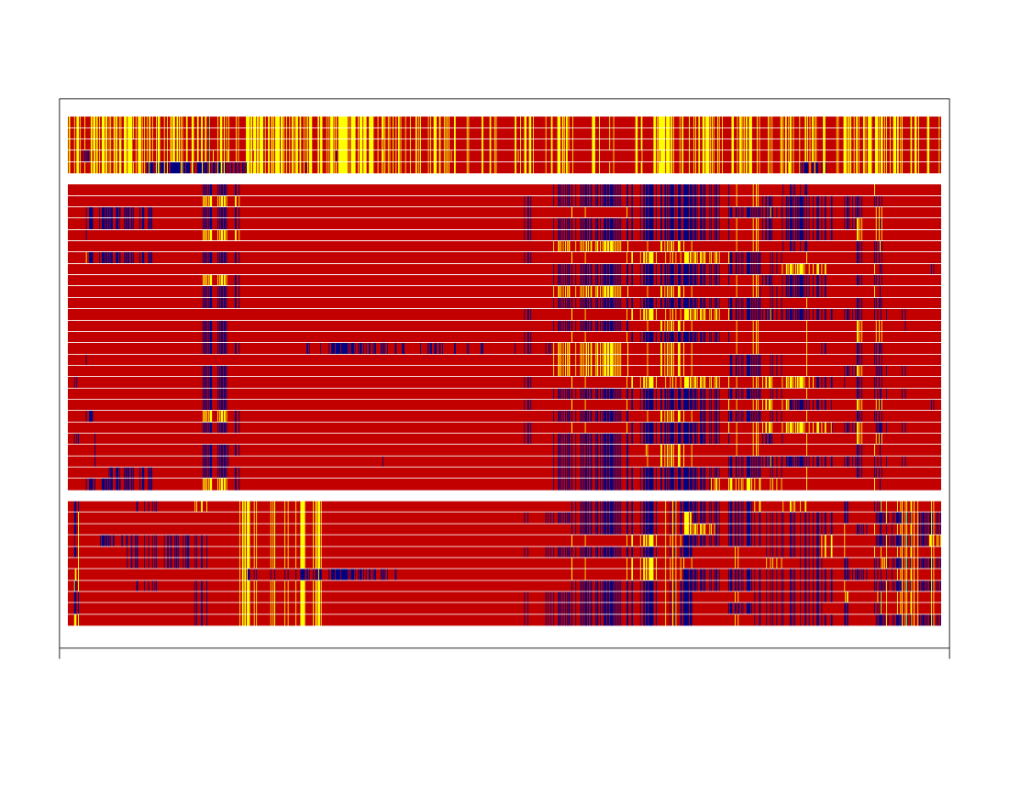
Chromosome 14
SLA^{bb} (n=5)
SLA^{cc} (n=27)
SLA^{dd} (n=11)
Homozygous for major allele
Heterozygous
Homozygous for minor allele

Slide 16
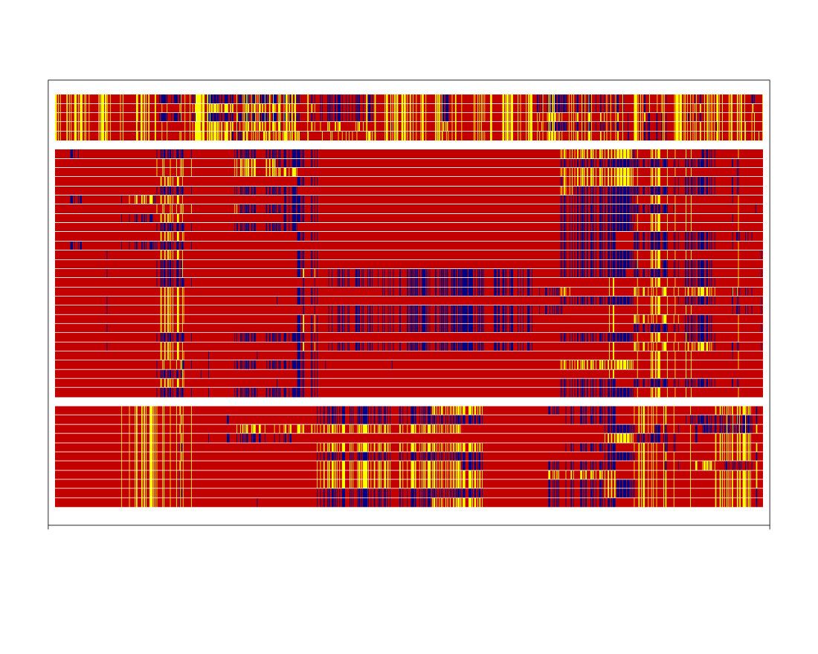
Chromosome 15
SLA^{bb} (n=5)
SLA^{cc} (n=27)
SLA^{dd} (n=11)
Homozygous for major allele
Heterozygous
Homozygous for minor allele

Slide 17
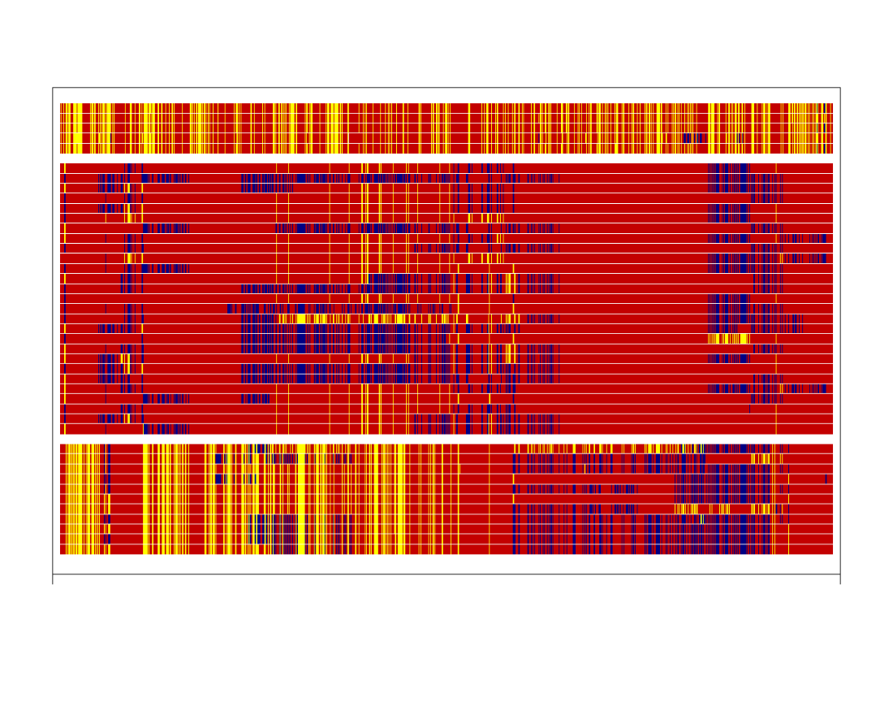
Chromosome 16
SLA^{bb} (n=5)
SLA^{cc} (n=27)
SLA^{dd} (n=11)
Homozygous for major allele
Heterozygous
Homozygous for minor allele

Slide 18
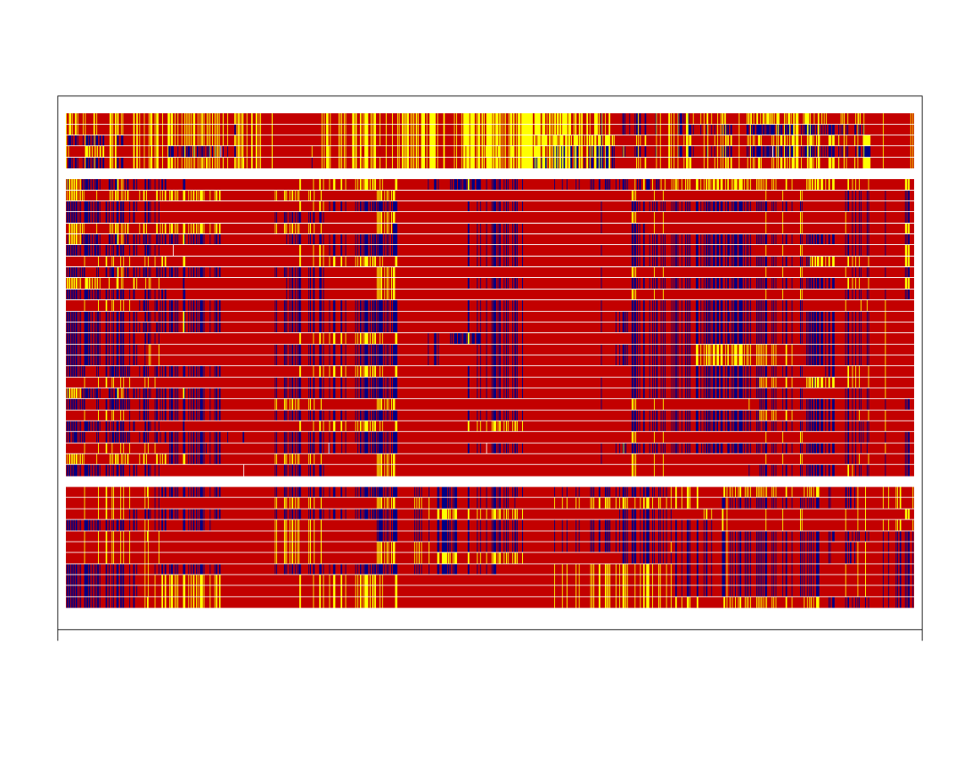
Chromosome 17
SLA^{bb} (n=5)
SLA^{cc} (n=27)
SLA^{dd} (n=11)
Homozygous for major allele
Heterozygous
Homozygous for minor allele

Slide 19
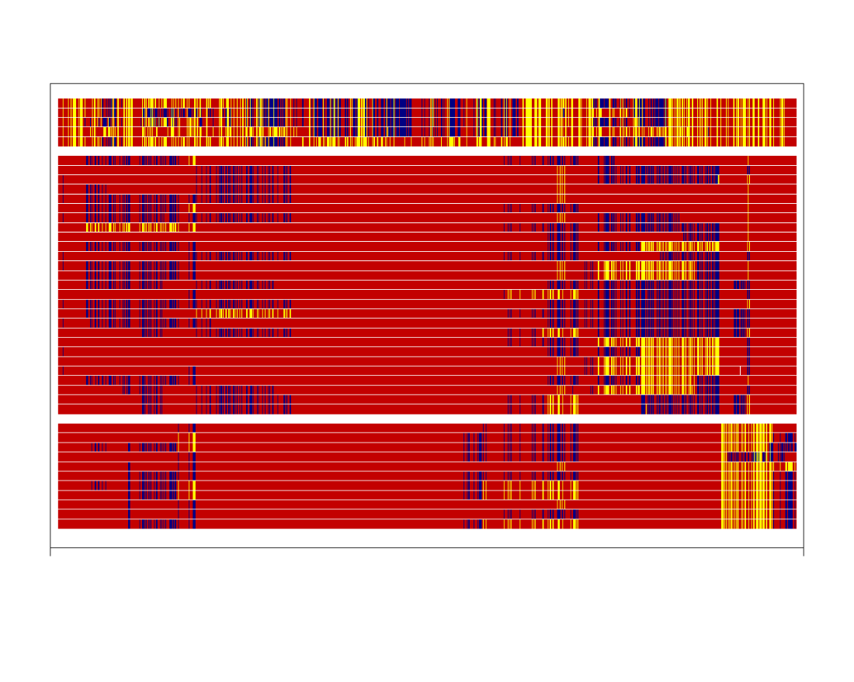
Chromosome 18
SLA^{bb} (n=5)
SLA^{cc} (n=27)
SLA^{dd} (n=11)
Homozygous for major allele
Heterozygous
Homozygous for minor allele

