Slide 1
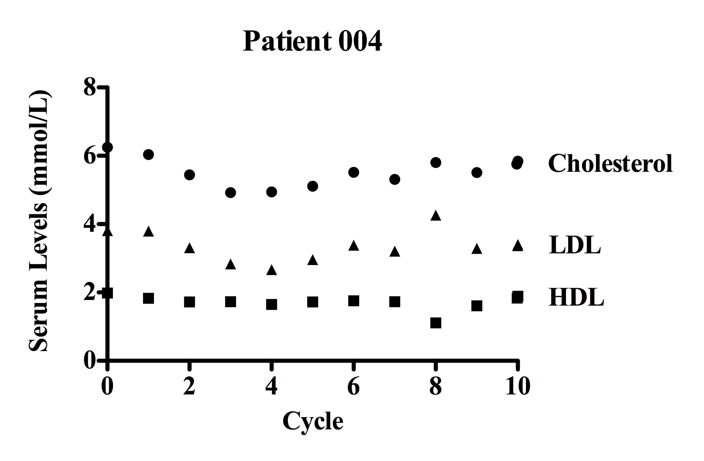
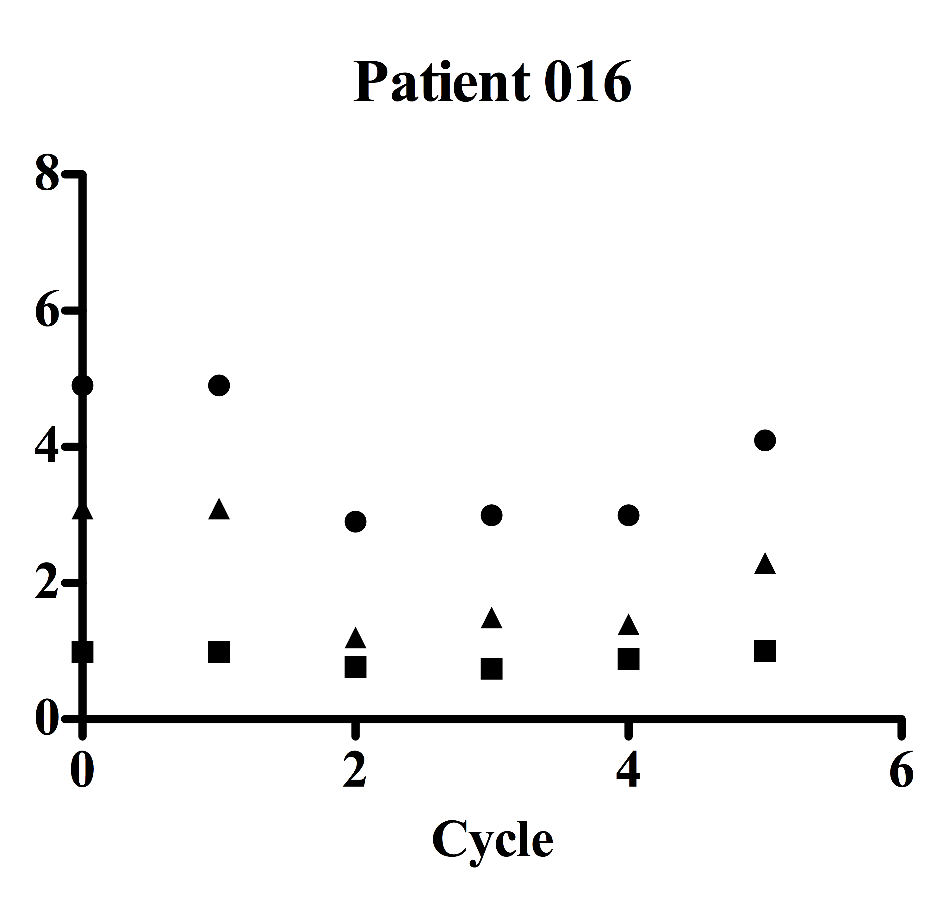
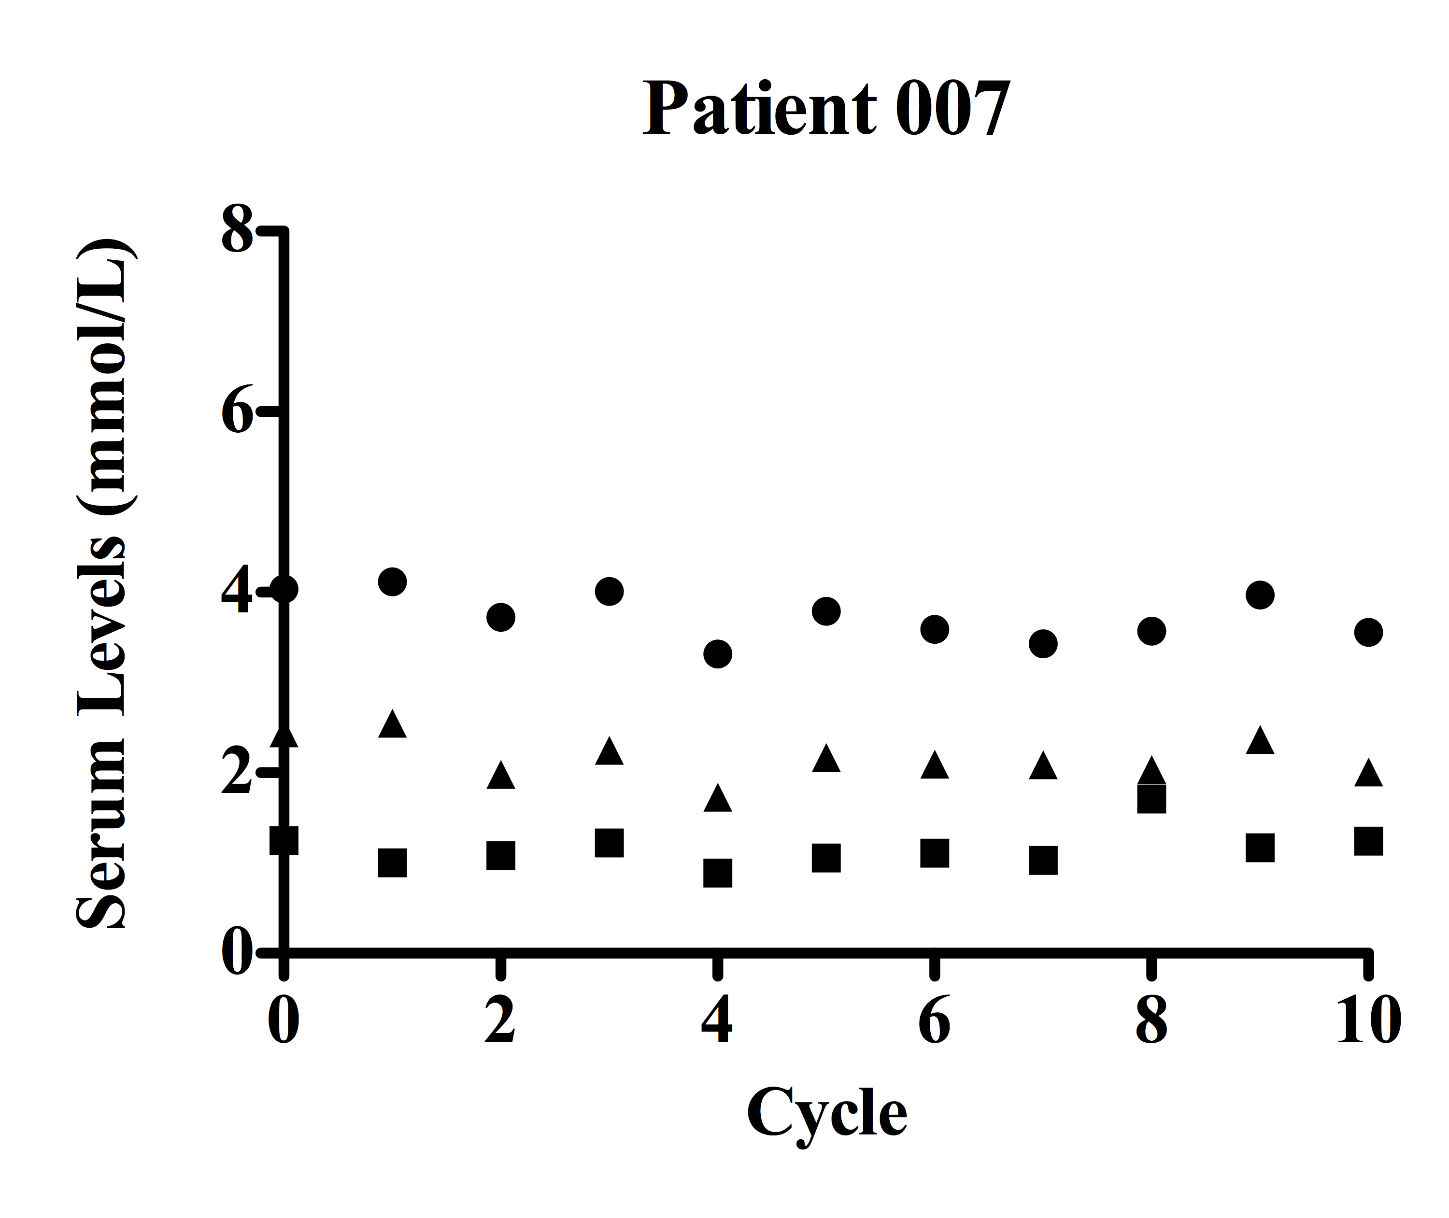
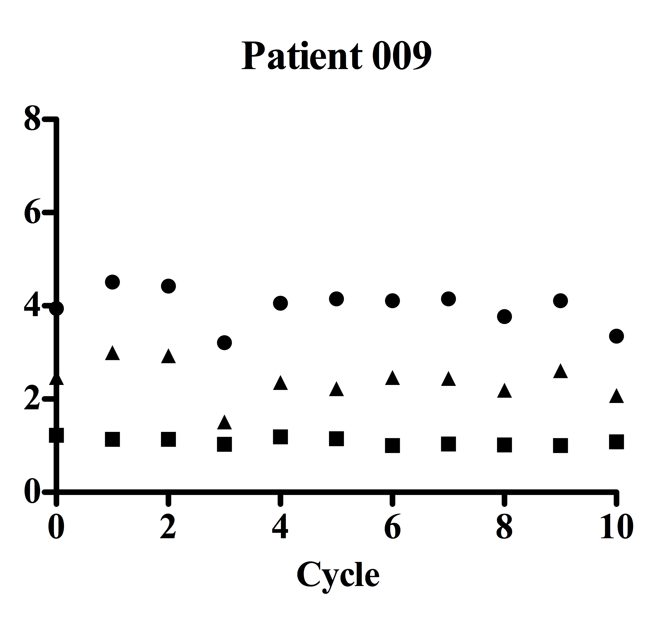
Serum Lipid Levels on Study
A
B
1mg/kg/day rosuvastatin
2mg/kg/day rosuvastatin
Supplemental Figure S3

