Slide 1
Supplementary Figure 1

Slide 2
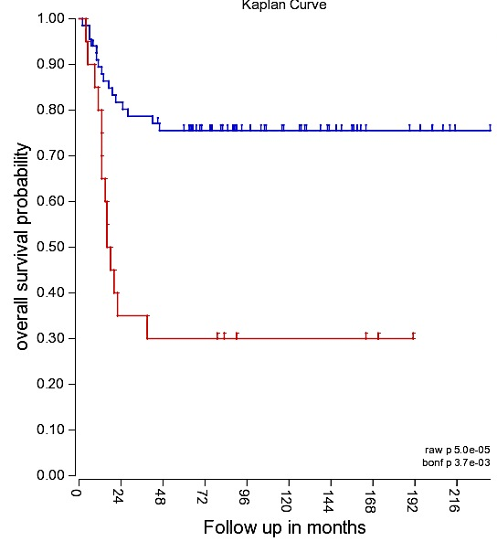
Supplementary Figure 2A
Tumor Neuroblastoma-Versteeg-88
PRICKLE1
High (n=68)
Low (n=20)
raw p=5.0e-05

Slide 3
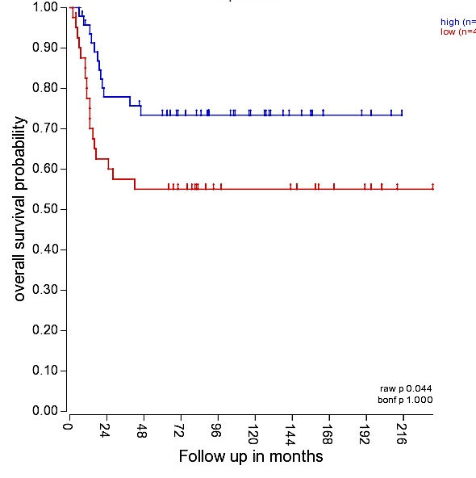
Supplementary Figure 2A
Tumor Neuroblastoma-Versteeg-88
VANGL2
High (n=47)
Low(n=41)
Raw p=0,044

Slide 4
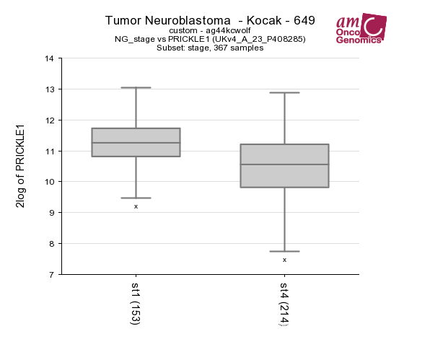
Supplementary Figure 2B
PRICKLE1
Tumor Neuroblastoma-Kocak-649
Inss_stage 1 vs 4 p-value 1.6e-14

