Slide 1
Supplementary Figure S1
A
B

Slide 2
Supplementary Figure S2
A B
C
PRE
8W
24W
48W

Slide 3
Supplementary Figure S3
A B
C D

Slide 4
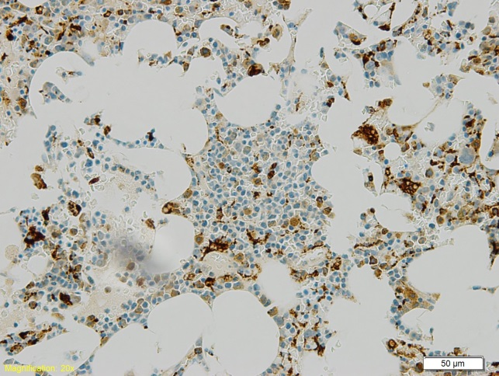
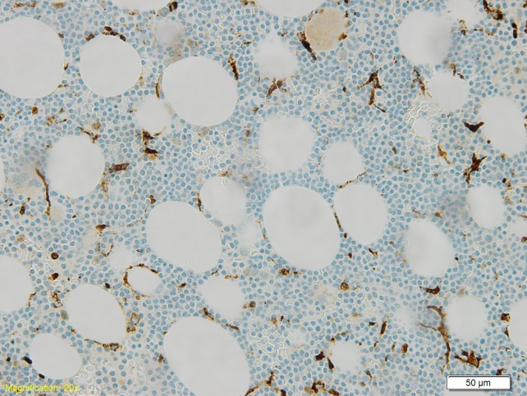
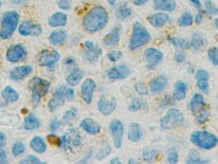
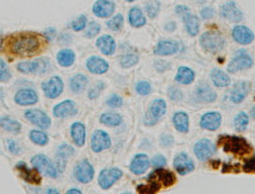
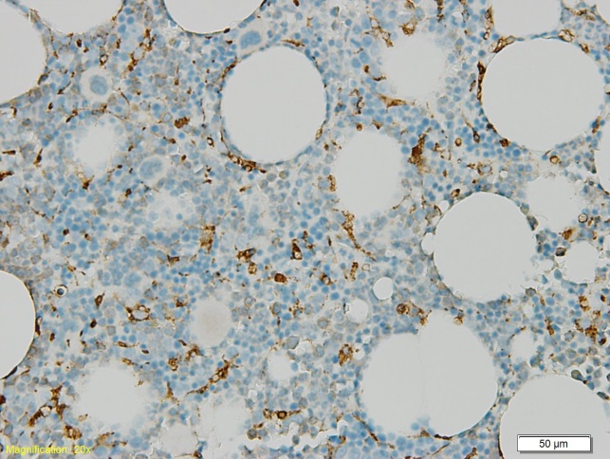
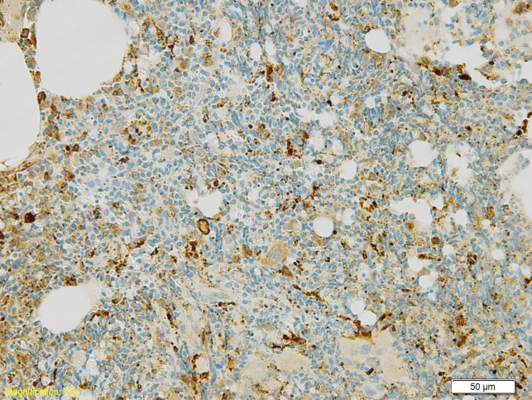
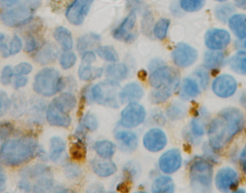
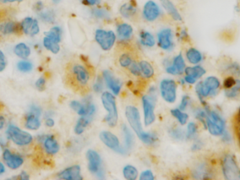
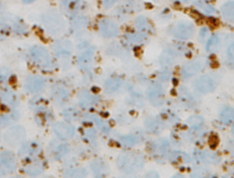
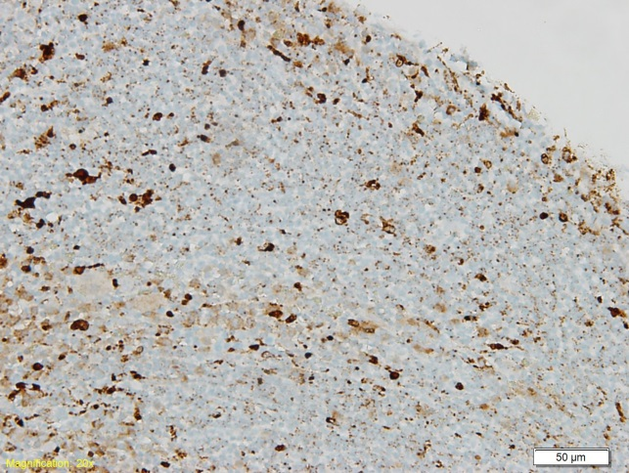
Supplementary Figure S4
A B
Grade 0
Grade 1
C D
Grade 2
Grade 3
E
Grade 4

Slide 5
Supplementary Figure S5
A B
C D

