Slide 1
Figure 1
*
**
***

Slide 2
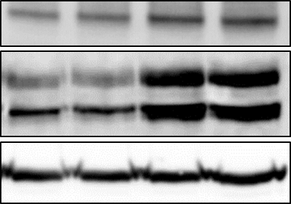
Figure 2
(A)
(B)
EEDS (μg/mL)
0 | 0.2 | 1 | 5
DR4
DR5
WB
β-act

Slide 3
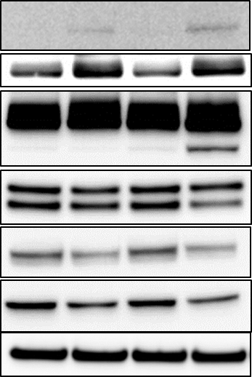
Figure 3
(A)
***
***
- | E | - | E
- | - | T | T
(B)
- | E | - | E
- | - | T | T
DR5
DR4
PARP
proaspase-3
*
proaspase-8
procaspase-9
β-actin

Slide 4
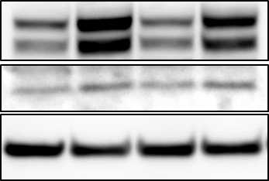
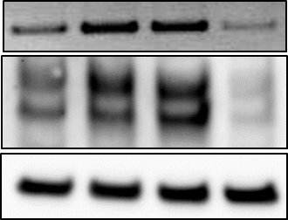


Figure 4
(A)
- | + | - | +
- | - | + | +
(B)
EEDS
- | + | + | +
- | - | Ctrl | CHOP
EEDS
TRAIL
siRNA
DR5
CHOP
CHOP
WB
DR5
WB
β-actin
β-actin
(C)
(D)
TRAIL
*
DR5
EEDS
- | + | + | +
- | + | + | +
- | - | Ctrl | CHOP
EEDS
Death
TRAIL
siRNA

