Slide 1
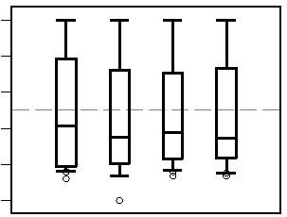

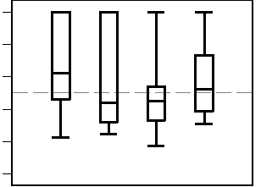
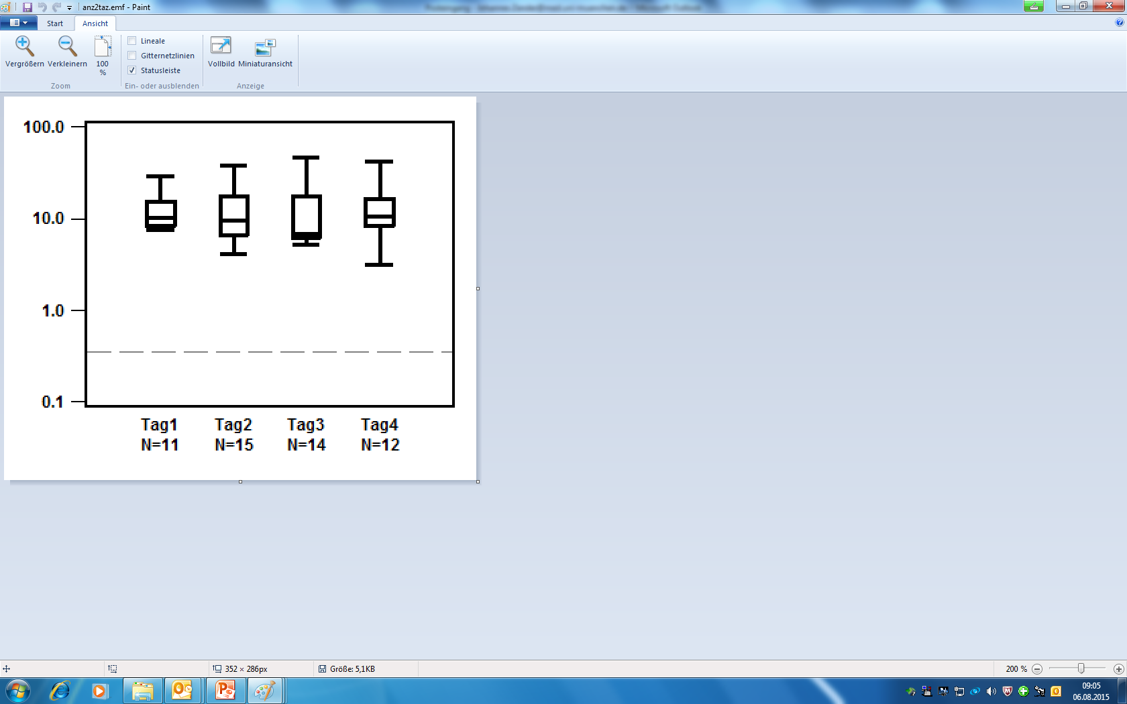
Additional File 3
a) PIP, all patients
100
80
60
40
20
0
b) PIP, patients with 3 x PIP-TAZ daily
100
80
Percentage of time with piperacillin (PIP) > 90 mg/L (%)
60
40
20
0
c) PIP, patients with 2 x PIP-TAZ daily
100
80
60
40
20
0
1 2 3 4
Day
Lower limit of target range for piperacillin values

