Slide 1
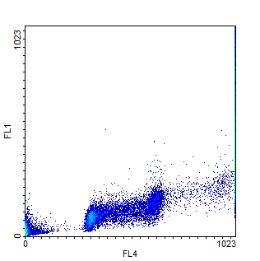
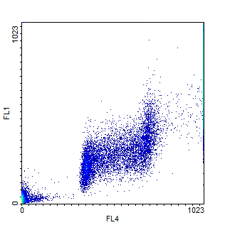
Ctrl
IR, 2h
G2
P53 Ser15
G1
S
G1
S
G2
Figure S1. The bivariate (phospho-p53 Ser15 vs DNA content) distribution of control and irradiated with 6 Gy mESCs. Measurements were carried out 2 h post-irradiation.
 | G1/S | S | G2/M
Control | 16.2% | 60,6% | 23,2%
+ pifithrin-α | 16,5% | 58,2% | 25,3%
+ NaBut | 28,6% | 55,1% | 16,3%
+ NaBut + pifithrin-α | 30,4% | 48,5% | 21,1%
Figure S2. Cell cycle distribution of control, treated with pifithrin-α (10µM), treated with NaBut (4 mM), treated with NaBut + pifithrin-α. Measurements were carried out 24 h post treatment.

Slide 2
A
Ctrl
IR, 1d
G1: 26%
S: 56%
G2/M: 18%
G1: 31%
S: 47%
G2/M: 22%
B
C
Relative fluorescence units
relative cell viability, %
Ctrl 1d 3d 1d 3d 1d, 6 Gy
6 Gy 6 Gy 3 Gy 3 Gy +ZVAD
Ctrl 1d 1d
3 Gy 6 Gy
D
E
Relative fluorescence units
relative cell viability, %
Ctrl Nutlin, 1d Nutlin,1d
+ZVAD
Ctrl Nutlin, 1d
Figure S3. Irradiation and nutlin treatment caused a significant level of apoptosis in mESCs. (A) Cell cycle distribution of control and irradiated (6Gy, 24h) mESCs. (B): In vitro caspase-3 activity assay of mESCs irradiated with 3 Gy and 6 Gy and examined 1 and 3 days post-irradiation. Data are presented as mean ±S.E.M. of three independent replicates (n=3). Caspase inhibitor ZVAD was added to the reaction sample 1 day after IR 6Gy to use as a negative control. (C): MTT assay. The effect of irradiation by a dose of 6 Gy on mESCs viability. Measurements were carried out 24 h post-irradiation. (D) In vitro caspase 3 activity assay of control mESCs and treated with nutlin (10 µM) for 1 day. A sample with caspase inhibitor ZVAD added to the reaction served as a negative control. Data are presented as mean ±S.E.M. of three independent replicates (n=3). (E) MTT assay. The effect of nutlin treatment (10 µM) on mESCs viability.

