Slide 1
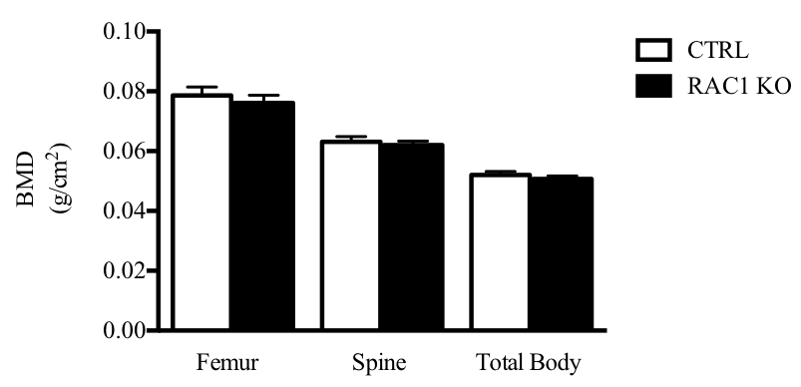
Supplemental Fig 1

Slide 2
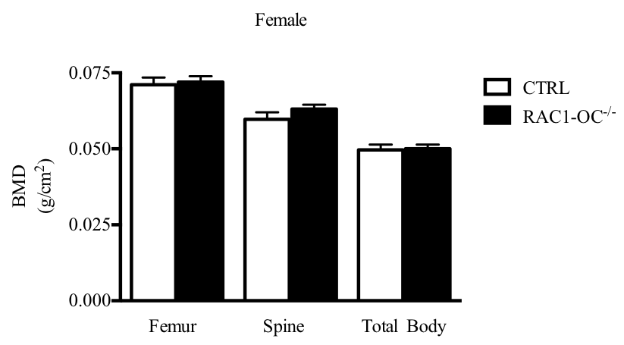
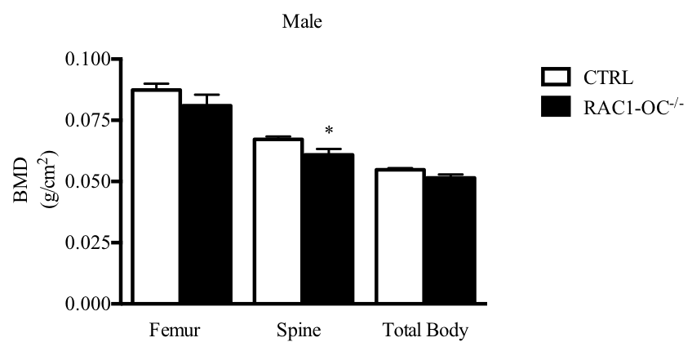
Supplemental Fig 2

Slide 3
Supplemental Fig 3
Rac1 ^{f / f} X CtskCre ^{/ +}
⬇
Rac1 ^{f / +} CtskCre ^{/ +} X Rac1 ^{f / f}
⬇
Rac1 ^{f / f} CtskCre ^{/ +} (Rac1-OC ^{- / -}) X Rac2 ^{- / -}
⬇
Rac1 ^{f / +} CtskCre ^{/ +} Rac2 ^{+ / -} X Rac1 ^{f / +} CtskCre ^{- / -} Rac2 ^{+ / -}
⬇
Rac1-OC ^{- / -} Rac2 ^{- / -}

Slide 4
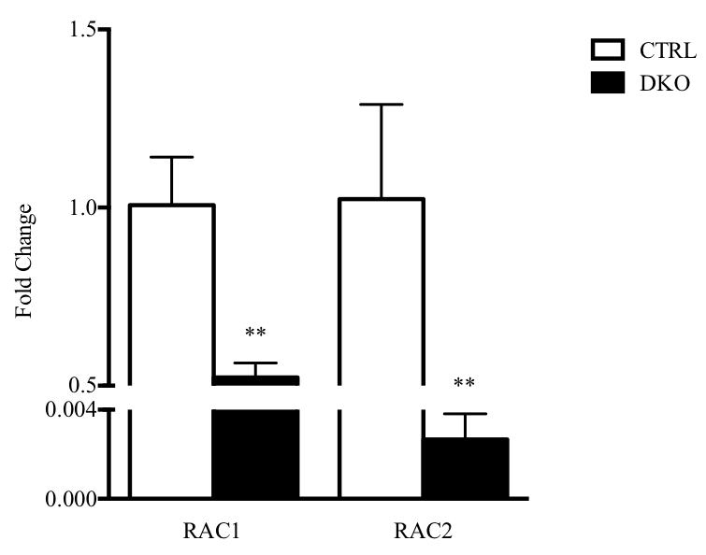
Supplemental Fig 4
Only keep Rac1 Rac2

Slide 5

Supplemental Fig 5
RAC1 (21 KDa)
WT DKO

Slide 6
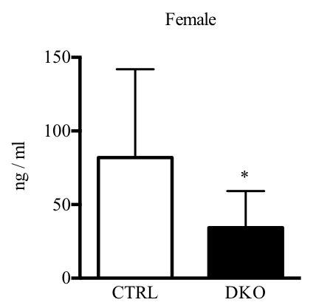
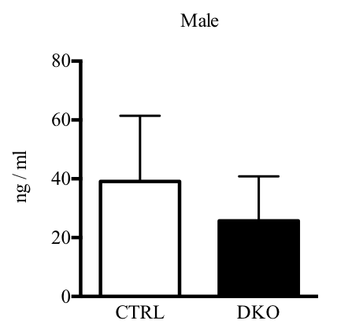
Supplemental Fig 6

Slide 7
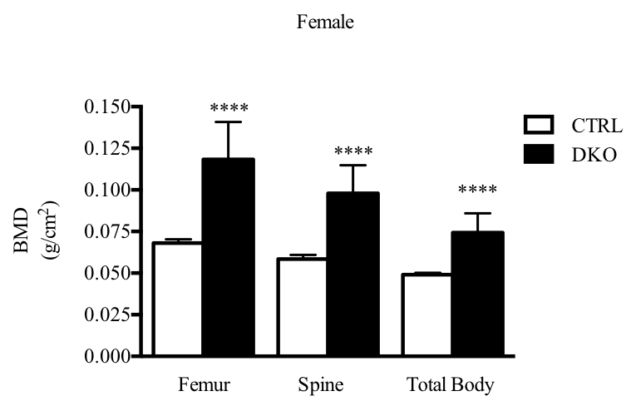
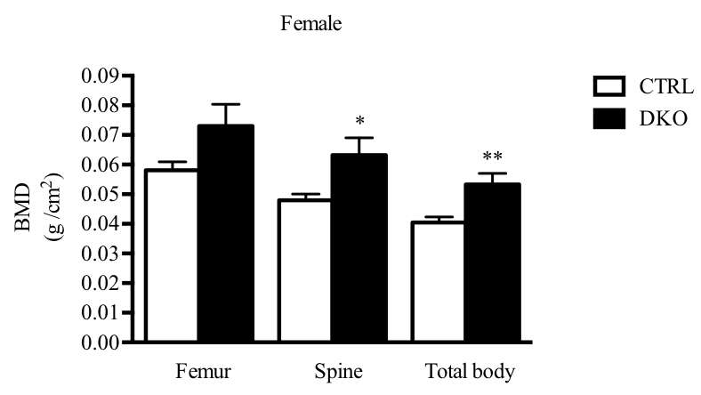
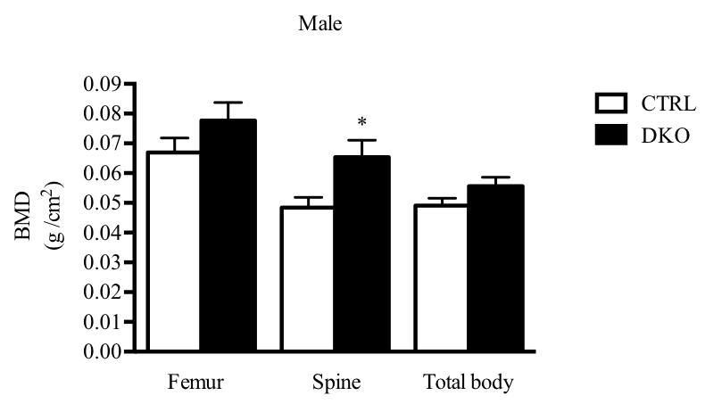
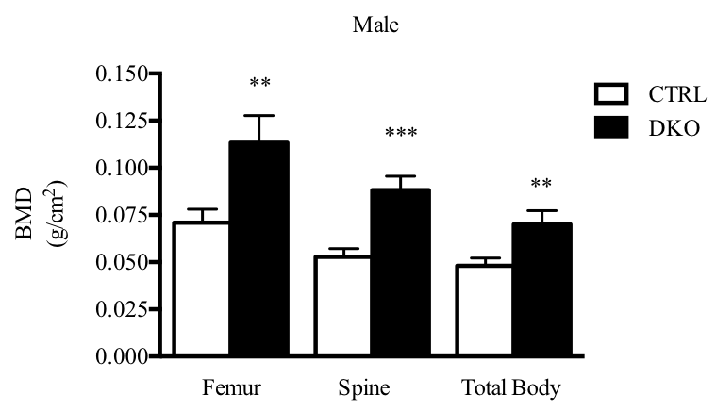
Supplemental Fig 7
4-6 weeks
14-16 weeks
4-6 weeks

Slide 8

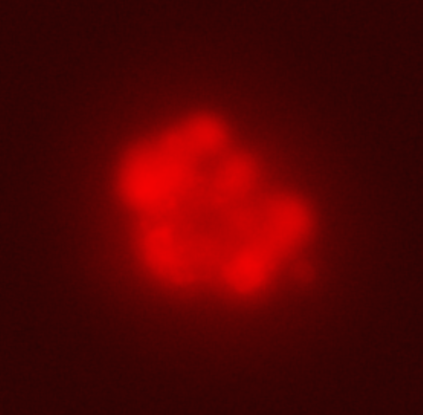
Supplemental Fig 8
Negative
Positive

Slide 9
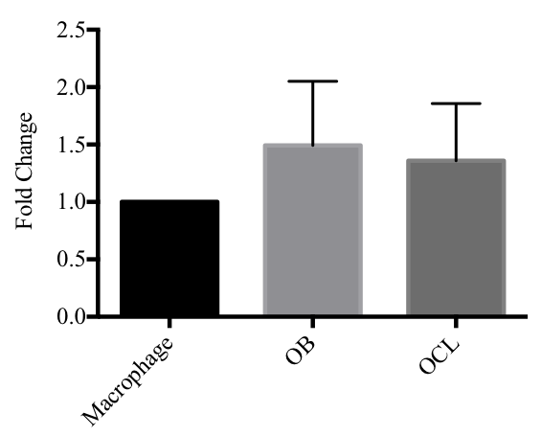
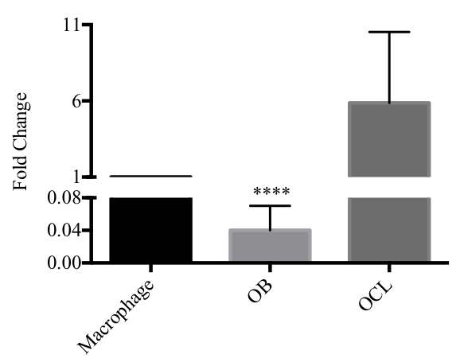
Supplemental Fig 9
RAC1
RAC2

Slide 10
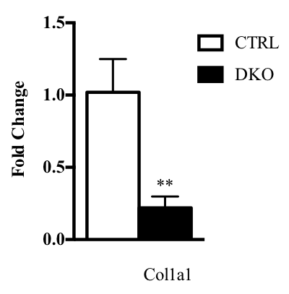
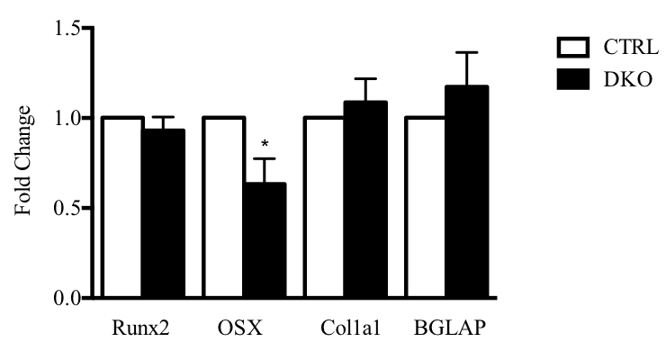
Supplemental Fig 10
A
B

Slide 11
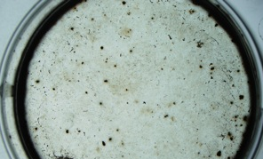
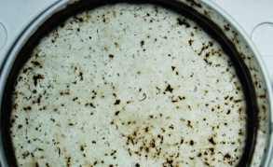
Supplemental Fig 11
CTRL
DKO

Slide 12
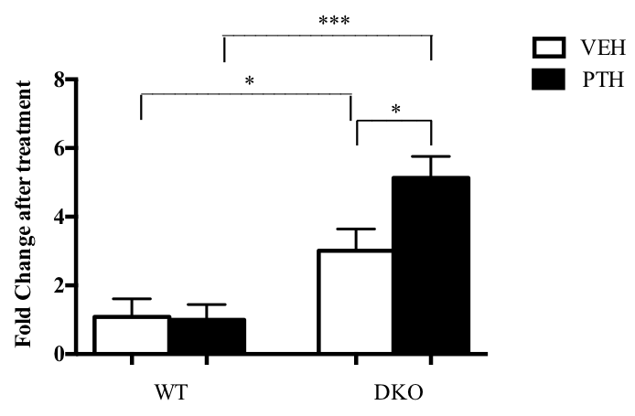
Supplemental Fig 12

Slide 13
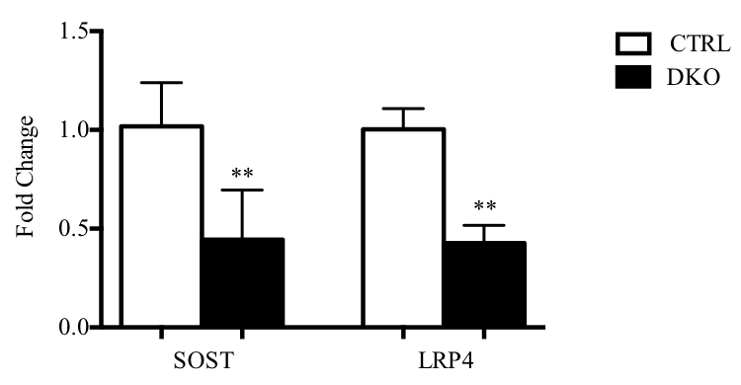


Supplemental Fig 13
A
B
LRP4 (216 KDa)
β-Actin (43 KDa)
CTRL DKO

Slide 14
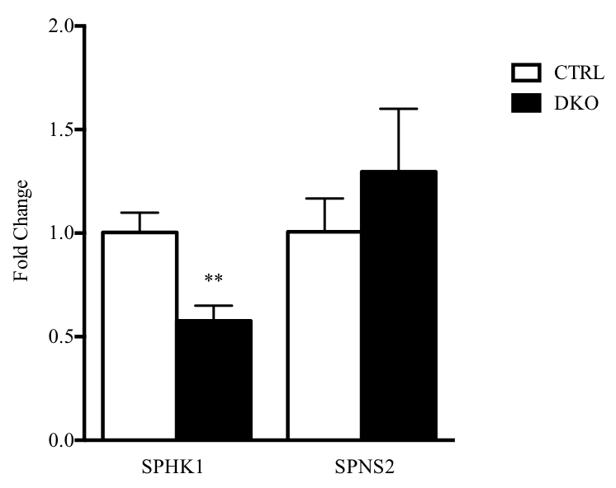
Supplemental Fig 14

Slide 15
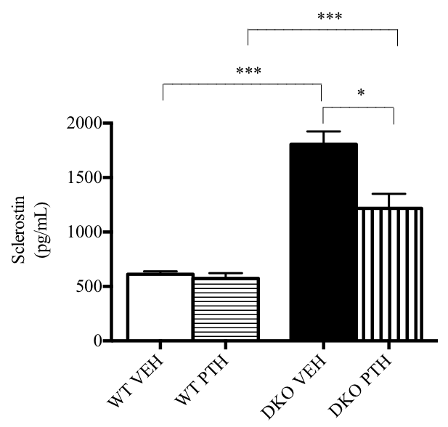
Supplemental Fig 15

Slide 16
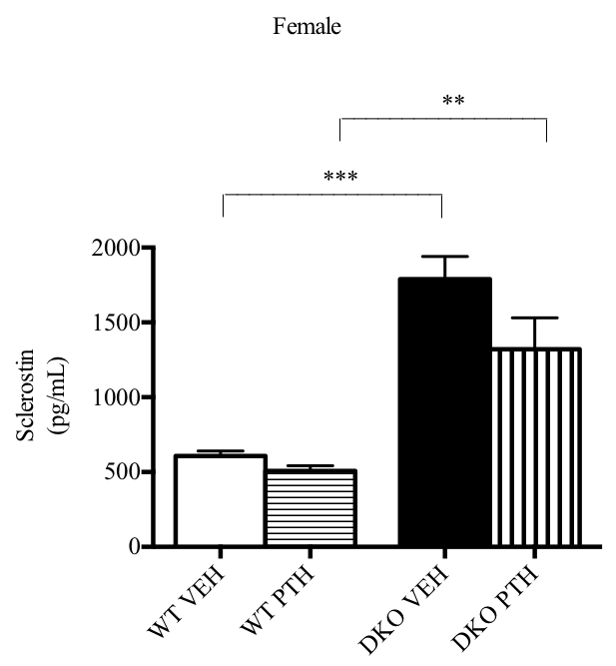
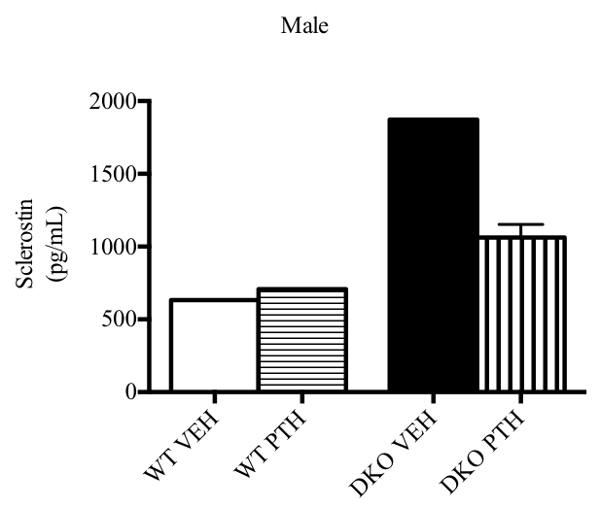
Supplemental Fig 16
Female
Male

Slide 17
Supplemental Fig 17
Third trochanter
sections
CTRL femur
DKO femur
500 mm
Imaging Region
Bright field
DAPI Phalloidin
Bright field
DAPI Phalloidin

Slide 18
Supplemental Fig 18
Distal
Proximal
sections
Deltoid tuberosity
CTRL humerus
DKO humerus
500 mm
Bright field
DAPI Phalloidin
Bright field
DAPI Phalloidin

Slide 19
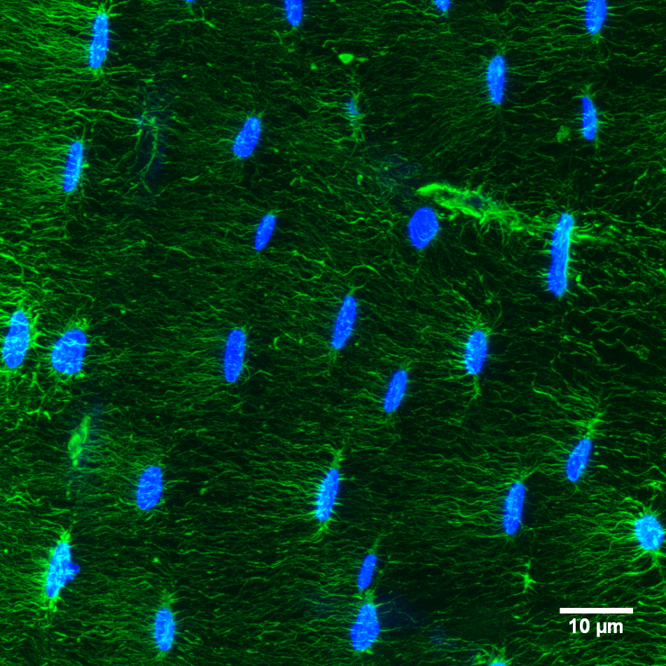
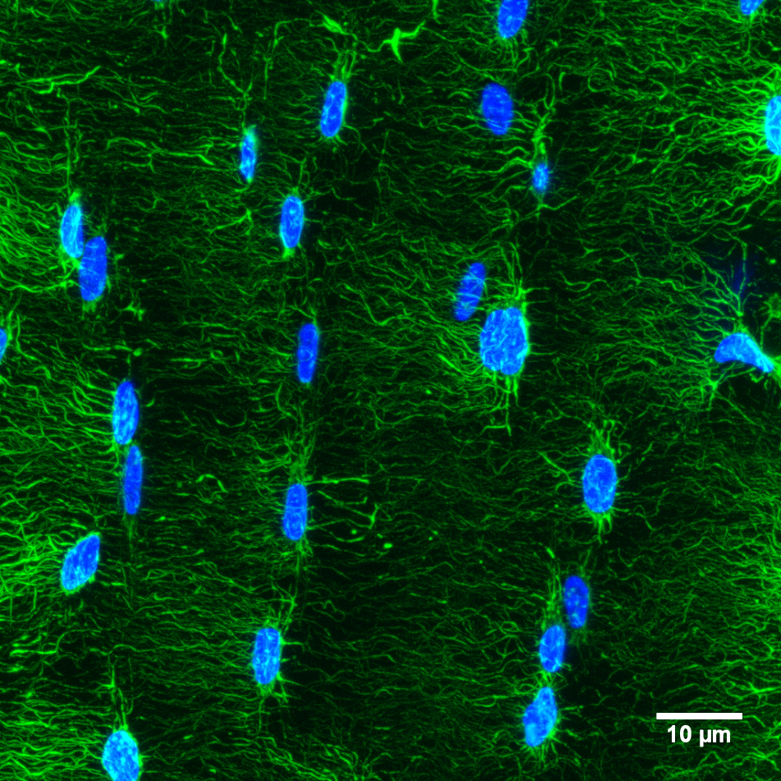
Supplemental Fig 19
CTRL
RAC2 KO

Slide 20
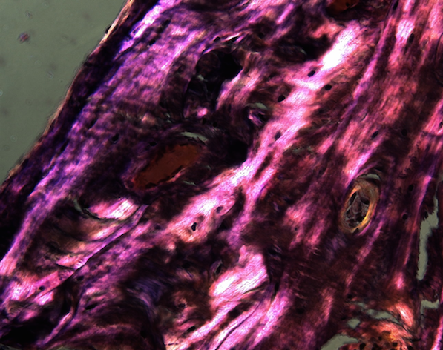
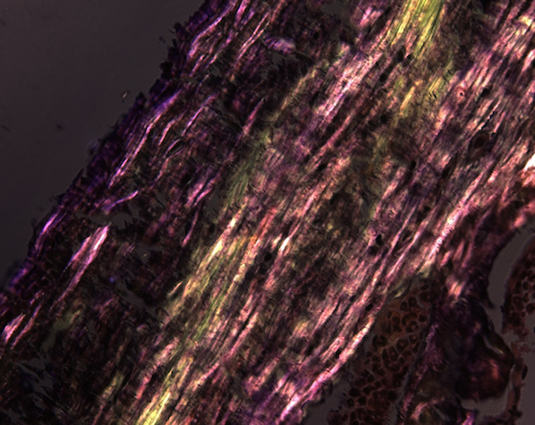
Supplemental Fig. 20
CTRL DKO

Slide 21
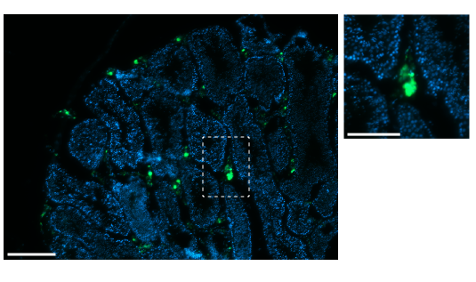
Supplemental Fig 21
a
a
A
B

