Slide 1
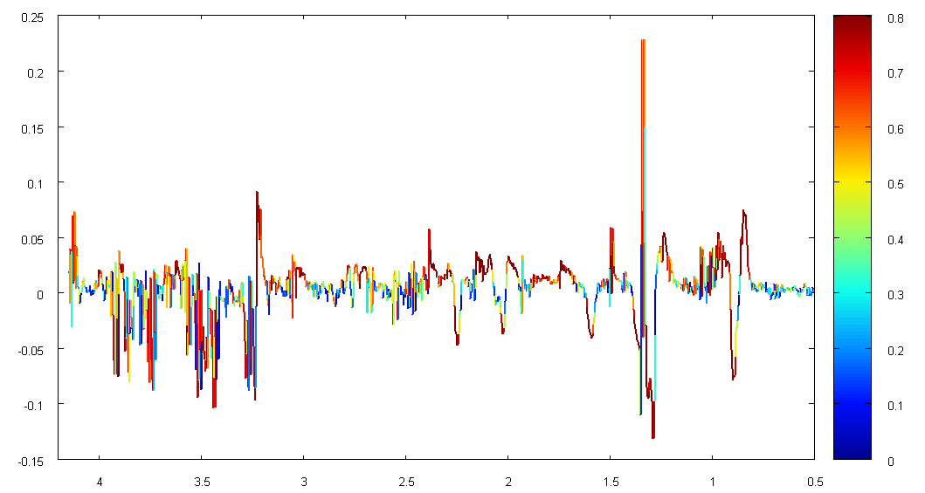
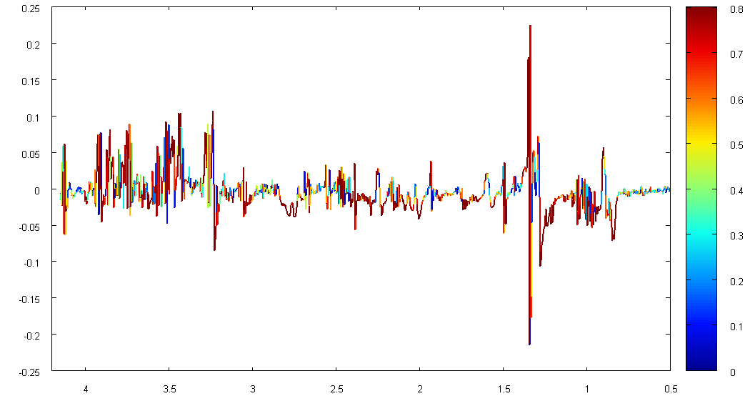
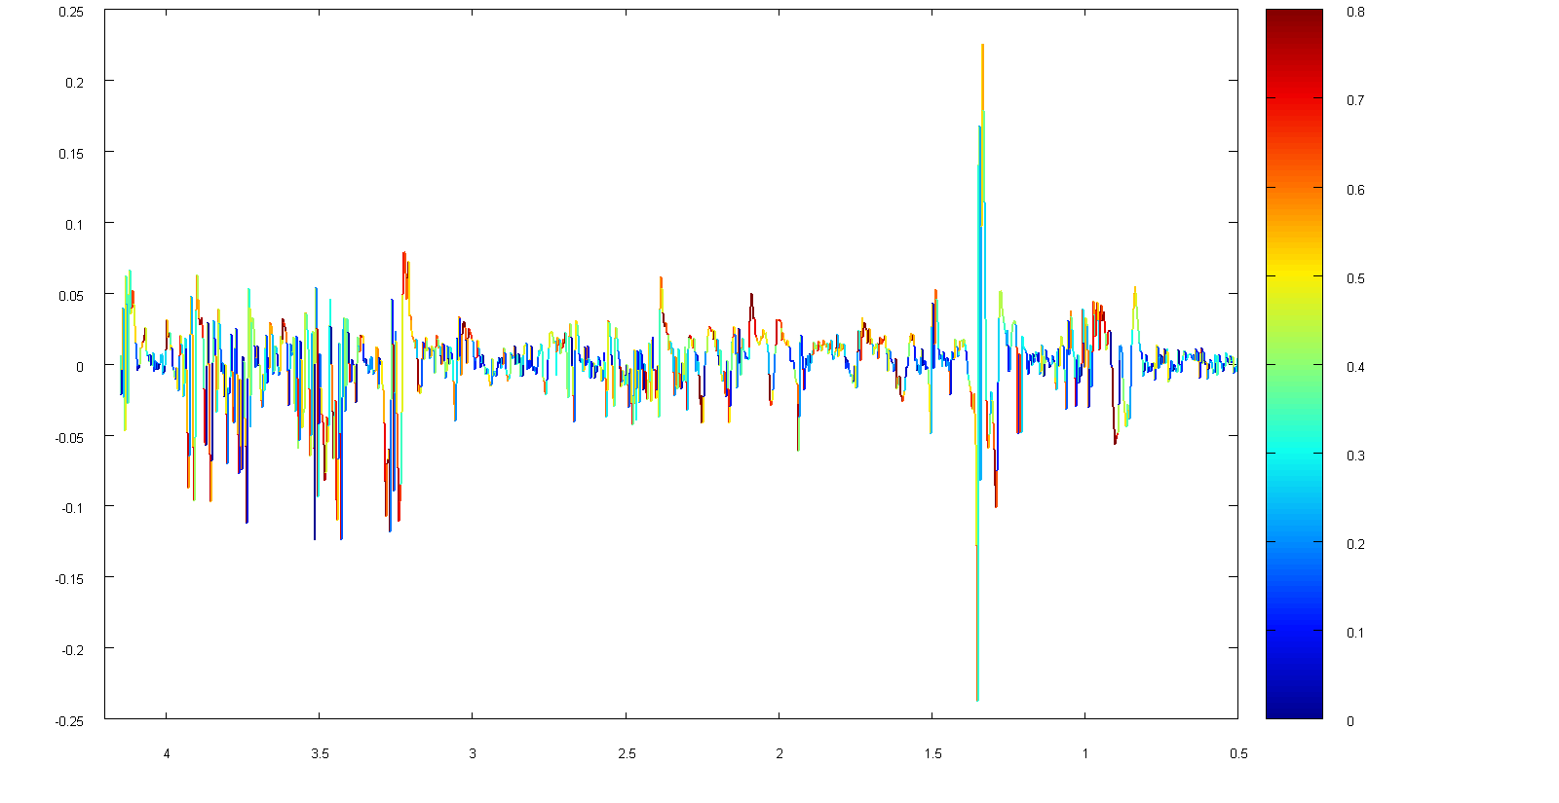
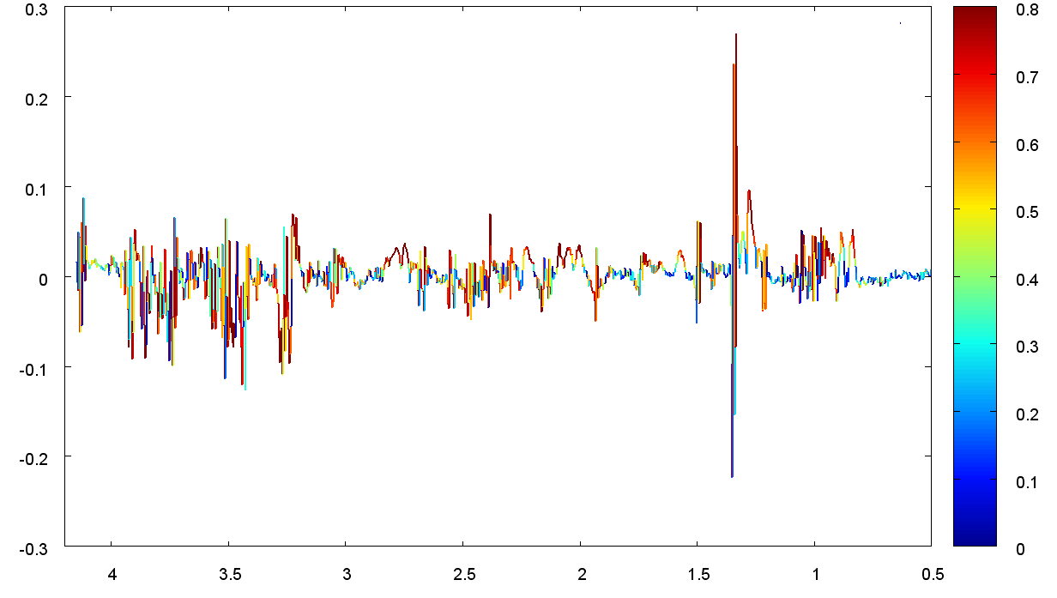
A
0.8
b
a
OPLS-DA Coefficients (a.u.)
1e
1d
1c
1a
1b
0.0
4.0
3.5
3.0
2.5
2.0
1.5
1.0
0.5
0.8
d
c
OPLS-DA Coefficient (a.u.)
1d
1a
1f
1b
4.0
3.5
3.0
2.5
2.0
1.5
0.0
1.0
0.5
B
b
0.8
a
OPLS-DA Coefficient (a.u.)
1e
1c
1d
1b
1a
4.0
3.5
3.0
2.5
2.0
1.5
1.0
0.5
0.0
c
d
0.8
1e
1c
1b
1a
1f
1d
OPLS-DA Coefficient (a.u.)
Additional file 3
4.0
3.5
3.0
2.5
2.0
1.5
1.0
0.5
0.0

