Slide 1
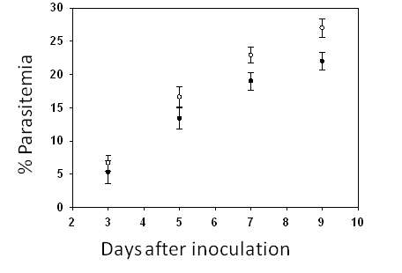
% Survival
Days after inoculation
Additional file 4

