Slide 1
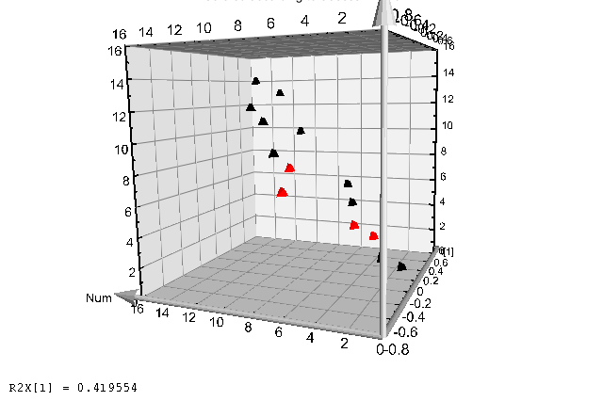
Day 2
Day 3
Day 4
Day 5
Additional file 5

