Slide 1
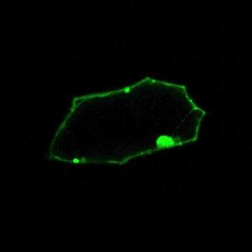
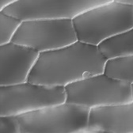
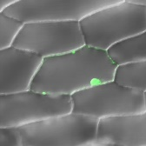

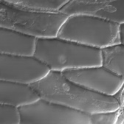
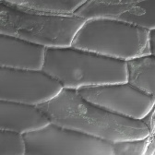

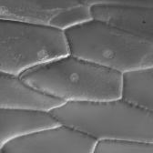
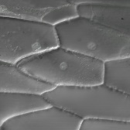

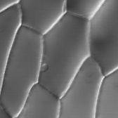

Additional file 3
A
B
OsMAGO1-YN + OsY14b-YC
OsRH2-YN + OsRH2-YC
Fluorescence
Bright field
Merged
Fluorescence
Bright field
Merged
C
OsRH2-YN + OsRH34-YC
D
OsRH34-YN + OsRH34-YC
Fluorescence
Bright field
Merged
Fluorescence
Bright field
Merged
Additional file 3: BiFC analysis of the interaction between rice OsRH2 and OsRH34. N- and C-terminal fragments of YFP (YN and YC) were fused to the C-terminus of OsRH2 and OsRH34, respectively. Onion epidermal cells were cotransformed with 35S::OsMAGO1–YN and 35S::OsY14b–YC (A), 35S::OsRH2–YN and 35S::OsRH2–YC (B), 35S::OsRH2–YN and 35S::OsRH34–YC (C), 35S::OsRH34–YN and 35S::OsRH34–YC (D).

