Slide 1
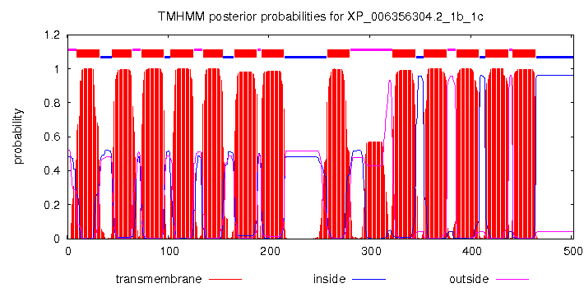
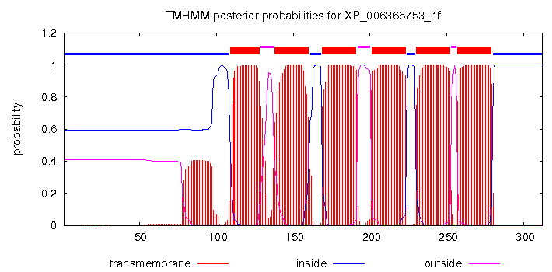
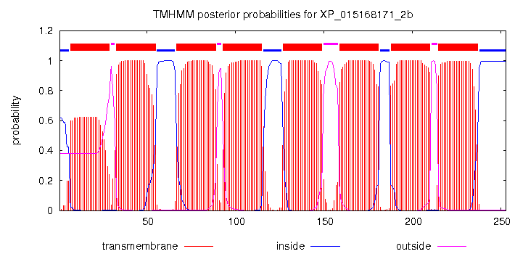
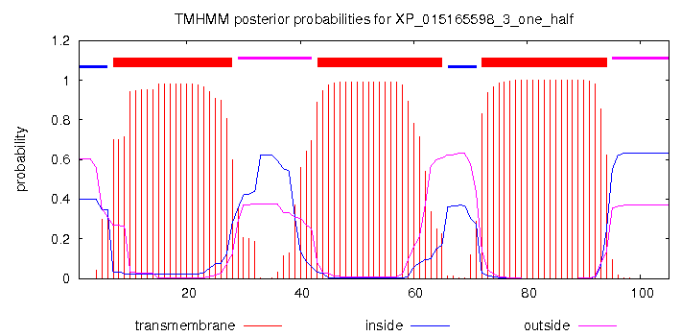
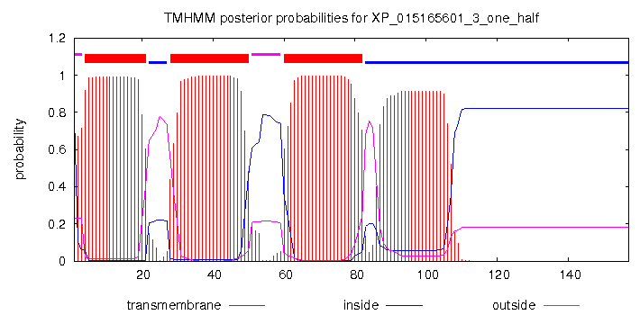
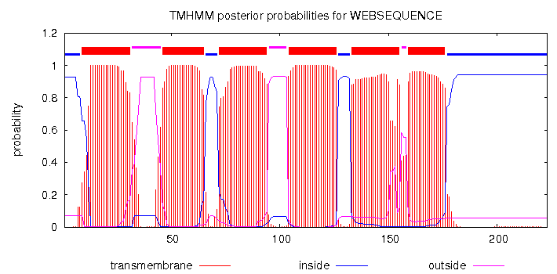
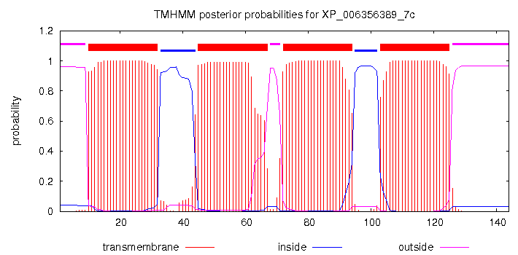
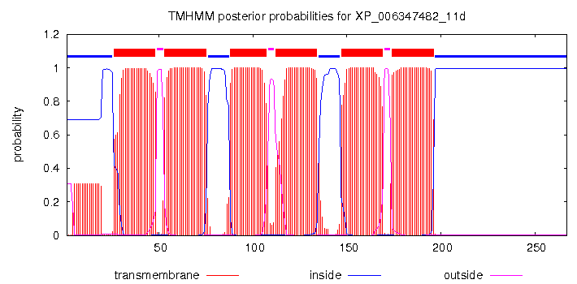
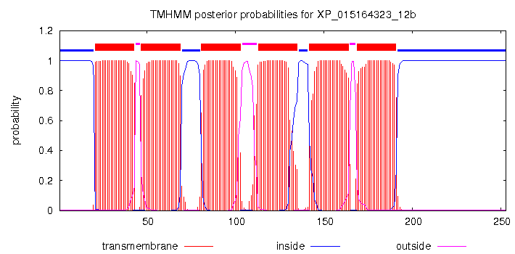


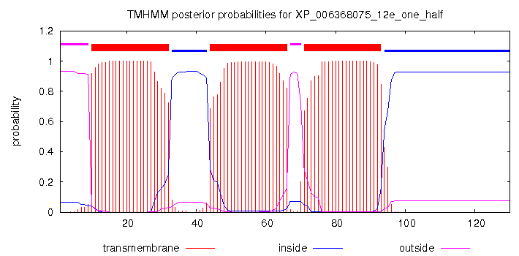
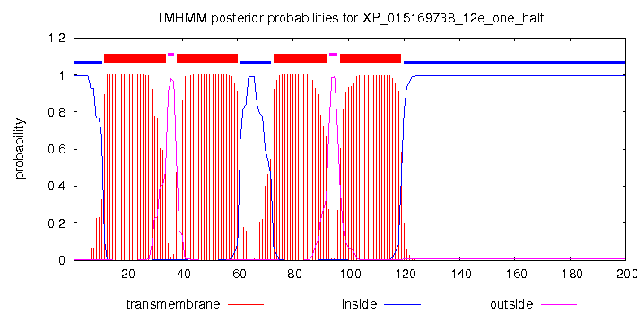
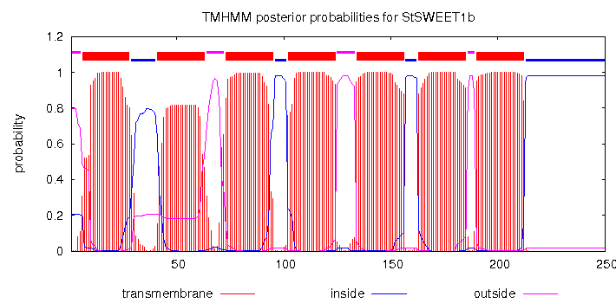
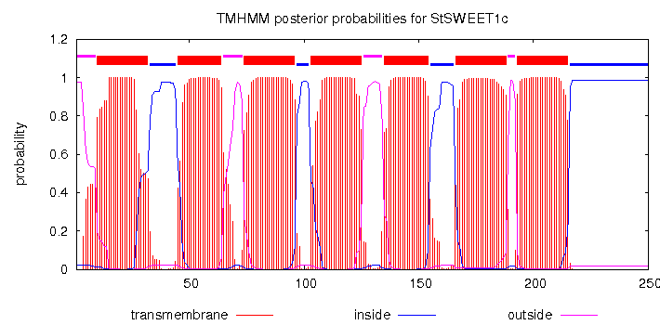
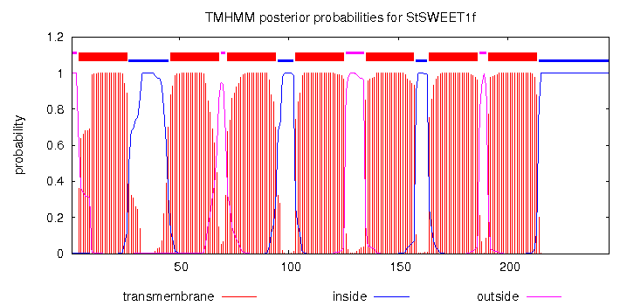
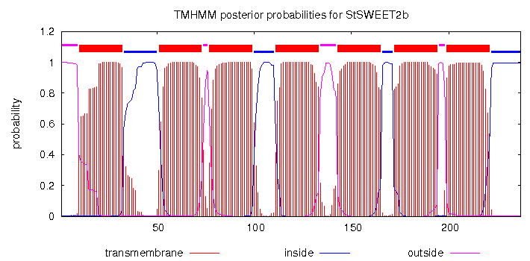
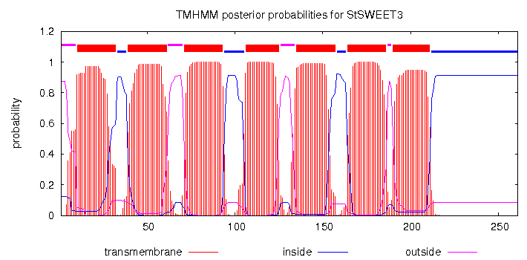
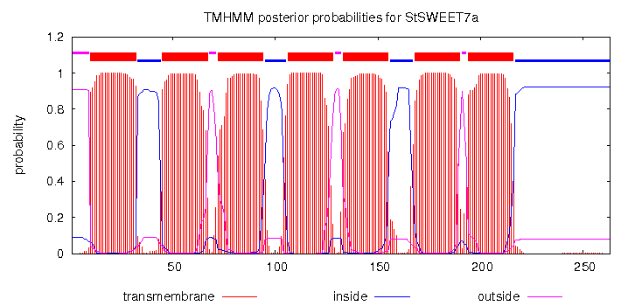
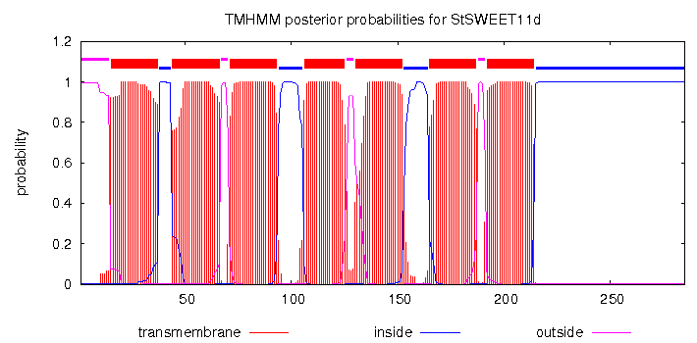
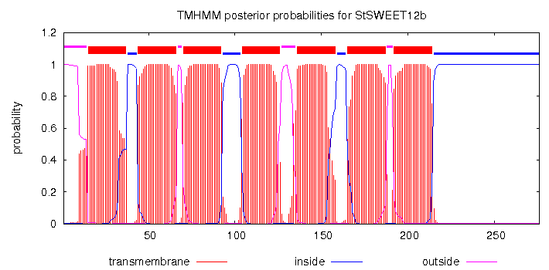

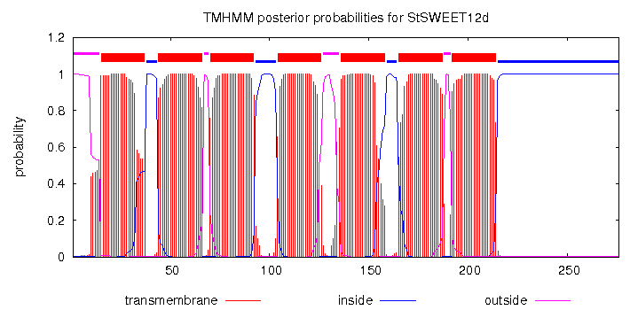
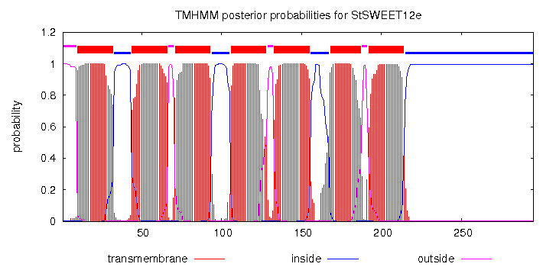
NCBI annotation
6
13
SWEET1b and SWEET1c
8
SWEET1f
3
3
SWEET2b
6
SWEET3
4
SWEET7a
6
SWEET7c
6
SWEET11d
6
SWEET12b
6
SWEET12c
3
4
SWEET12d
0
100
200
300
400
500
SWEET12e
amino acid position
manual annotation
7
SWEET1b
7
SWEET1c
7
SWEET1f
7
SWEET2b
7
SWEET3
7
SWEET7a
4
SWEET7c
7
SWEET11d
7
SWEET12b
7
SWEET12c
7
SWEET12d
0
100
7
300
SWEET12e
200
400
500
amino acid position
transmembrane
inside
outside
Supplementary Figure 1. Topology analysis of potato SWEETs. The upper panel shows the predicted domain structure of potato SWEETs in the NCBI database that were predicted to have more or less than 7 TM domains. Manual annotation and expression data (here not shown) revealed that almost all of them were wrongly annotated. Only SWEET7c that is possibly a pseudogene contains only 4 TM domains.

