Slide 1
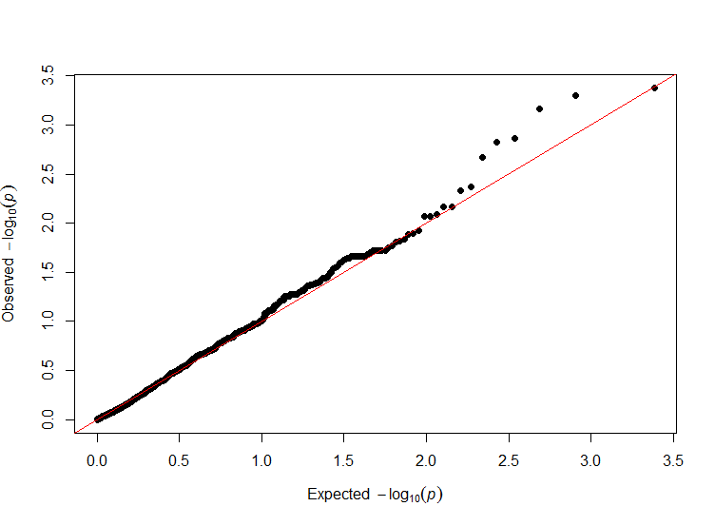
Observed X²
Expected X²

