Slide 1
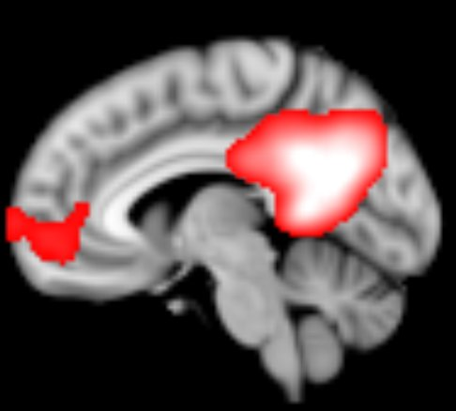
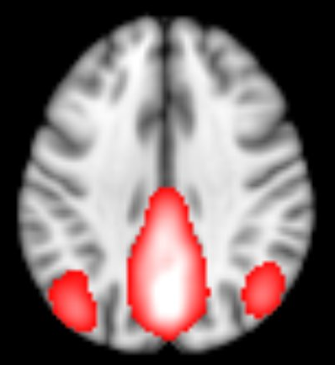
Supplementary Figure 1
MPFC
PCC/ Precu
PL
PL
1
Notes:
tVNS treatment:
Location: The points for sham tVNS are located in the auricular concha area where there is rich vagus nerve branch distribution (Figure 2).
Intervention procedure: Patients take a seated position or they lay on their side. After the stimulation points are disinfected according to standard practice, ear clips are attached to the ear area (auricular concha) to be stimulated. Stimulation parameters include: 1) density wave adjusted to 20Hz, with less than 1ms wave width, and 2) a 1mA current turned on. The intensity is adjusted based on the tolerance of the patients. Each treatment lasts for 30 minutes and is carried on twice a day, 5 days per week for the duration of the treatment period (12 weeks).
Sham tVNS treatment
Location: The stimulation points for sham tVNS are located at the superior scapha (outer ear margin midpoint), where there is no vagus nerve distribution (Figure 2).
Intervention procedure: All procedures performed in the sham tVNS treatment group are identical to the procedures for the verum tVNS group.
1

