Slide 1
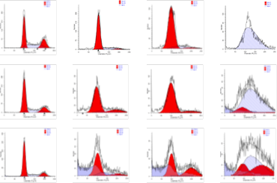
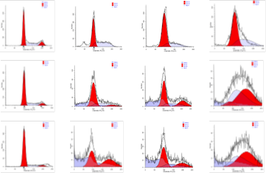
Supplementary Figure S1
A
PC9
BO-1978
0 1 2 4 (μM)
100
24 h
80
60
% of cells
48 h
40
Cell number
20
0
72 h
24 48 72 24 48 72 24 48 72 24 48 72 h
0 1 2 4 μM
DNA content
BO-1978
B
PC9/gef B4
BO-1978
0 1 2 4 (μM)
100
24 h
80
60
% of cells
48 h
40
Cell number
20
0
72 h
24 48 72 24 48 72 24 48 72 24 48 72 h
0 1 2 4 μM
DNA content
BO-1978
Supplementary Figure S1. Interference with cell cycle progression and induction of apoptosis by BO-1978 in PC9 (A) and PC9/gef B4 (B) cells. The growing cells were treated with various concentrations of BO-1978 (1 to 4 μM) for various time periods (24 to 72 hours). The distribution of cell cycle phases was analyzed with a flow cytometer and ModFit LT 3.0 software (Verity Software House, Topsham, ME).

Slide 2
Supplementary Figure S2
Supplementary Figure S2. Pharmacokinetics of BO-1978 in blood of Spargue Dawley (SD) rats. SD rats (n=8) were administered with 10 mg/kg BO-1978 (dissolved in 20% ethanol and 80% PEG400 at the concentration of 10 mg/mL) via an indwelling catheter in jugular vein. Serial blood samples were collected from tail veins at the time indicated. Concentrations of BO-1978 in blood were determined by HPLC using Agilent HC-C18 column (4.6×100 mm) and UV detector (229 nm). The solution of mobile phase was 35% acetonitrile and 65% 10 mM NaH₂PO₄ (pH 3.0).

Slide 3
Supplementary Figure S3
Supplementary Figure S3. Histopathological examination of various organs in BO-1978 treated ICR mice. The heart, lung, liver, spleen and kidney were harvested from ICR mice treated with intravenous single injection of vehicle control, 20 mg/kg or 40 mg/kg BO-1978 for 48 hours or 14days. Histopathological sections from organs of ICR mice were stained with H&E and examined with microscope. Scale bar, 100 μm.

