Slide 1
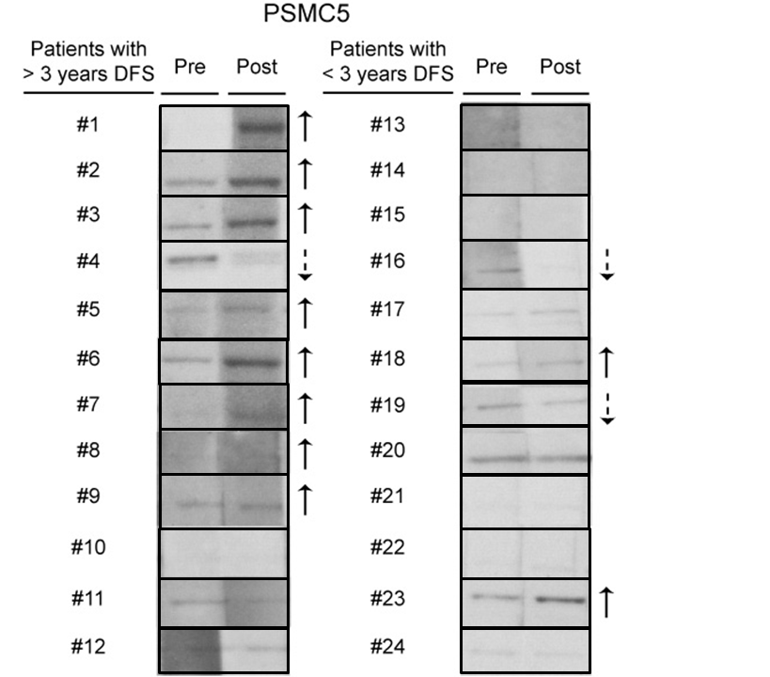
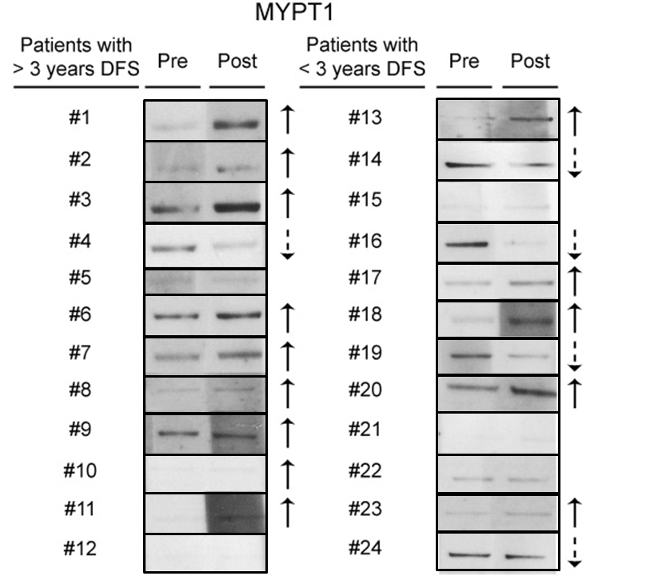
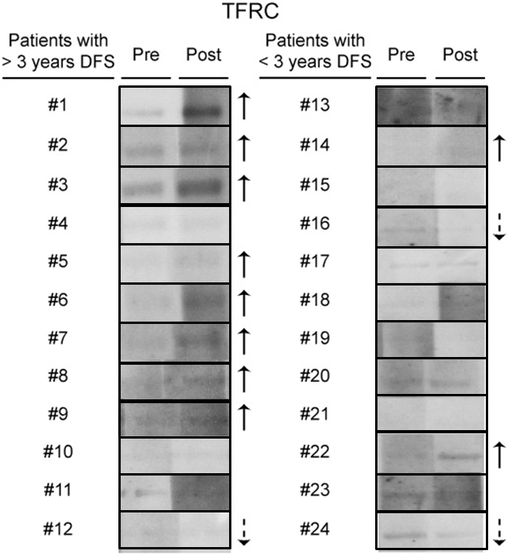
Antibody Responses in Vaccinated Pancreatic Cancer Patients
Supplemental Figure S3
A
B
C
Supplemental Figure S3. Increased antibody response post-vaccination correlates with an improved disease free survival (DFS). Purified recombinant (A) PSMC5, (B) MYPT1 and (C) TFRC expressed in human HEK293 cells were resolved by SDS-PAGE and then transferred onto a nitrocellulose membrane. The membrane was cut into individual lanes. Each individual lane was probed with either pre-vaccination or post-vaccination serum of the various patients. Solid upward arrow indicates an increase post-vaccination whereas a dotted downward arrow shows a decrease post-vaccination in antibody response.

