Slide 1
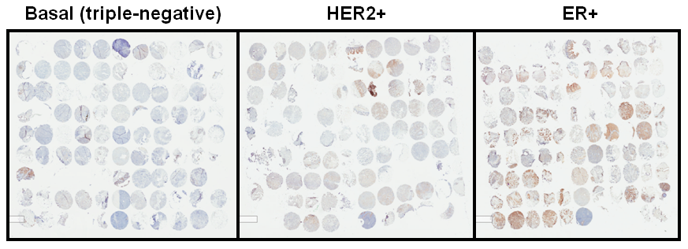
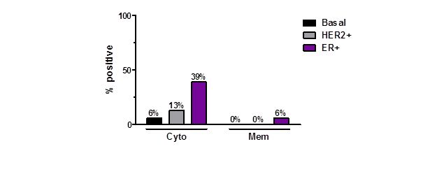
Antibody Responses in Vaccinated Pancreatic Cancer Patients
Supplemental Figure S5
A
B
Supplemental Figure S5. MYPT1 and PSMC5 expression in 3 different subtypes (basal, HER-2 positive and ER positive) of breast cancer. (A) Snapshot of MYPT1 expression in 3 breast cancer tissue microarrays. 19% of all breast cancers express cytoplasmic MYPT1 but only 2% express membranous MYPT1. (B) Cytoplasmic MYPT1 staining differs with different breast cancer subtypes – Basal (triple-negative, 6%), HER2+ (13%) and ER+ (39%). However, the membrane MYPT1 staining was very little in ER+ breast cancer (6%) and no membranous staining was observed in basal or HER2+ breast cancers. (C) Snapshot of PSMC5 expression in 3 breast cancer tissue microarrays. 88% of all breast cancers express cytoplasmic PSMC5 but only 35% express nuclear PSMC5. (D) Cytoplasmic PSMC5 staining was similar between the different breast cancer subtypes - Basal (triple-negative, 94%), HER2+ (82%) and ER+ (88%). However, nuclear PSMC5 staining was most in basal (47%), followed by HER2+ (38%) and the least in ER+ (24%) breast cancers. * p < 0.05 Fisher exact test.

Slide 2
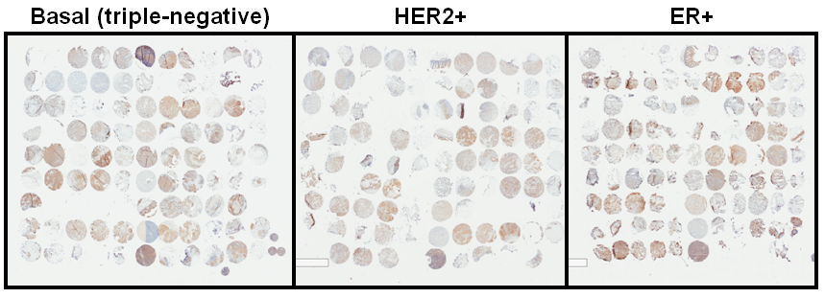
Antibody Responses in Vaccinated Pancreatic Cancer Patients
Supplemental Figure S5 (continued)
C
D
Supplemental Figure S5 (continued). MYPT1 and PSMC5 expression in 3 different subtypes (basal, HER-2 positive and ER positive) of breast cancer. (C) Snapshot of PSMC5 expression in 3 breast cancer tissue microarrays. 88% of all breast cancers express cytoplasmic PSMC5 but only 35% express nuclear PSMC5. (D) Cytoplasmic PSMC5 staining was similar between the different breast cancer subtypes - Basal (triple-negative, 94%), HER2+ (82%) and ER+ (88%). However, nuclear PSMC5 staining was most in basal (47%), followed by HER2+ (38%) and the least in ER+ (24%) breast cancers. * p < 0.05 Fisher exact test.

