Slide 1

A 15-year-old Indian girl with dysphagia, facial dystonia, brisk reflexes and unsteadiness
Teaching NeuroImages
Neurology
Resident and Fellow Section
Schwarting et al.
© 2015 American Academy of Neurology

Slide 2
Vignette
A 15-year-old Indian girl presents with many years of the following :
Dysphagia
Oropharyngeal dystonic movements
Brisk reflexes
Unsteadiness on tandem walking
A muscle biopsy was normal.
Schwarting et al.
© 2015 American Academy of Neurology

Slide 3
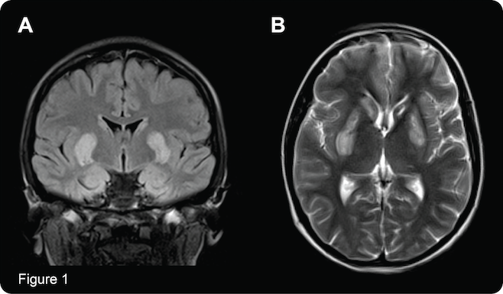
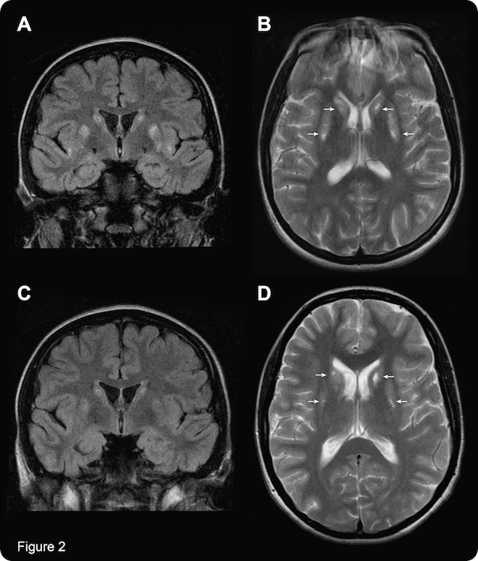
Imaging
Schwarting et al.
© 2015 American Academy of Neurology
Notes:
Figure 1 (top left)
Coronal and axial T2-weighted MRI at presentation
Coronal FLAIR (A) and Axial T2 weighted (B) MRI slices at presentation showing relatively symmetric hyperintensity in the corpora striata,
and apparent cystic changes in the left head of caudate.
Figure 2 (top right)
Coronal and axial T2-weighted MRI 2 months and 2 years after treatment
Coronal and Axial T2-weighted MRI slices showing symmetrical hyperintensities in the corpora striata at 2 months (A,B) and 2 years (C,D) after Biotin and Thiamine treatment, demonstrating a progressive reduction in the corpus striatal hyperintensity with residual small areas of cystic damage (small white arrows).

Slide 4
Biotin-responsive
basal ganglia disease
Secondary to mutations in the SLC19A3 Thiamine transporter gene
Middle-Eastern and Indian patients most commonly affected.
Untreated it can progress to severe dystonia, quadriparesis and coma.
It is important to recognize the clinical and imaging features as it is responsive to combined Biotin and Thiamine therapy.
Schwarting et al.
© 2015 American Academy of Neurology
Notes:
References:
Tabarki B, Al-Shafi S, Al-Shahwan S, et al. Biotin-responsive basal ganglia disease revisited: clinical, radiologic, and genetic findings. Neurology 2013;80:261-267.
Tabarki B, Alfadhel M, AlShahwan S, Hundallah K, AlShafi S, AlHashem A. Treatment of biotin-responsive basal ganglia disease: Open comparative study between the combination of biotin plus thiamine versus thiamine alone. Eur J Paediatr Neurol 2015;19:547-552.

