Slide 1
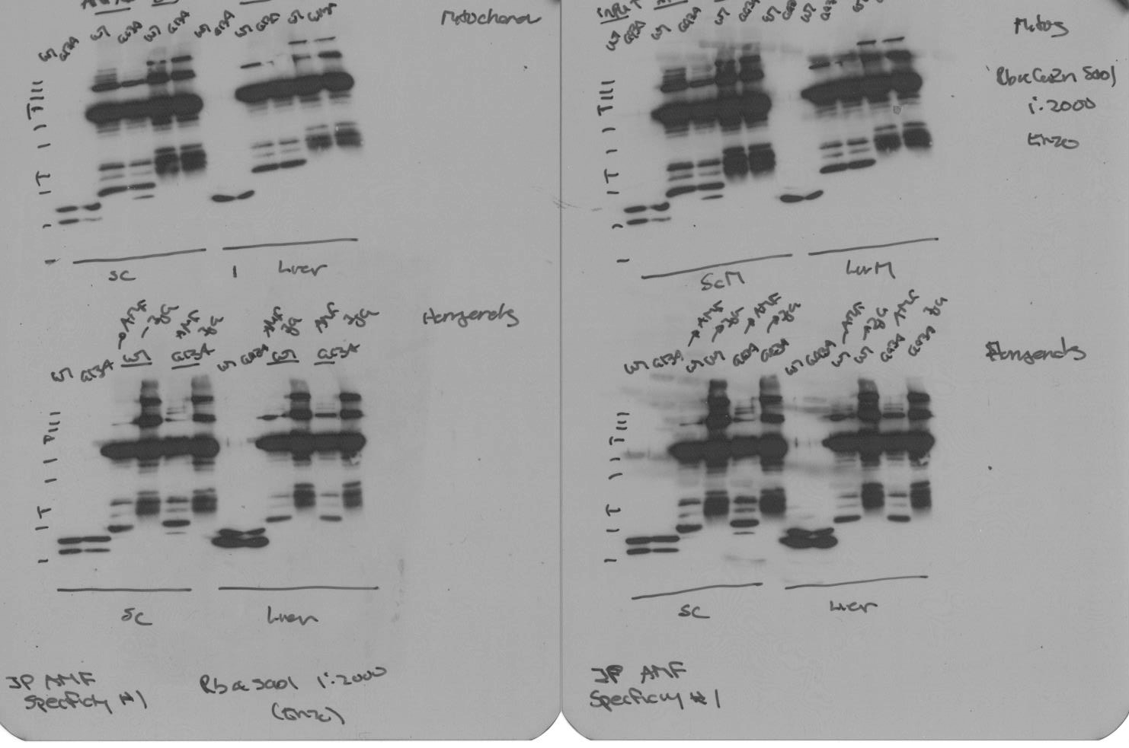
Homogenates
Spinal Cord
Liver
WT
G93A
WT
WT
G93A
G93A
WT
G93A
AMF7-63
IgG
AMF7-63
IgG
IgG
AMF7-63
AMF7-63
IgG
Input
Input
IP
20 kDa
ns
hSOD1
rSOD1
Mitochondria
Spinal Cord
Liver
Input
AMF7-63
IgG
Input
AMF7-63
IgG
WT
G93A
WT
G93A
WT
G93A
WT
G93A
WT
G93A
WT
G93A
20 kDa
ns
hSOD1
rSOD1
Pickles et al. Figure S2

