Slide 1
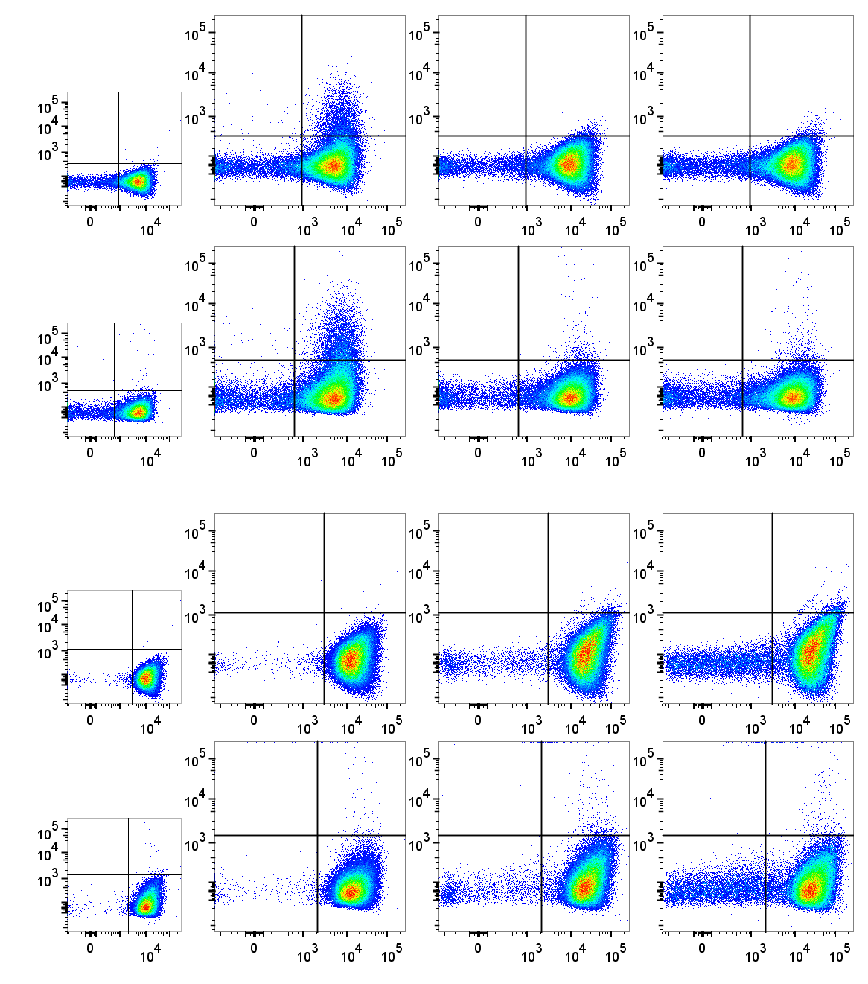
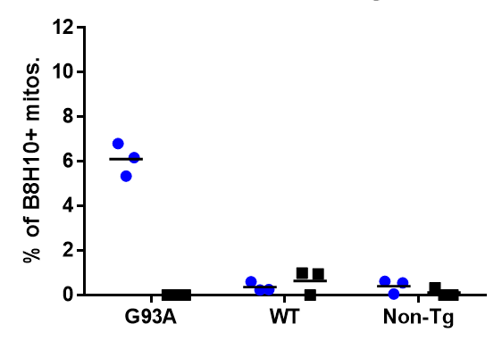
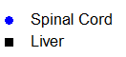
A
SOD1^{G93A}
SOD1^{WT}
Non-Tg
B
Iso.
6.4%
0.5%
0.7%
***
Spinal Cord
0.2%
***
***
0.2%
0.6%
0.5%
Liver
0.3%
B8H10
MTG
Pickles et al. Figure S3

