Slide 1
Supplemental Figure 1. TGFβR inhibition suppresses mesenchymal features in human HCC cell lines.
Notes:
Supplemental Figure 1.

Slide 2
A)
B)
Supplemental Figure 2. AXIN2 and GLI are induced by Wnt and SHH signals in the epithelial-to-mesenchymal transition network model.
Notes:
Supplemental Figure 2.

Slide 3
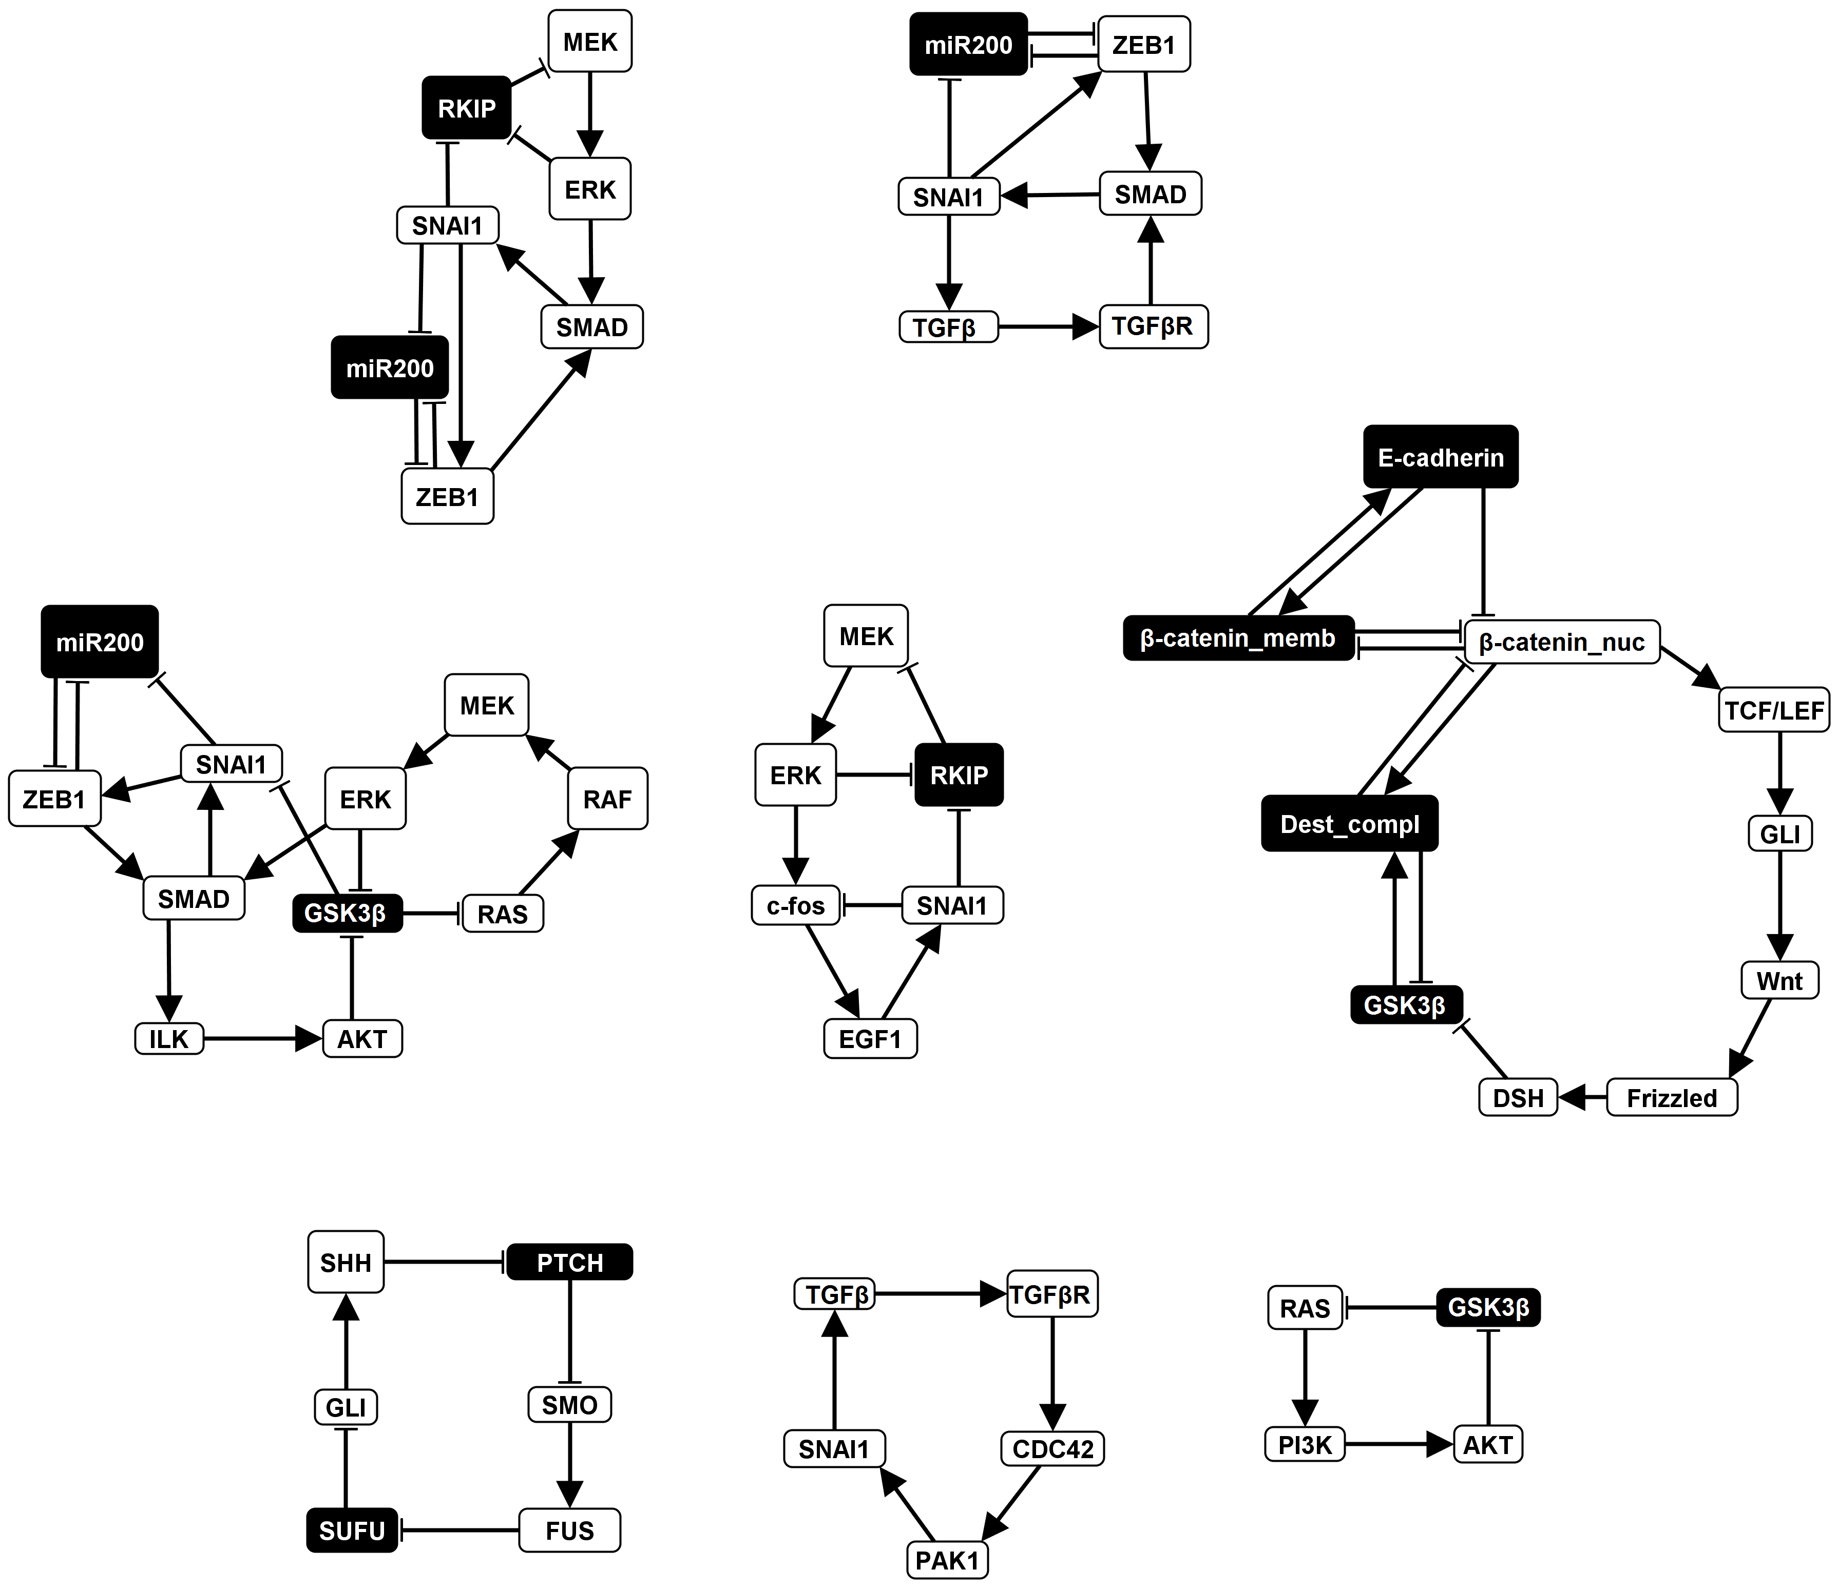
Supplemental Figure 3. All stable motifs (feedback loops) stabilizing the TGFβ-driven EMT phenotype.
Notes:
Supplemental Figure 3.

Slide 4
5X
50X
Supplemental Figure 4. The quantitative value of ratio between the timescale of the slow and fast processes does not matter as long as it is significantly larger than one

Slide 5
A)
Mutual Inhibition
β-catenin_nuc*= not Dest_compl and not β-catenin_memb and (not Sufu or not Ecadherin)
β-catenin_memb*=Ecadherin and not β-catenin_nuc
Supplemental Figure 5. Exploration of alternative rules to describe nuclear localization of β-catenin.
β
β
B)
Uni-directional Inhibition
β-catenin_nuc*= not Dest_compl and (not Sufu or not Ecadherin)
β-catenin_memb*=Ecadherin and not β-catenin_nuc
β
β

