Slide 1
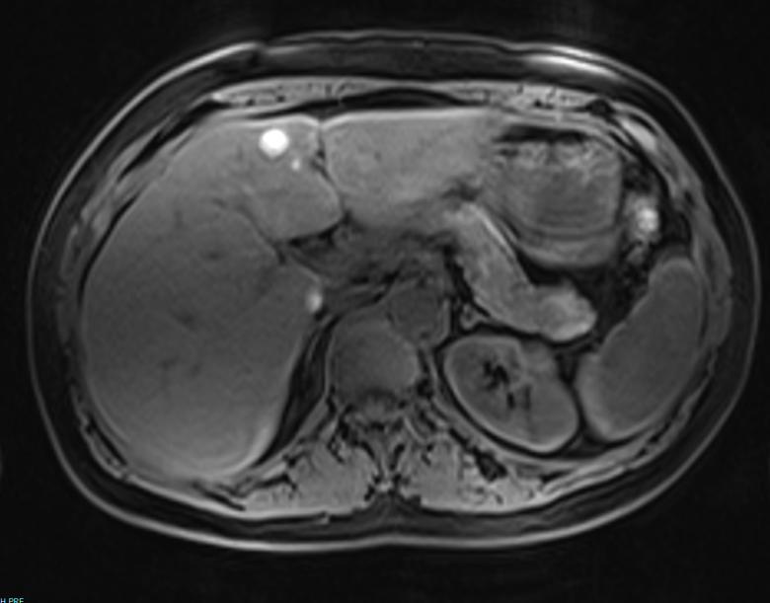
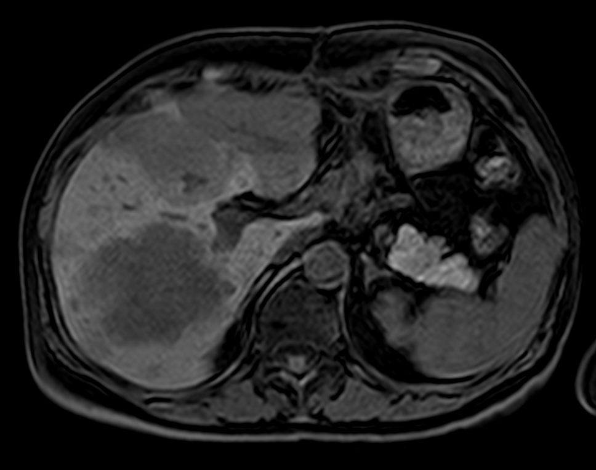
Supplementary Figure 1.
A.
798 - 804
Patient UM3
Mean Tumor intensity = 801
Mean Normal intensity = 198
T/N Intensity ratio = 4
Thus, HYPERINTENSE TUMOR
187
194
212
B.
Patient UM7
Mean Tumor intensity = 981
Mean Normal intensity = 1847
T/N Intensity ratio = 0.5
Thus, HYPOINTENSE TUMOR
1784
902
1983
1060
1774
In situ MRI assessment of tumor melanin content
T1-weighted MRI images without gadolinium were utilized to assess tumor signal intensity. Tumor hyperintensity, hypointensity, and mixed intensity were objectively determined by quantitative comparison of the MRI signal intensity of tumor versus adjacent normal tissue using Carestream Vue Solutions (version 11.3) software. Intensity values for tumor are shown in green; values for adjacent normal liver are shown in yellow. Hyperintense tumors were defined as having a mean tumor/normal intensity ratio > 1.5; representative example shown in A. Hypointense tumors had a mean tumor/normal ratio < 0.7; representative example shown in B. Mixed intensity tumors had both hyperintense and hypointense components.

Slide 2
Supplementary Figure 2.
Tumor Immunophenotype
UM and CM liver metastases demonstrate similar immunophenotype profile
Comparison between CM and UM liver metastases based upon immunohistochemical staining for CD3+, CD4+, CD8+ T cells and CD20+ B cells found in the tumor periphery (upper panel) and infiltrating within the tumors (lower panel). Numbers within the bubbles denote the percentage of tumors in the specified cohort with the indicated lymphocyte score. Bubble diameter is proportionate to these percentages. Statistical comparisons between CM and UM cohorts were performed with the Mann-Whitney test.

