Slide 1
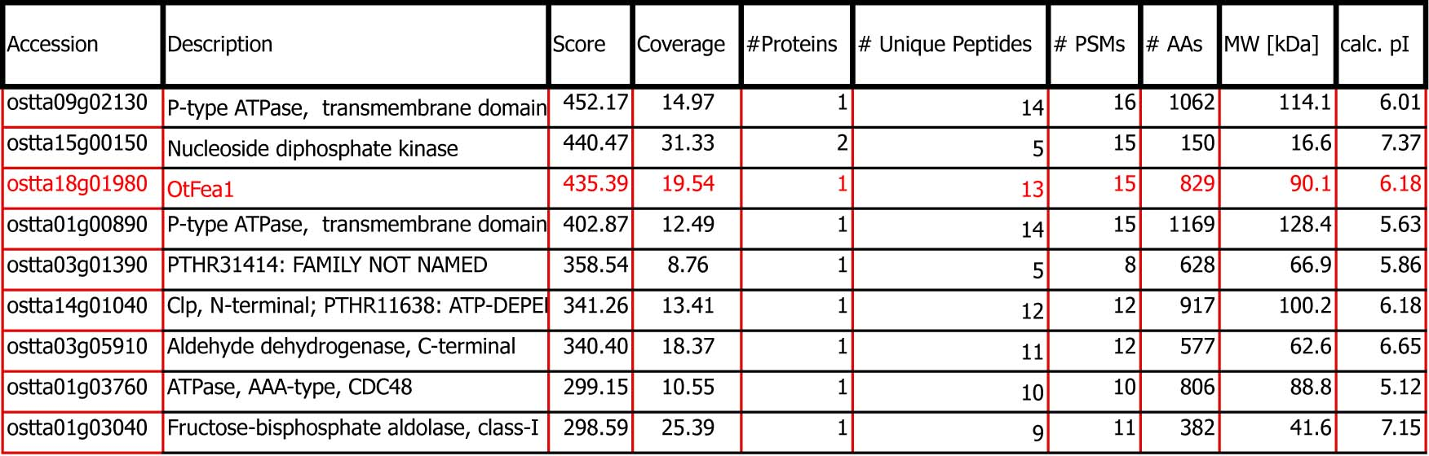
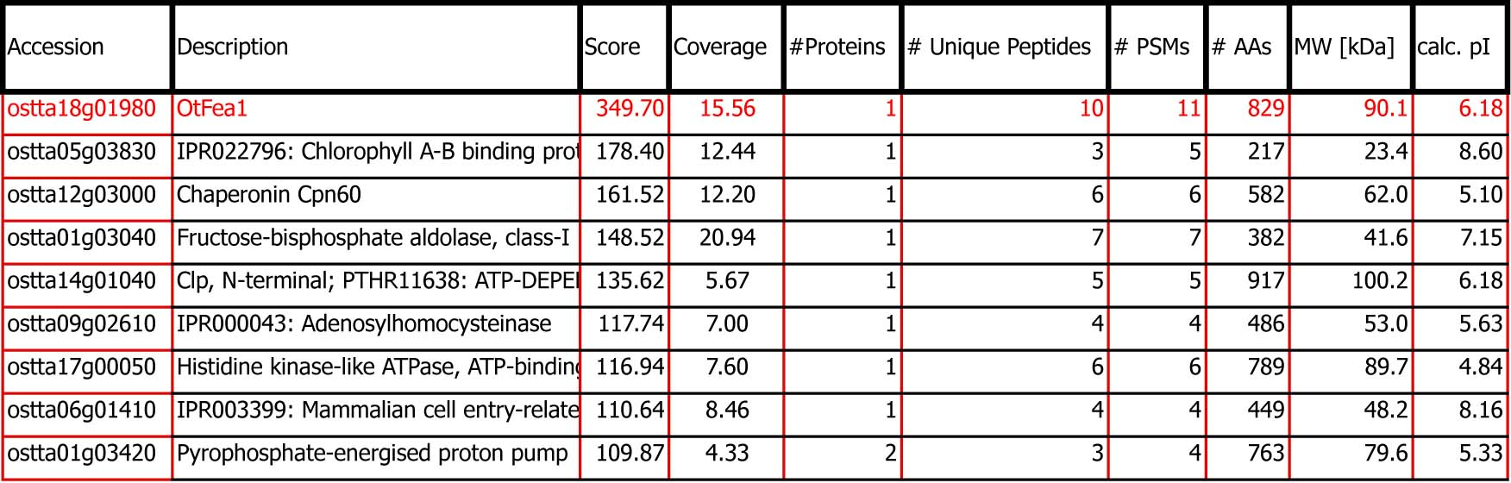
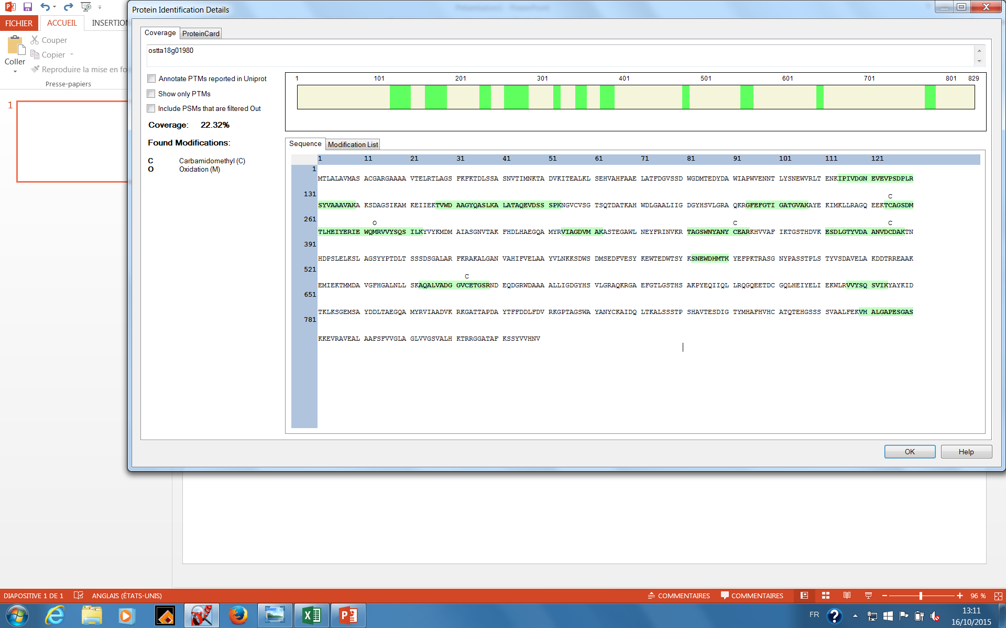
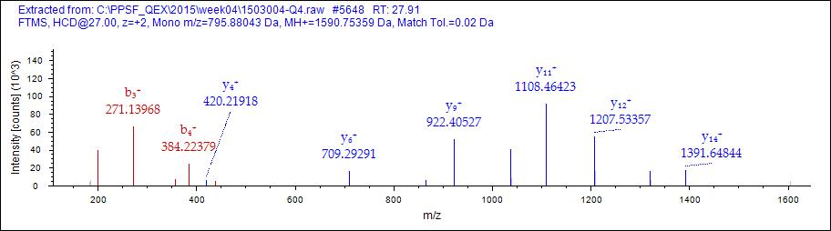
Figure S11
A
D
B
#1 | a⁺ | a²⁺ | b⁺ | b²⁺ | Seq. | y⁺ | y²⁺ | #2
1 | 44.04948 | 22.52838 | 72.04440 | 36.52584 | A |  |  | 16
2 | 172.10806 | 86.55767 | 200.10298 | 100.55513 | Q | 1519.71702 | 760.36215 | 15
3 | 243.14518 | 122.07623 | 271.14010 | 136.07369 | A | 1391.65844 | 696.33286 | 14
4 | 356.22925 | 178.61826 | 384.22417 | 192.61572 | L | 1320.62132 | 660.81430 | 13
5 | 455.29767 | 228.15247 | 483.29259 | 242.14993 | V | 1207.53725 | 604.27226 | 12
6 | 526.33479 | 263.67103 | 554.32971 | 277.66849 | A | 1108.46883 | 554.73805 | 11
7 | 641.36174 | 321.18451 | 669.35666 | 335.18197 | D | 1037.43171 | 519.21949 | 10
8 | 698.38321 | 349.69524 | 726.37813 | 363.69270 | G | 922.40476 | 461.70602 | 9
9 | 755.40468 | 378.20598 | 783.39960 | 392.20344 | G | 865.38329 | 433.19528 | 8
10 | 854.47310 | 427.74019 | 882.46802 | 441.73765 | V | 808.36182 | 404.68455 | 7
11 | 1014.50376 | 507.75552 | 1042.49867 | 521.75297 | C-Carbamidomethyl | 709.29340 | 355.15034 | 6
12 | 1143.54636 | 572.27682 | 1171.54127 | 586.27427 | E | 549.26274 | 275.13501 | 5
13 | 1244.59404 | 622.80066 | 1272.58895 | 636.79811 | T | 420.22014 | 210.61371 | 4
14 | 1301.61551 | 651.31139 | 1329.61042 | 665.30885 | G | 319.17246 | 160.08987 | 3
15 | 1388.64754 | 694.82741 | 1416.64245 | 708.82486 | S | 262.15099 | 131.57913 | 2
16 |  |  |  |  | R | 175.11896 | 88.06312 | 1
C

