Slide 1

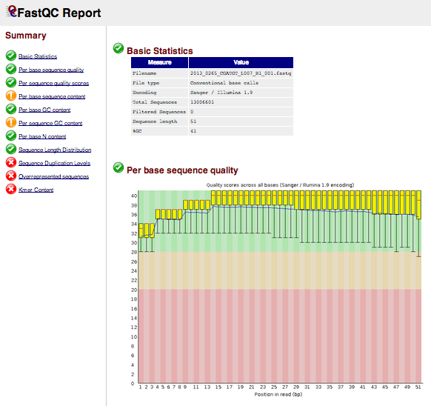
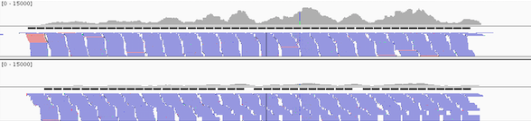
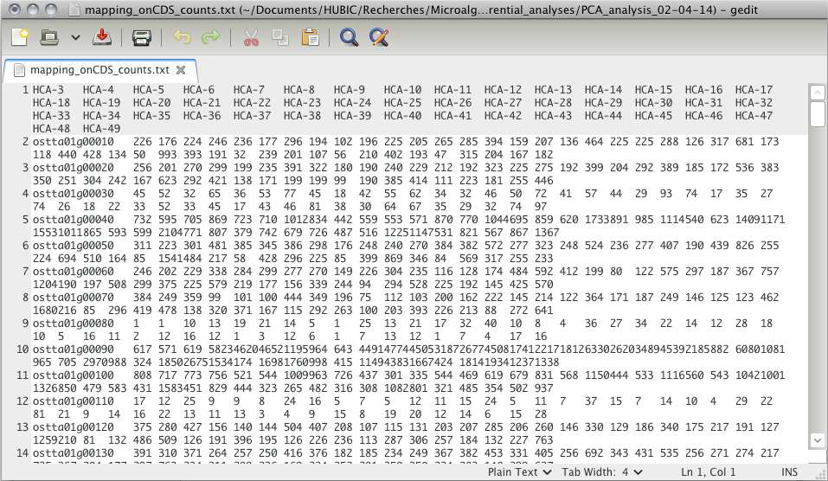
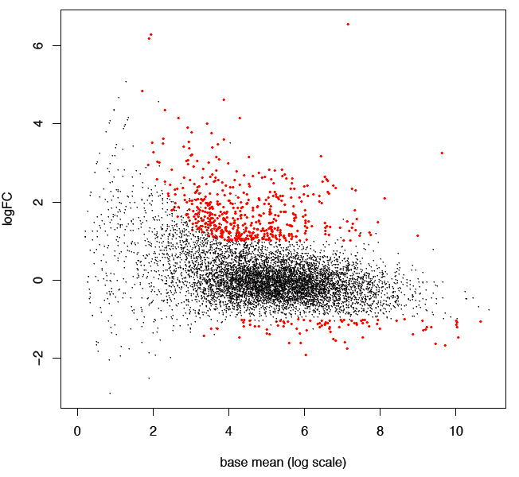
Figure S2
Sequencing results (reads)
CDS sequences (FASTA file)
STEP 2: read mapping
(FASTQ file)
BOWTIE program
STEP 1: sequence quality controls
Unmapped reads
(FASTQ file)
Mapped reads with genomic positions
(SAM and BAM files)
FASTQC program
(HTML file)
(IGV snapshot)
STEP 3: Calculation of read numbers for each CDS in all conditions
BEDTOOLS program
STEP 4: Search for DE genes
DEseq program
(TEXT file)
(MA plot)

