Slide 1
Supplementary Figure 2: Screengrab images from the Ariol system visualising the algorithm training for representative images detailed in Supplementary Figure 1. A1, B1, C1, D1) DAB colour recognition (red) and haematoxylin colour recognition (green) demonstrating the effect of cytoplasmic ER staining and dark heamatoxylin staining on colour recognition. A2, B2, C2, D2) Nuclear segmentation, based on the colour recognition. Yellow dots delineate ER-positive nuclei. Pink dots delineate ER-negative tumour cells according to the tuned algorithm A) SEARCH study; B) ABCS study (BOOG_E TMA); C) ABCS study (BOOG_J TMA); D) KBCP study.

Slide 2
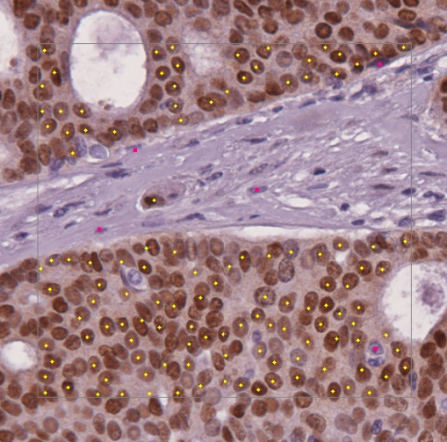
A1
A2
B1
B2
C1
C2
D1
D2

