Slide 1
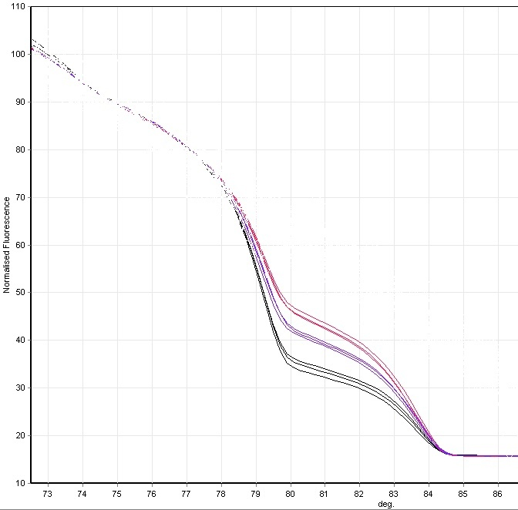
Affected individual
– maternal duplication
Unaffected father
– no duplication
Unaffected mother
– paternal duplication

