Slide 1
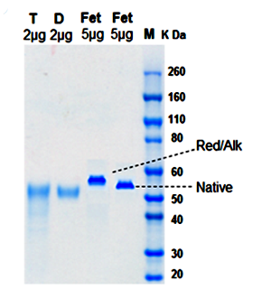
A
HHHHHHSIQT GNQNHPETCN QSIITYENNT WVNQTYVNIS NTNVVAGQDA TSVILTGNSS LCPISGWAIY SKDNGIRIGS
50
58
63
68
88
B
Fig . 1

Slide 2
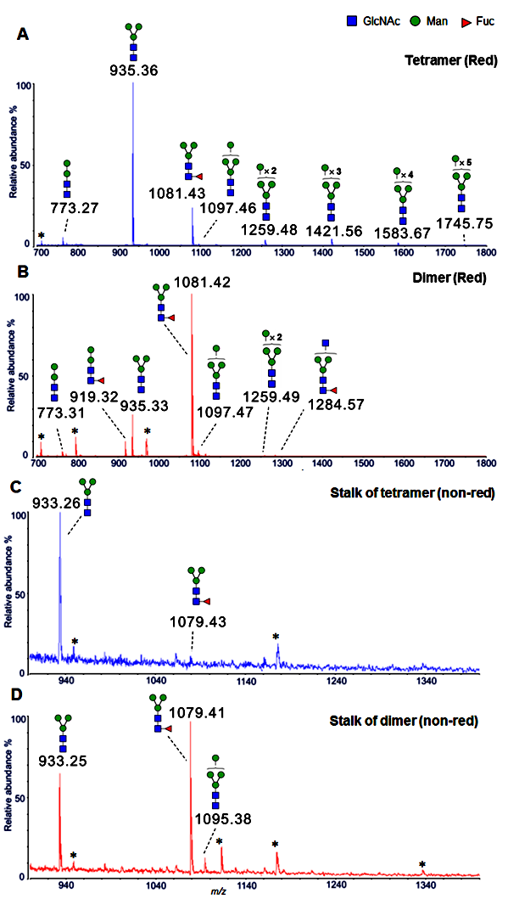
Tetramer (Reduced)
Relative
abundance %
Dimer (Reduced)
Relative
abundance %
Stalk of tetramer (Non-reduced)
Relative
abundance %
Stalk of dimer (non-reduced)
Relative
abundance %
Fig. 2.

Slide 3
A
Tetramer
Dimer
FUT8 + + +
FUT11 + + +
Protein
Staining
Strep-HRP
probing
B
9000
6000
Counts (CPM)
3000
0
Tetramer
+ FUT8
Dimer
+ FUT8
Tetramer
Dimer
Fig . 3

Slide 4
1.5
1
Relative activity
0.5
0
0
5
10
20
Reaction time (min)
Fig . 4

