Slide 1
Differential Regulation of Angiogenesis using Degradable VEGF-Binding Microspheres
David G. Belair, Michael J. Miller, Shoujian Wang, Soesiawati R. Darjatmokon, Bernard Y.K. Binder, Nader Sheibani, William L. Murphy
SUPPORTING INFORMATION

Slide 2
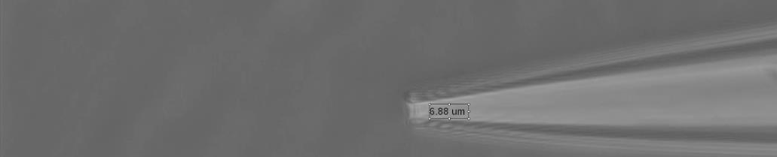
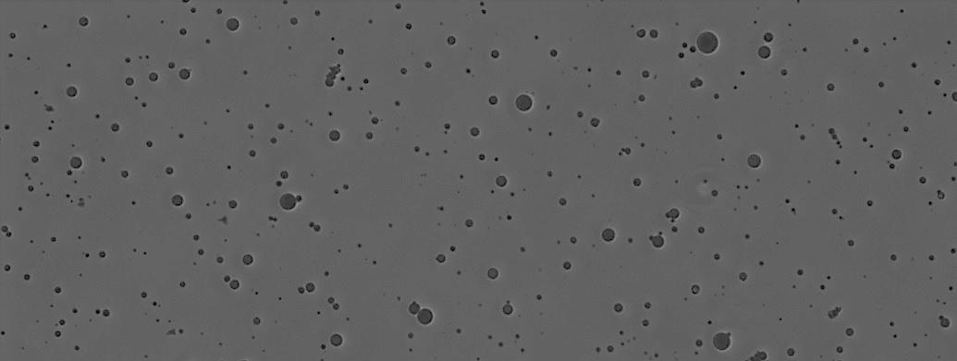
A
100µm
Capillary Diam: 6µm
B
100µm
Sonicated Microspheres
C
D
Figure 1S: Microsphere diameter is influenced by emulsion conditions. A: Phase contrast image of glass capillary used for injection in choroidal neovascularization model. Image analysis (NIS Elements) revealed that the mean diameter of the capillary tube is ~6 µm at the tip. B: Phase contrast image of sonicated N-Blank microspheres stained with Trypan blue. C: Histograms of microsphere diameter after emulsifying via vortexing for 60 s or sonication at one of three different power levels for 40 s. Dashed line indicates 6 µm diameter of capillary tube. D: Mean diameter (+/- SD) of N-Blank microspheres generated (as shown in panel C). Microsphere diameter was strongly influenced by the emulsion conditions (one-way ANOVA p-value < 0.0001), and the microspheres generated via sonication at 100W exhibited the smallest mean diameter relative to all other conditions (p-value < 0.0001 via ANOVA and Tukey’s post-hoc test). Dashed line indicates 6 µm diameter of capillary tube.

Slide 3
A
B
C
Figure 2S: Cumulative VEGF release (ng) from Blank, VBP, or Scramble microspheres (crosslinked with PEG-T-DT, PEG-M-DT, or PEG-DT) pre-loaded with VEGF. Error bars were propagated at each time point and represent one standard deviation about the mean cumulative release for each time point for three replicates per condition.

Slide 4
A
*
*
B
Figure 3S. HUVEC metabolic activity in the presence of microspheres alone or VEGF alone. A: HUVEC metabolic activity (in fluorescence intensity) in the presence of VEGF. No VEGF condition is shown as 0.001 ng/mL on x-axis. Statistical significance compared to no VEGF condition denoted with (*) at p-value < 0.05 using Student’s t-test. B: HUVEC metabolic activity (in fluorescence intensity) in the presence of VBP, Scramble, or Blank microspheres crosslinked with PEG-T-DT, PEG-M-DT, or PEG-DT. HUVEC metabolic activity in the absence of microspheres or VEGF is shown as dashed line. Two-way analysis of variance was performed (microsphere peptide identity p-value>0.05, microsphere crosslink type p-value>0.05, interaction p-value>0.05). No statistical differences were observed in post-hoc Bonferroni test.

Slide 5
Figure 4S. Amount of phosphorylated VEGFR2 (in ng) measured via ELISA normalized to the total protein content of the cell lysate (in mg) after treatment of HUVECs with medium (2 vol.% FBS in M199) containing no supplemented VEGF or containing 10 ng/mL supplemented VEGF. Data is presented as mean +/- standard deviation for three (-VEGF) or five replicates (+VEGF), and statistical significance is denoted for p-value < 0.05 using Student’s t-test (*).

Slide 6
Figure 5S: F-VBP microspheres sequester murine VEGF. F-Type microspheres were assayed for binding murine VEGF₁₆₄ (R&D Systems), hereafter referred to as mVEGF, by incubating microspheres in a solution containing 1 wt.% BSA in PBS with 10 ng/mL mVEGF for 4 hours at 37°C. After incubation, microspheres were centrifuged at 10,600 x g for 5 minutes, and the supernatant was assayed with a mVEGF ELISA (R&D Systems) using the manufacturer’s protocol. The concentration of mVEGF in the supernatant was correlated to the amount of mVEGF sequestered to the microspheres by subtracting the supernatant mVEGF concentration in each microsphere condition from the mVEGF concentration in the no microsphere condition (No Sphere). Data is presented as ng sequestered mVEGF per mg microspheres relative to the No Sphere condition. Error bars represent one standard deviation about the mean for three replicates. Asterisks denote statistical significance in Student’s t-test relative to F-Blank (*) and F-Scramble (**) microspheres for p-value < 0.05.

Slide 7
A
B
Figure 6S. Influence of soluble VEGF inhibitors on mean CNV area in mouse model. Data are presented as mean area of CNV in µm² +/- one standard error of measurement (SEM) about the mean after treatment with (A) 40 µg/mL of IgG (Control) or Eylea or with (B) vehicle control (DMSO) or 5 µg/mL SU4312. Statistical significance relative to the control (black bars) in each respective experiment was determined using a Student’s t-test and denoted for p-value<0.01 (**) or p-value<0.001 (***).

