Slide 1
S1
A
B
S2
A
B
*
*
*
*
*

Slide 2
S3
*
*
*
*
*
*
*

Slide 3
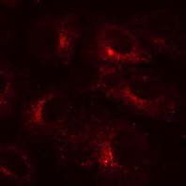
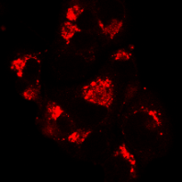
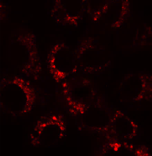
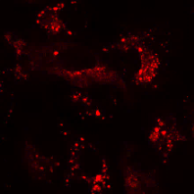
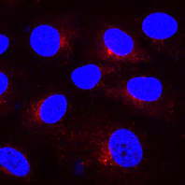
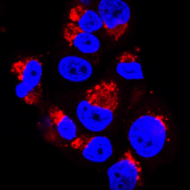
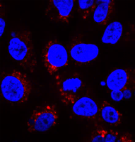
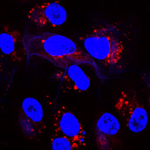
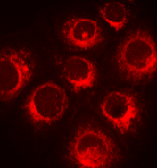
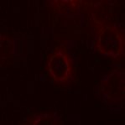
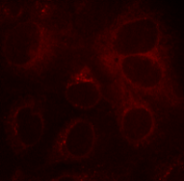
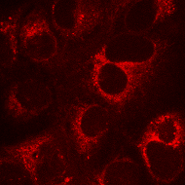
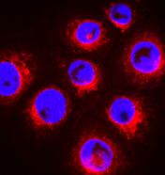
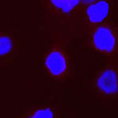
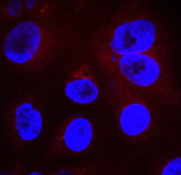
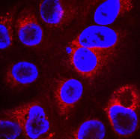
S4
S5
Vehicle SRT1720 SRT1460 SRT3025
LAMP-2
LAMP-2/
DAPI
S6
Vehicle BafA1 NH₄Cl CQ
LysoTracker
Red
LysoTracker
Red/DAPI

Slide 4
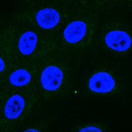
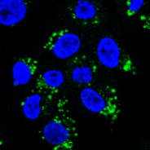
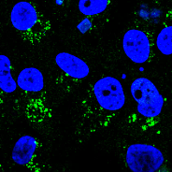

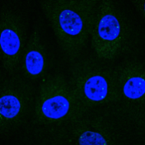
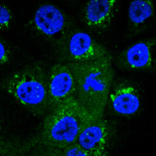
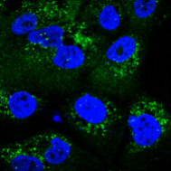


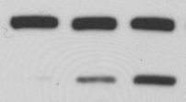
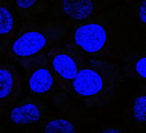
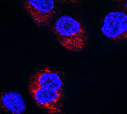
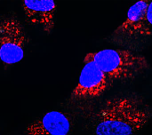

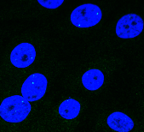
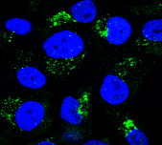
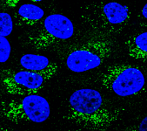




S7
S8
Vehicle
SRT1460
SRT3025
- - - + CQ
- - + - NH₄Cl
- + - - BafA1
LC3-II/DAPI
LC3-II
p62/DAPI
p62
Tubulin
S9
SU86.86
S10
- 2 4 SRT1720 (μM)
Vehicle
SRT1720
SRT1720+ BafA1
PARP-1
LC3-II/DAPI
Cleaved caspase- 3
Tubulin
p62/DAPI
S11
S12
- - + - + - NH₄Cl
- - - + - + CQ
- + + + - - SRT1720
LC3-II
Cleaved
caspase-3
Tubulin

Slide 5
S13
A
B
*
*
*
*
*
S14
A
B
*
*
SRT1460
SRT1460
S15
A
B

