Slide 1
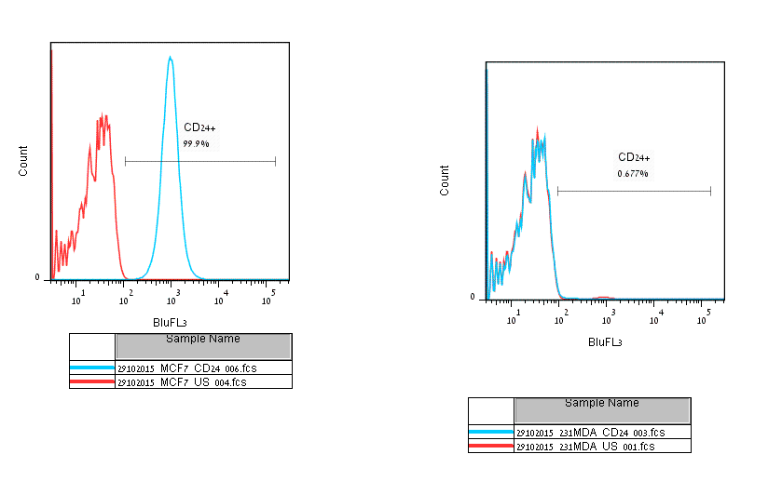
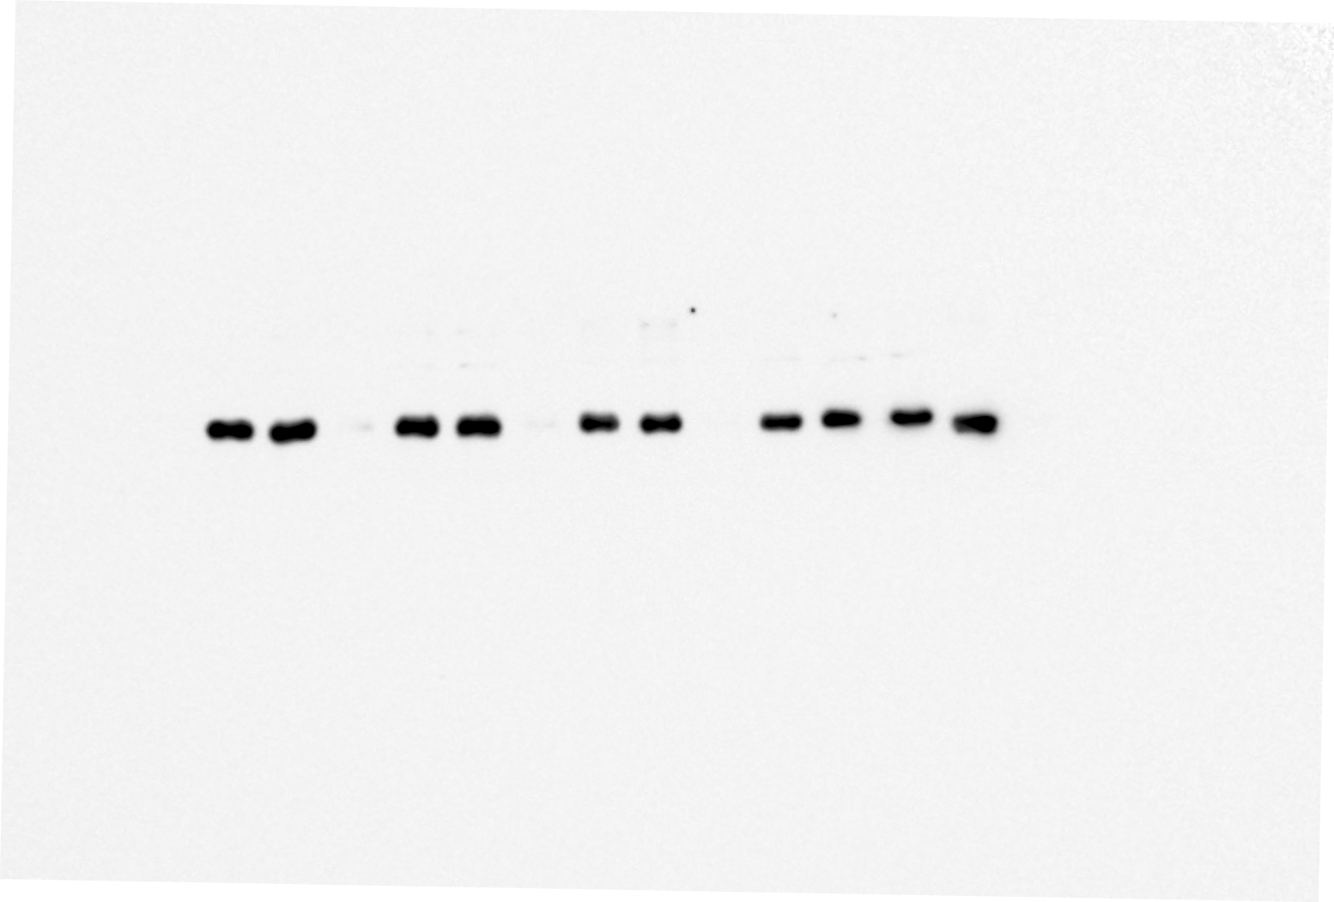
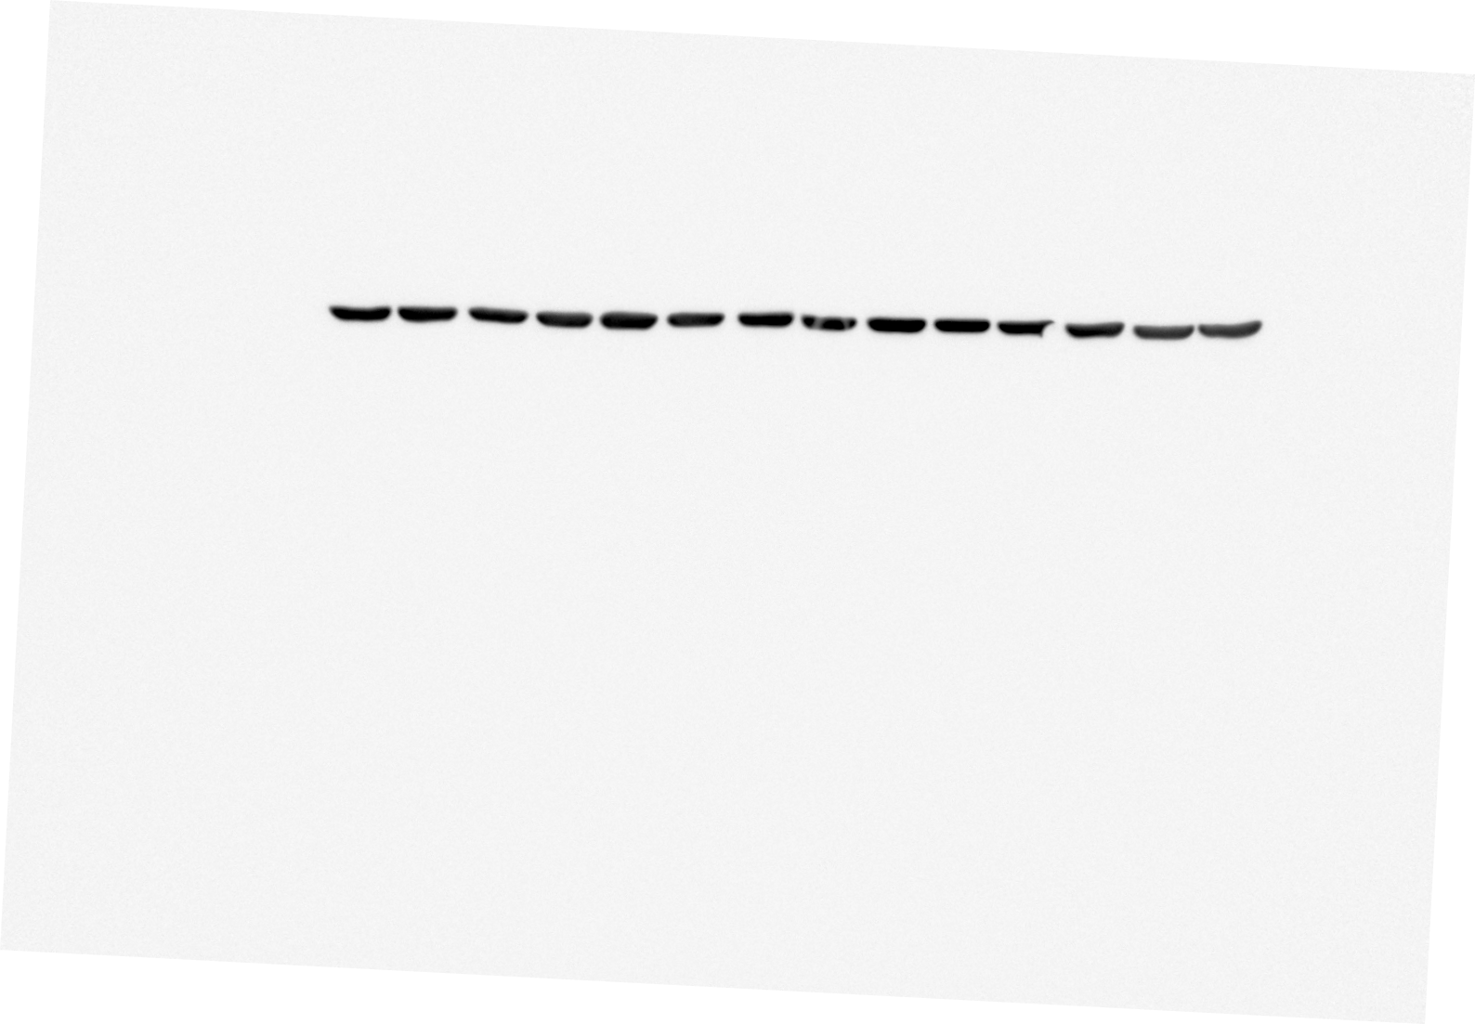
Supplementary S3
A
B
C
MCF7
control
IGF1R-KD
IGFIR
β-actin
Count
CD24

