Slide 1
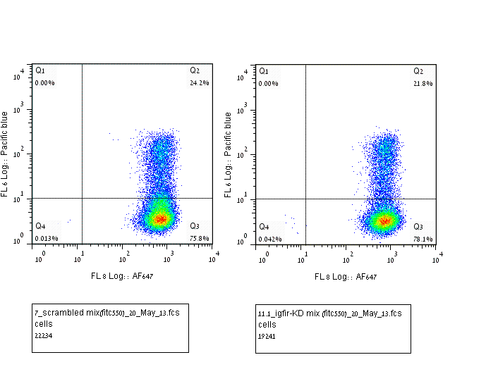
Supplementary S4
Mvt1 control cells
Mvt1 IGF1R-KD cells
CD24
CD49f

