Slide 1
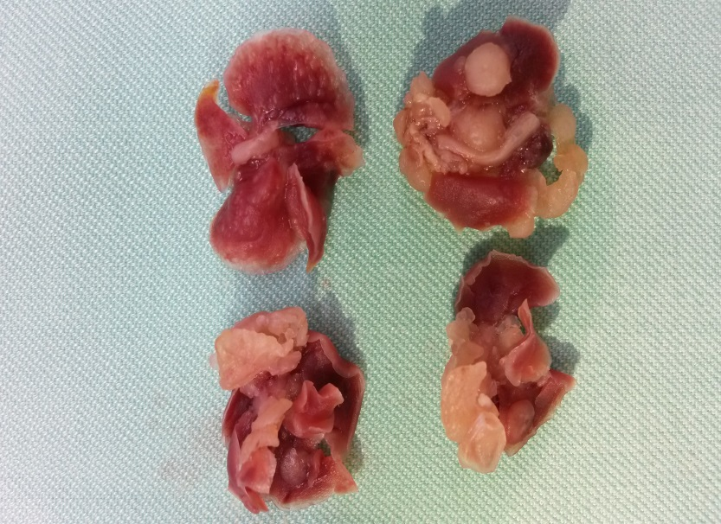
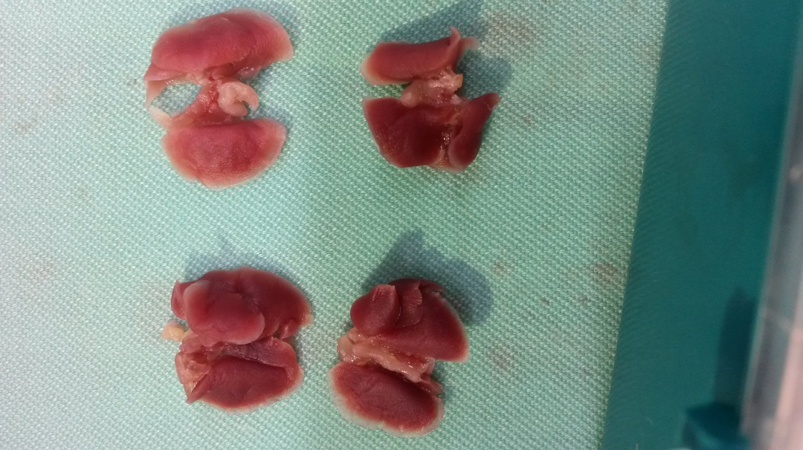
Supplementary S5
CD24⁺ control
CD24⁺ IGF1R-KD
**

