Slide 1
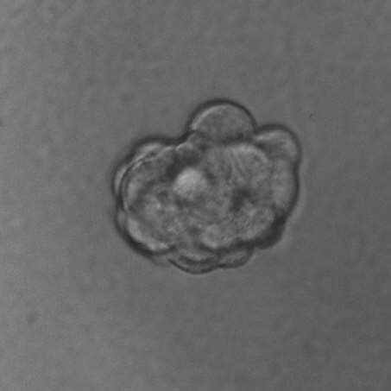
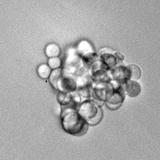
Supplementary Figure 1. CXCR1/2 and EGFR/HER2 regulate mammosphere formation/self-renewal and the proportion of aldefluor positive cell in HER2 positive breast cancer cell lines.
A
B
C
D
MCF7/HER2-18
E
F
G
H
I
J

