Slide 1
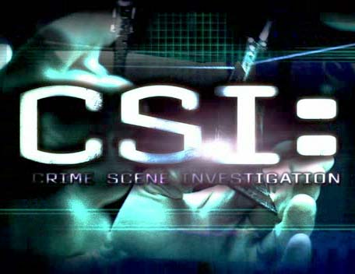
Columbia

Slide 2
Hackathon # 2
Introduction
  Person identification
  Molecular understanding of heritability
MinION activation
Discuss assignments

Slide 3
Person Identification
Solve crimes
Paternal/maternal testing
Ancestry

Slide 4
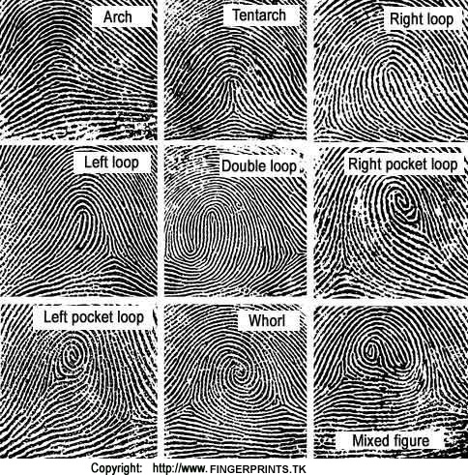
Finger printing
Specific to 1 person
Not inherited
  Identical twins do not share the same finger prints

Slide 5
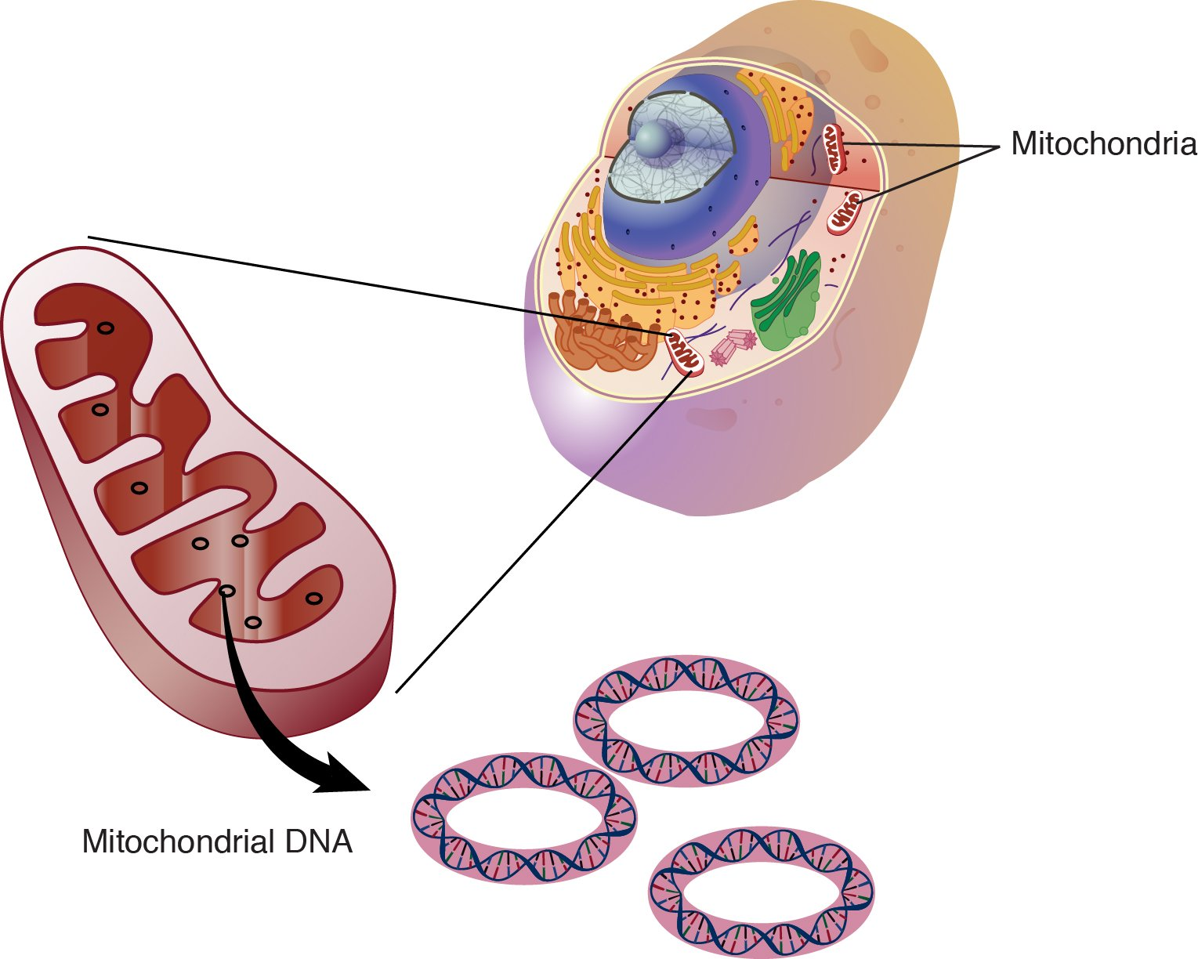
Mitochondrial DNA
Inherited from mother
17 kb, circular DNA
Hundreds of copies
No recombination
Haploid
2 copies nDNA
Hundreds of copies
Adapted from: http://epi.grants.cancer.gov/mitochondrial/
Notes:
Highly damaged DNA
Human mtDNA was first sequenced in Sanger's laboratory in Cambridge in 1981.
For example, all Ashkenazi jews, and there are approximately 8 million of them on the planet can be tracked down to 4 Italian women who lived around 2 thousand years ago.
Why mtDNA?
• Although nuclear DNA is more powerful
• mtDNA is more stable over time/conditions
• Why is that?
– mtDNA is present in many copies
– mtDNA exists within a double membrane
organelle
• Can get more DNA – if sample is limited
• Can get DNA from highly degraded source
What is Mitochondria?
• Energy Power Plant of the Cell
• Organelle – vital for Cellular Respiration
• Many copies within one cell
• Only organelle with it’s own DNA
– Many copies of mtDNA genome within one
organelle
Mitochondrial DNA
• Contains 37 genes
• Two main regions:
– Non-coding region – control’s mtDNA
– Coding region – contains 37 genes
• Gene categories:
– 22 tRNAs (translation RNA)
– 2 rRNAs (ribosomal RNA – translation)
– 13 genes used in cellular energy production
Mitochondrial DNA
• Heavy vs. Light strands
– Heavy greater number of guanines
– Contains most of genes (28 out of 37)
• Tightly packed genome
– No introns
– Only 55 nucleotides not being used
• Two hypervariable regions
– Within D-loop
– HV1 and HVII
mtDNA vs. Nuclear DNA
Nuclear
• 3.2 Billion bps
• 2 copies per cell
•Linear
• Inherited from father
and mother
• Diploid genome
• Recombination
• Unique
mtDNA
• 17,000 bps
• Hundred’s copies
• Circular
• Inherited from mother
only
• Haploid genome
• No recombination
• Shared by everyone
within maternal lineage

Slide 6
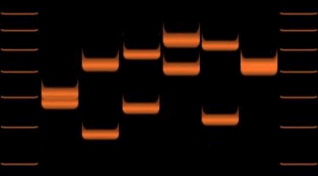
STRs
Jeffreys , University of Leicester 1984
Identification – 13 loci
Inherited ; information about family context
6 individuals

Slide 7
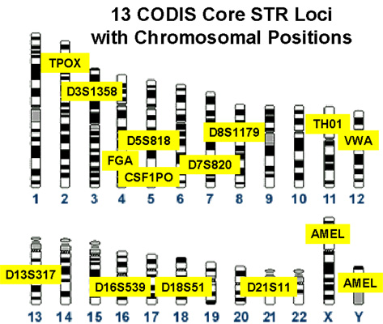
Combined DNA index System
National DNA Index System (NDIS)
Offenders:
National: 12.10⁶ DNA profiles, 2015
NY state: 5 10⁵⁵DNA profiles, 2015
California: 1.7 10⁶ DNA profiles, 2015
http://www.cstl.nist.gov/div831/strbase/fbicore.htm

Slide 8
Phonotypical readouts
Single nucleotide polymorphisms (SNPs) on autosomal chromosomes :
  Eyes
  Hair
  Skin
  Etc.

Slide 9
How are traits transmitted?
Why do we have traits from both mom and dad?

Slide 10
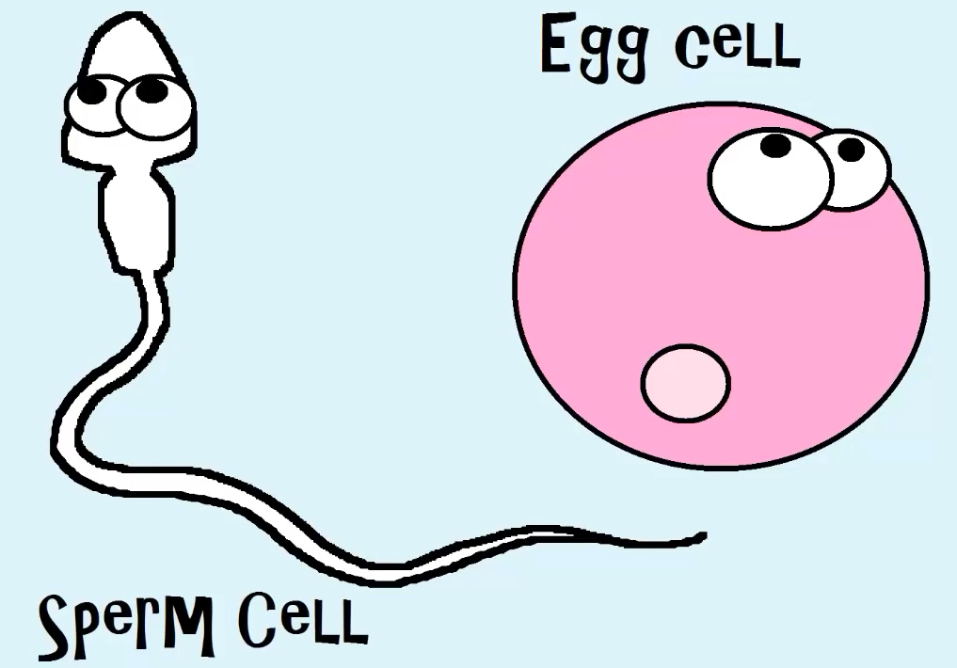
Let me tell ya about….
birds and bees
Reductional cell division:
23 Chromosomes
23 Chromosomes

Slide 11
Meiosis
Sperm
Chromosome 1
Chromosome 2
S-phase
DNA replication

Slide 12
Meiosis
synapse
DNA breaks induced
SPO11

Slide 13
Meiosis
Cross over recombination
~1 Cross over/chr
Chromosome 1
Genetic variation created

Slide 14
Meiosis I – separation homologues
Metaphase 1 : segregating homologues
Possibility 1:
Possibility 2:
Possibility 2^{n}:
Independent orientation:
2² = 4
2²³ = 8388608

Slide 15
Meiosis II: segregating sister chromatids

Slide 16
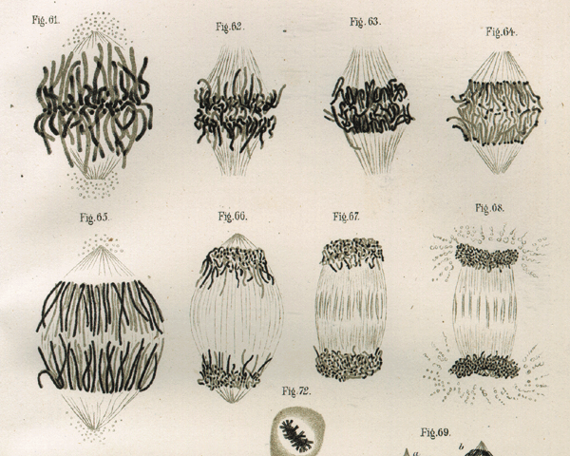
Meiosis II: segregating sister chromatids
Drawing of mitotic cell division by Walther Flemming. (Leipzig, 1882).

Slide 17
Resulting in gametes : ready to mate

Slide 18
2n
4n
Synapse
Breaks
Recombination
1n Gamete
MII : Sis. Segregation
MI : Hom. Segregation

Slide 19
Fusion gametes:
23 Haploid (1n)
23 Haploid (1n)
Diploid (2n)

Slide 20
Jessy
Chris
x
Son George
meiosis
Bethany
x
Missy
meiosis
x
?

Slide 21
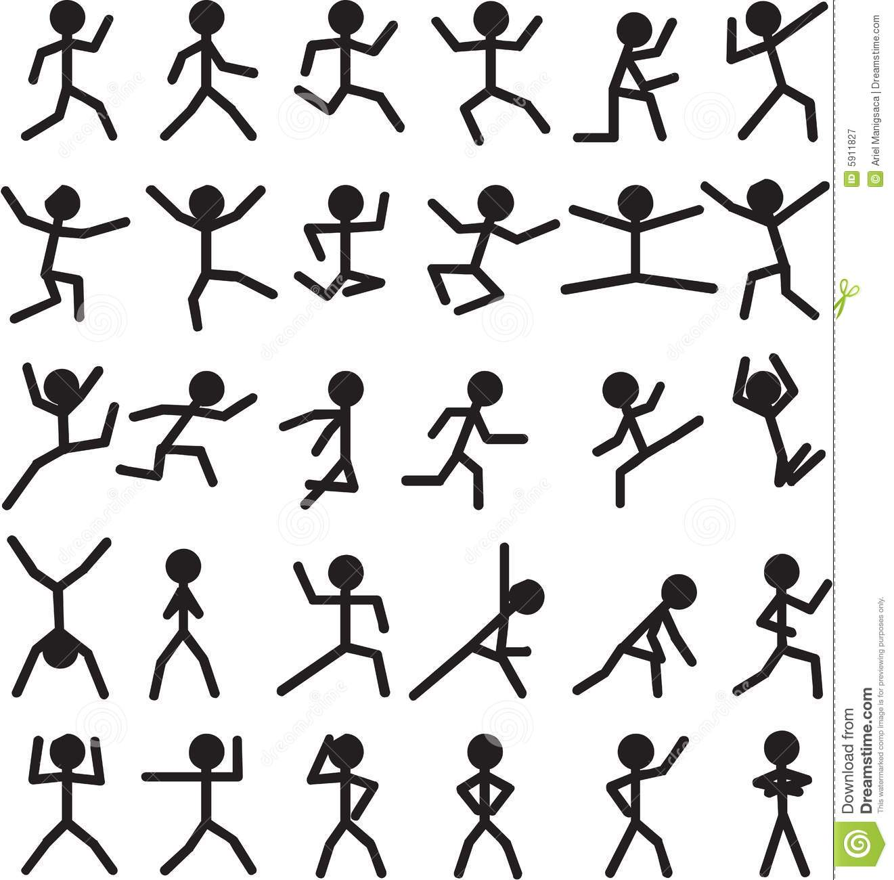

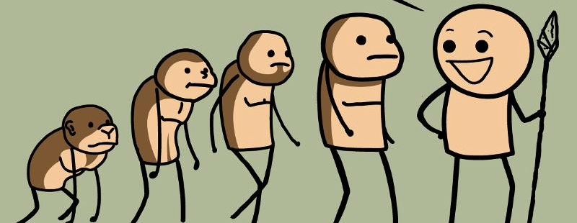
Next generation inherits blocks
Blocks get smaller every generation
  Infer IBD
Generation
~
6
5
4
3
2
1
?

Slide 22
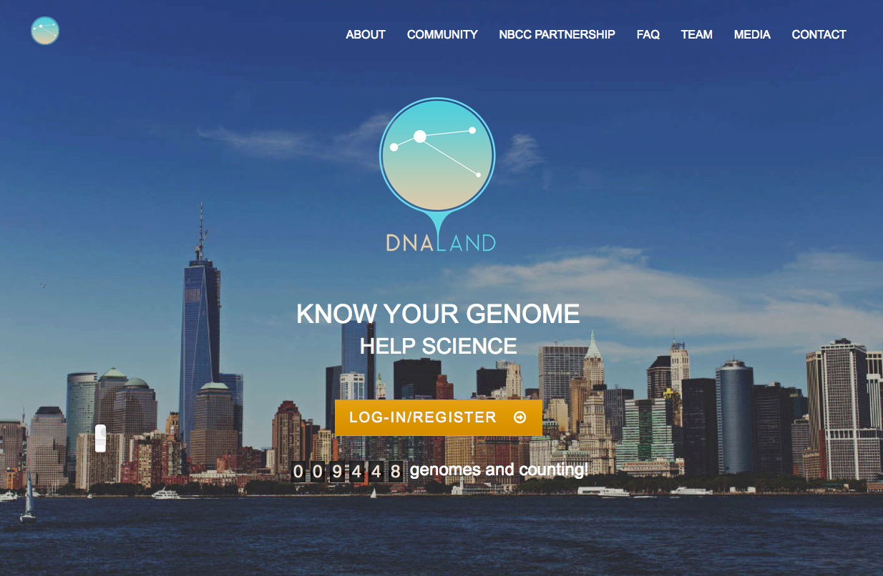

Slide 23
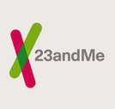


Consumer sequencing
Samples the genome for SNPs:
Ancestry
Identify Neatherthal in you
(Phenotypic traits )
(Disease associated traits)

Slide 24
What DNA.land does:
It takes: DNA SNP data (23&me, ancestry,
family tree )
It does : Imputation
Prediction of the original DNA sequence
You need context to infer the words.
B_ R_K O_ AM_ _S _R _ S _D_ _ T
We get context by sequencing
A_ _ _ T G C A _ _ _ _ _ T C T C _ _ _ _

Slide 25
Identity by decent (IBD):
Find shared blocks back and infer family relation ships
Find segments
Find overlap:
Find segment length for prediction of distance:
Mum
Grand-mum
Dad
Grand-Dad

Slide 26
DNA.land output:
Find segment length for prediction of distance:
Missy
DNA-land:
Missy’s sister
Not shared
Shared

Slide 27
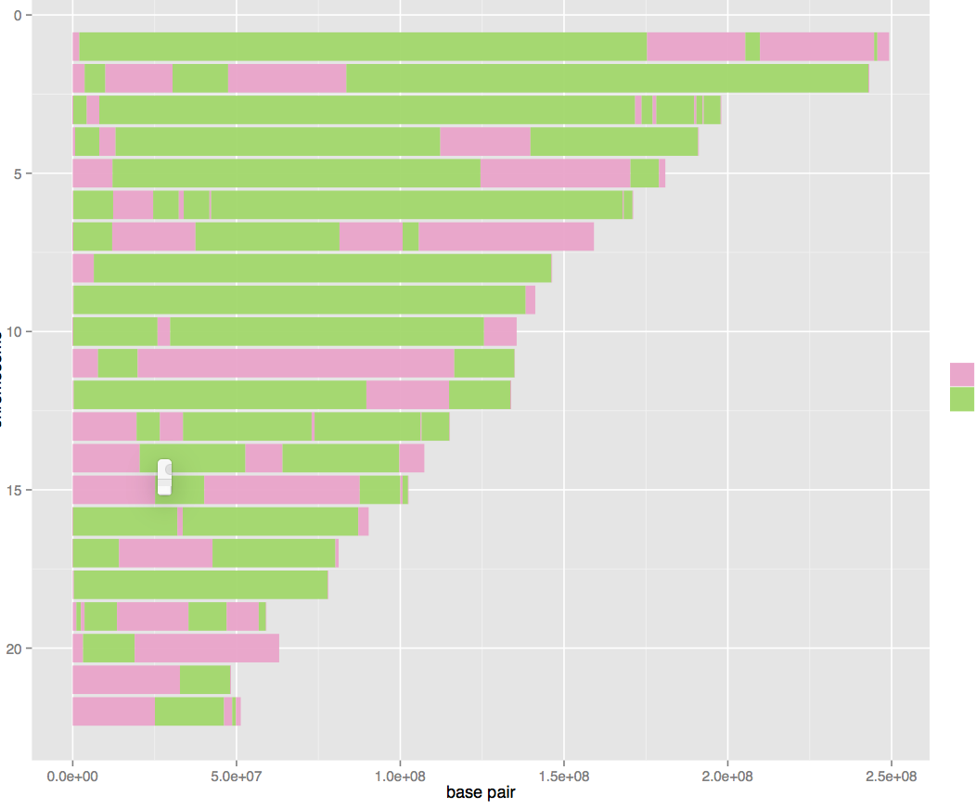
DNA.land examples: siblings
Chromosome #
Not shared
Shared
Length chromosome
By : R-Munoz, J.Yuan

Slide 28
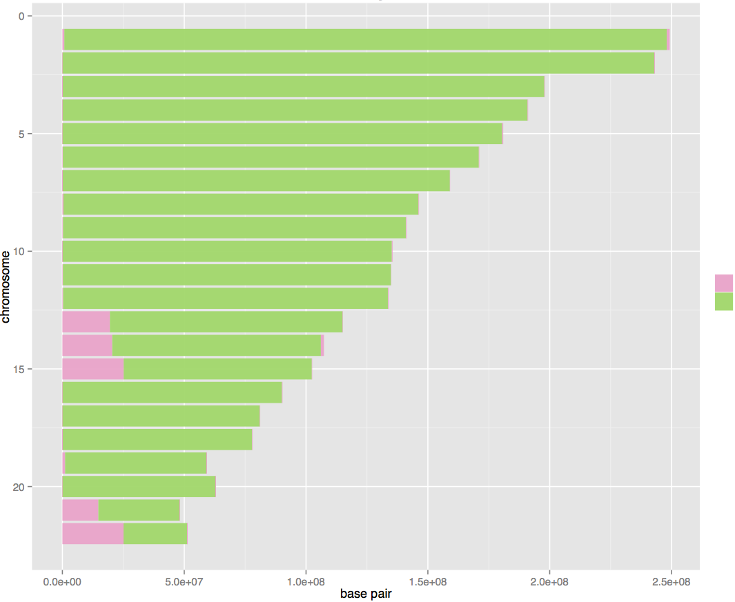
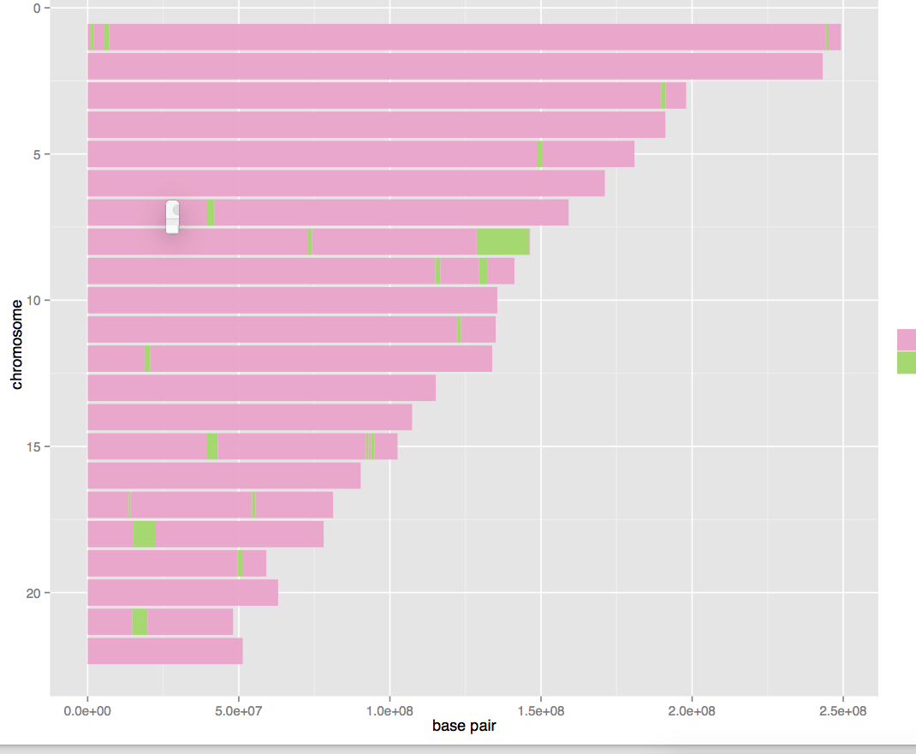
Siblings
Homozygotic twins
Chromosome #
3rd cousin
Not shared
Shared
Length chromosome
By : R-Munoz, J.Yuan

Slide 29
In this Hackathon:
New approach: finding context using the minION.
minION data:
?Errors?
?Distribution reads?
QC data
?
Male / female?
Ancestry?
Phenotypic traits?
Any thing you can find

Slide 30

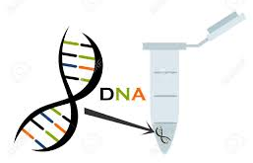
In this Hackathon:
New approach: finding context using the minION.
Behind the scenes:

Slide 31
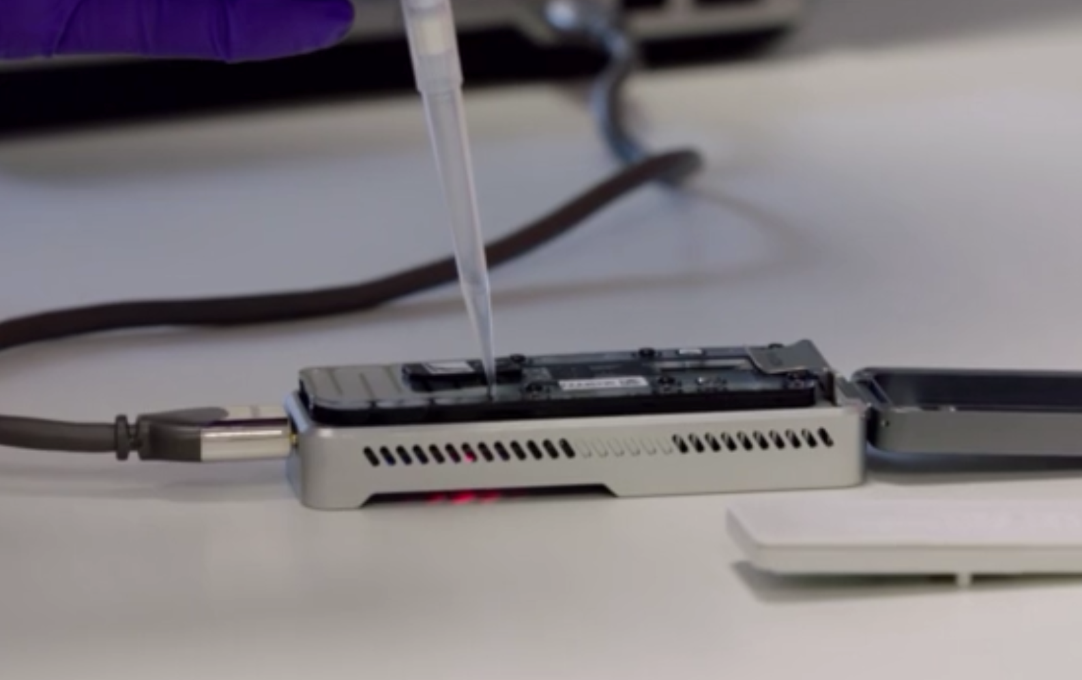
Prime flow cell with fuel
Pipet sample into flow-cell

Slide 32
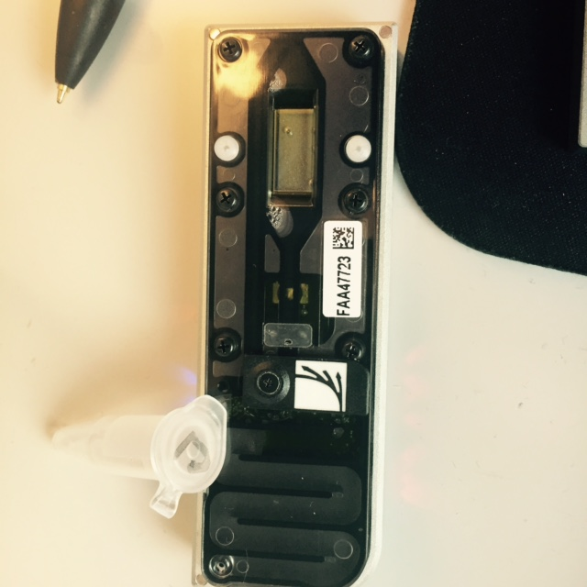
The flow cell
Step 2
Step 1
BUT, be aware of bubbles! No air should be in the channel!
Slowly remove the air , before pipetting the fuel-mix!

Slide 33
Start Protocol
Remove air-bubble
Pipet (really slow) 500 ul fuel-mix into the port.
Wait 10 min
Pipet (really slow) 500 ul fuel-mix into the port.
Wait 10 min
Pipet the library into the port – start run!
Notes:
Yaniv – tour in the genome center

Slide 34
Assignments

