Slide 1
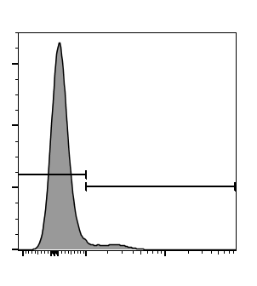
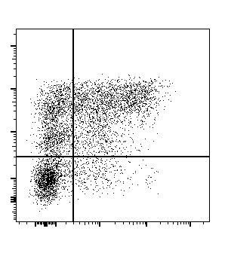
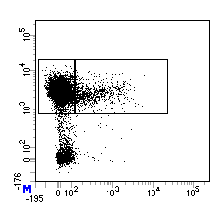
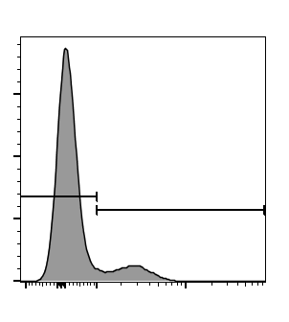
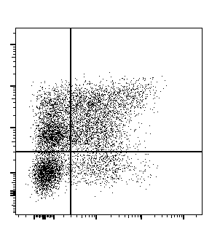
Supplemental Figure 2
C
gated TDLN CD45+ cells
gated non-tumor cells (RFP^{neg})
gated RFP+ cells
A
tumor associated CD45+ cells
circulating CD45+ cells
WT
46%
26%
B
79%
7%
6%
21%
7%
CD45 BV605
(ex vivo)
Cell counts
STING-KO
36%
36%
CD11b
CD45.2 PE-Cy7
(in vivo)
16%
21%
7%
RFP
CD11c

