Slide 1
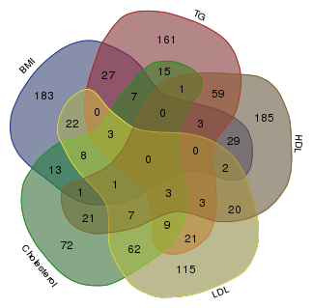

a
b
TG
TG
TG
BMI
BMI
HDL
HDL
Cholesterol
Cholesterol
LDL
LDL
OTUS
Taxonomies
S3 Fig. The number of OTUs (a) or taxonomies (b) associated with TG, HDL, LDL, cholesterol and BMI at FD < 0.05, and their overlaps with each other. BMI indicates body mass index; TG, triglycerides; HDL, high-density lipoprotein; LDL, low-density lipoprotein; and TC, total cholesterol.

