Slide 1
Supplemental Figure 1
Supplemental figure 1. PAE Phylogenetic tree with genes from Arabidopsis thaliana and 34 other species from PHYTOZOME. Slide 2-11 have fragments of the phylogenetic tree that can be concatenated to obtain the whole tree. Protein sequence alignments were performed using MUSCLE and Tree calculated by neighborjoining using BLOSUM62 by the Jalview 2.8.2 software package ¹⁷.

Slide 2
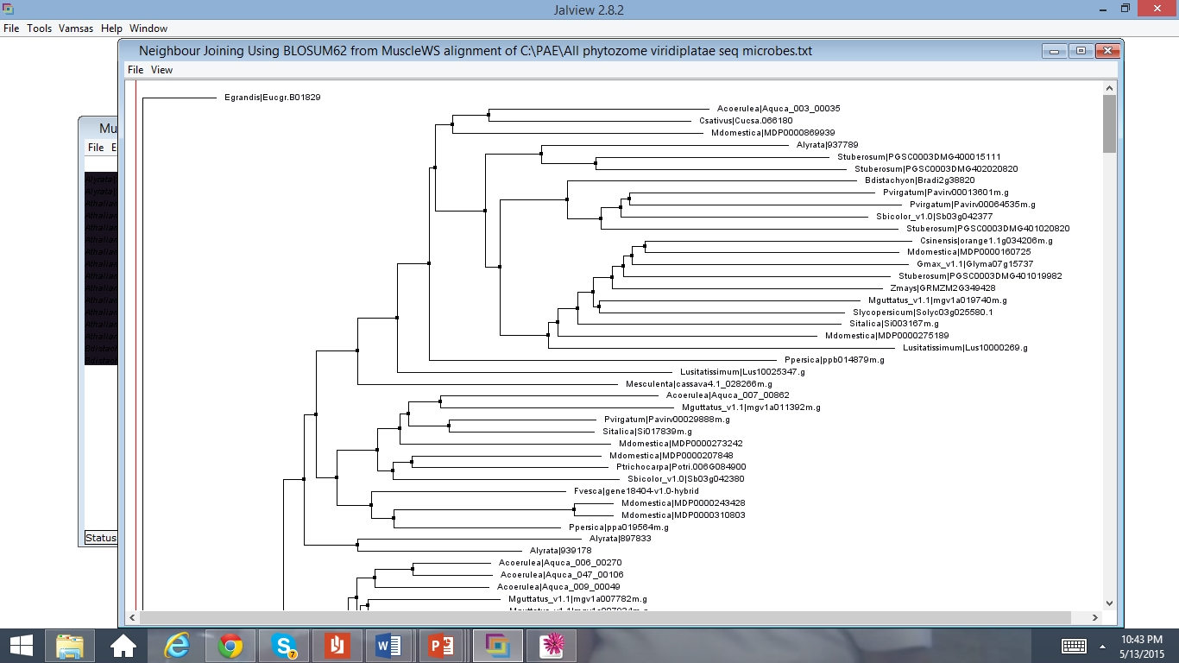

Slide 3
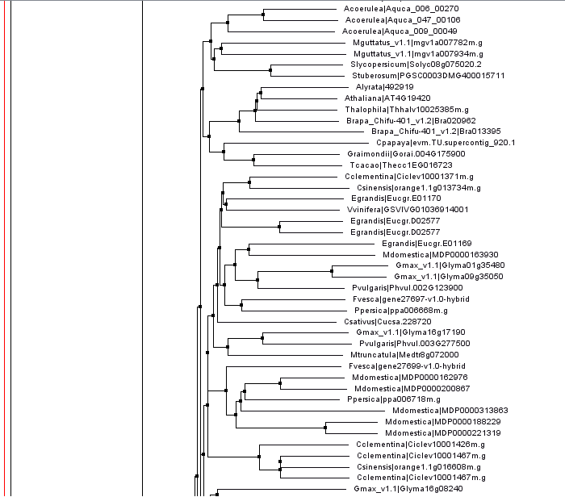

Slide 4
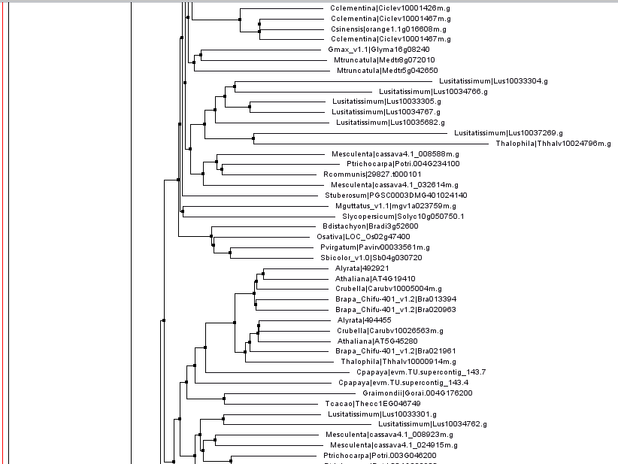

Slide 5
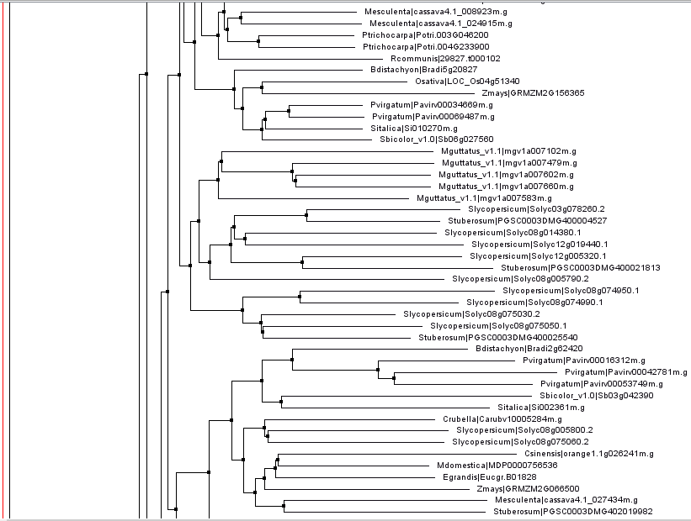

Slide 6
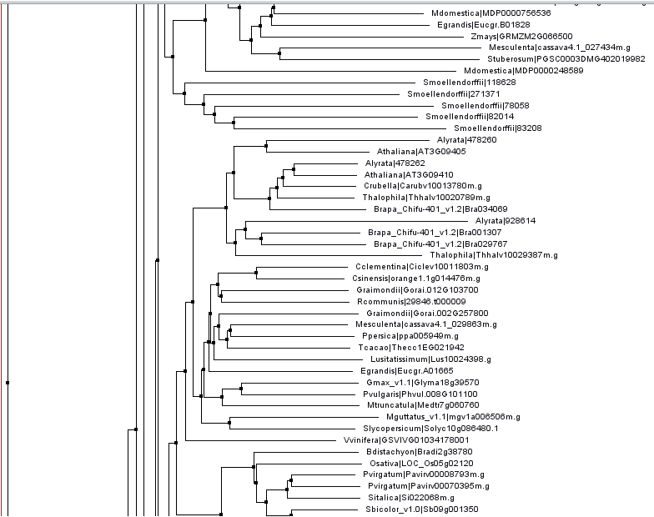

Slide 7
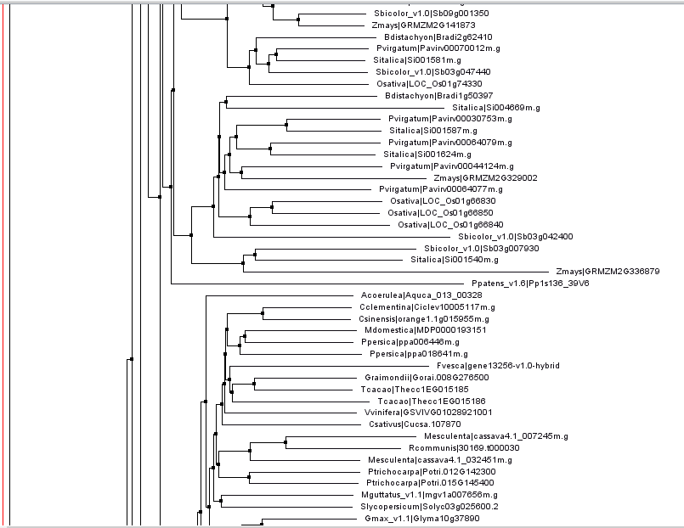

Slide 8
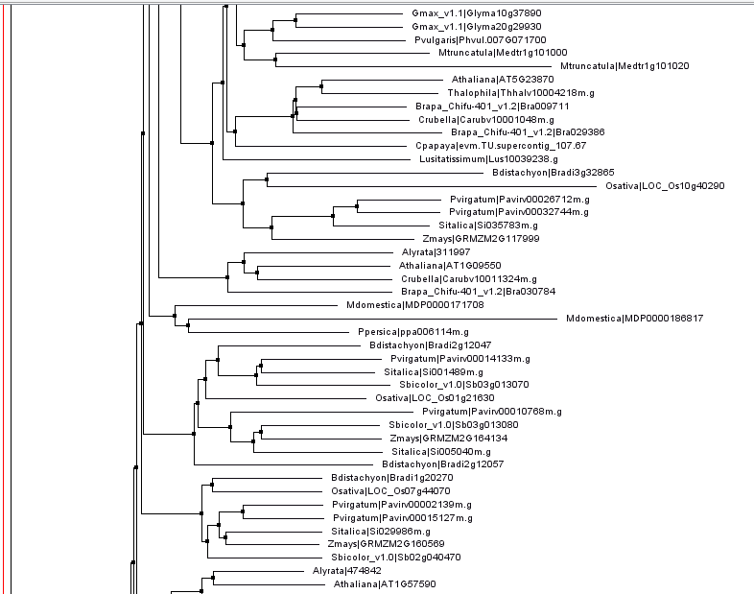

Slide 9
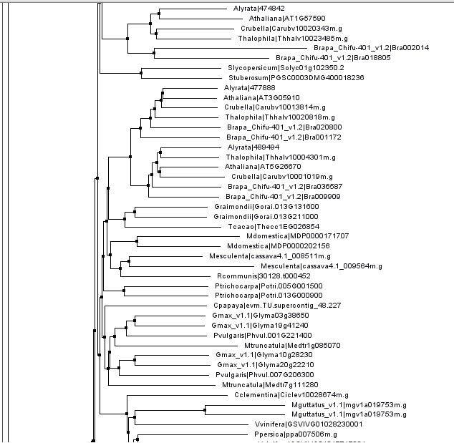

Slide 10
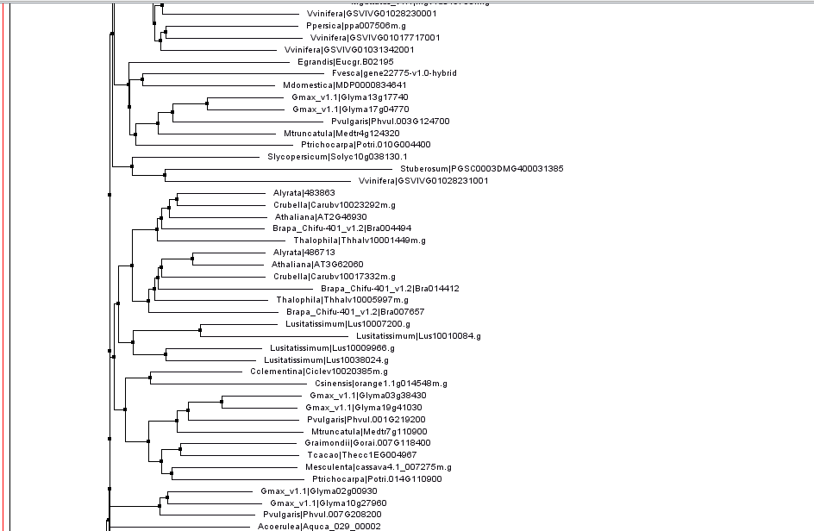

Slide 11
