Slide 1
Figure 1
TP1
TP2
TP3
Cycles of IER
1
2
3
4
Breast biopsies
Serum & urine
measures
0
10
Energy Restriction %
20
30
40
5 day 38% ER
IER (Average 45% ER)
50
60
60% CER
2 day 65% ER
70
Time/days

Slide 2
Figure 2
Baseline
4th cycle of IER
TP1
TP2
TP3
26
Increased
concentrations
59
196
170
308
331
39
Decreased
concentrations
23

Slide 3
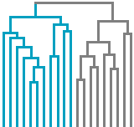
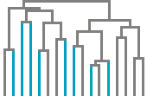
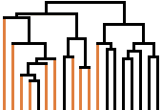

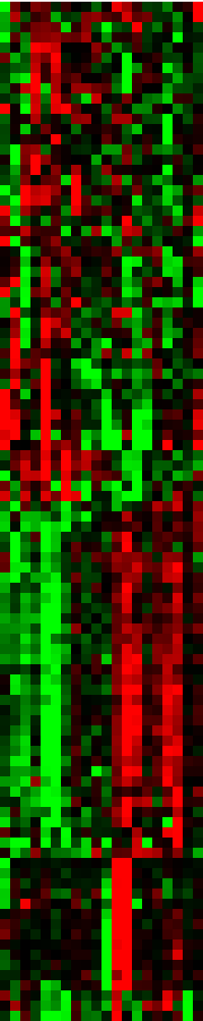
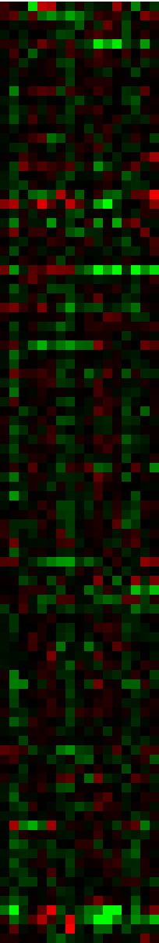
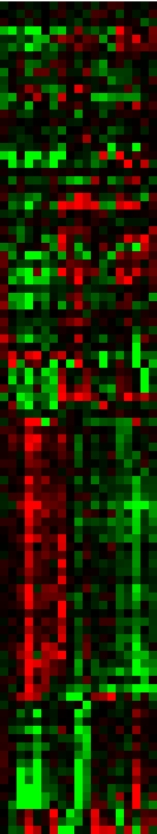
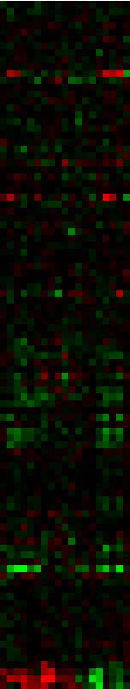
Figure 3
a b c d
IER Breast tissue IER Lymphocytes CER Breast tissue CER Adipose fat
HIST2H3A
MMRN1
ANKRD30B
AGR3
OLFM4
GALNT6
MUC1
CLIC6
CYP4X1
SNOU13
SPP1
TFPI2
DHRS2
ALOX15B
MIR3916
CXCL13
SLC26A3
ITIH2
TFF1
PIP
C2ORF27A
CPA3
OR5E1P
GOLGA8A
GSTA1
SHISA2
KCNK2
SLC28A3
CHI3L1
CPB1
DAPL1
SLC34A2
LCN2
HSD17B2
CLCA4
SLC6A14
EGF
MUC15
XDH
LBTN1A1
ALBA
CSN2
CSN1S1
CSN3
SCGB2A2
SCGB1D2
SCGB2A1
C4ORF7
PROL1
LINC00641
EGFL6
NPR3
TNMD
UCHL1
HSPB6
PLIN4
PDE3B
SLC16A7
THRSP
PRKAR2B
DEFB132
ACVR1C
DGAT2
GPAM
RP1-28O10.1
ADH1A
GYG2
LEP
LPL
PLIN1
ADIPOQ
PCOLCE2
CIDEC
RBP4
SLC19A3
AKR1C2
TIMP4
AQPEP
PCK1
C12ORF39
ME1
TRHDE-AS1
SCD
PLA2G2A
TYRP1
FLG
CLDN1
DSC1
DSG1
LCE2B
SBSN
LCE1B
LOR
KRT2
FLG2
KRTDAP
KRT1
CXCR2
S100A8
PPBP

Slide 4
Figure 4
BC (9)
BIER-NR (9)
p=0.9
BIER-R (11)
BCER (10)
p=0.02
6
4
p = 0.03
2
SCD
0
-2
-4
-6
-8
-10
-5
0
5
BCER (10)
BIER-R
(11)
BIER-NR
(9)
BC (9)
% Fat Change
BC (9)
BIER-NR (9)
p=0.3
BIER-R (11)
BCER (10)
p=0.01
2
p = 0.06
1
ALDOC
0
-1
-2
-15
-10
-5
0
5
BCER (10)
BIER-R
(11)
BIER-NR
(9)
BC (9)
% Weight Change

Slide 5
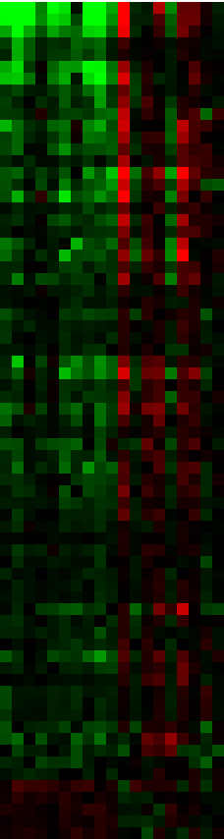
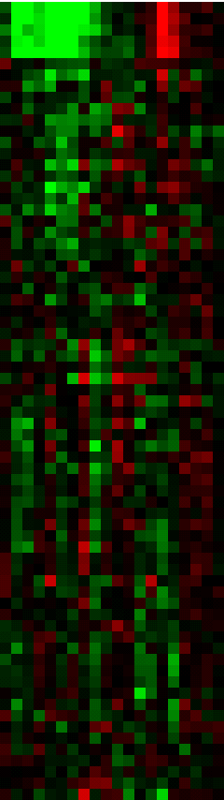
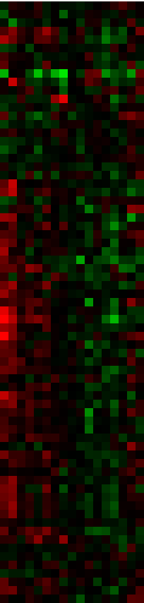

Figure S1
Controls
IER
CER
Log2 fold changes
Whole breast
Whole breast
Lymphocytes
-
8 0 5
SCD(211708_s_at)
SCD(211162_x_at)
SCD(200831_s_at)
SCD(223839_s_at)
SCD(200832_s_at)
FADS1(208963_x_at)
FADS1(208964_s_at)
ACACA(212186_at)
MME(203435_s_at)
ACOX1(209600_s_at)
ALDOC(202022_at)
ABCC6(214033_at)
THBS4(204776_at)
GPX1(200736_s_at)
LOC389393(222278_at)
MCART1(238574_at)
TF(214063_s_at)
FMOD(202709_at)
ANKRD38(229125_at)
HOXA10(213150_at)
LOXL2(202998_s_at)
HK2(202934_at)
IDH1(201193_at)
C14orf50(237654_at)
PRDX2(39729_at)
SFT2D1(226836_at)
PRO0149(228373_at)
SDHC(202004_x_at)
RPA1(215088_s_at)
SLC44A1(228486_at)
NID2(204114_at)
TMEM135(222209_s_at)
RSU1(201980_s_at)
GNG2(224964_s_at)
CD164(208654_s_at)
BOLA3(227291_s_at)
CD164(208405_s_at)
AGPS(225114_at)
PDHB(211023_at)
CD164(208653_s_at)
MTCH2(217772_s_at)
ALDH3A2(202053_s_at)
GCSH(213133_s_at)
GLUD2(215794_x_at)
LTB4DH(231897_at)
GTF3A(201338_x_at)
CNIH4(223993_s_at)
UBQLN1(222991_s_at)
SUB1(214512_s_at)
SUB1(212857_x_at)
SUB1(224586_x_at)
2'-PDE(1554915_a_at)
TINF2(220052_s_at)
HSD17B12(217869_at)
C17orf39(228452_at)
C1orf97(224444_s_at)
NDUFB5(203621_at)
FAM45A(225351_at)
DBI(209389_x_at)
DBI(211070_x_at)
DBI(202428_x_at)
IDI1(208881_x_at)
SYBL1(202829_s_at)
DPH5(222360_at)
GOLGA2(225672_at)
C10orf57(222545_s_at)
NA(230267_at)
NIBP(56829_at)
ARIH2(201230_s_at)
FLJ10099(224688_at)
FOXP1(223287_s_at)
Energy restriction 71 breast probests (Ong et al.)
PREDICTION
ER
Unchanged
PAM cross-validation/prediction of samples with energy restriction response

