Slide 1
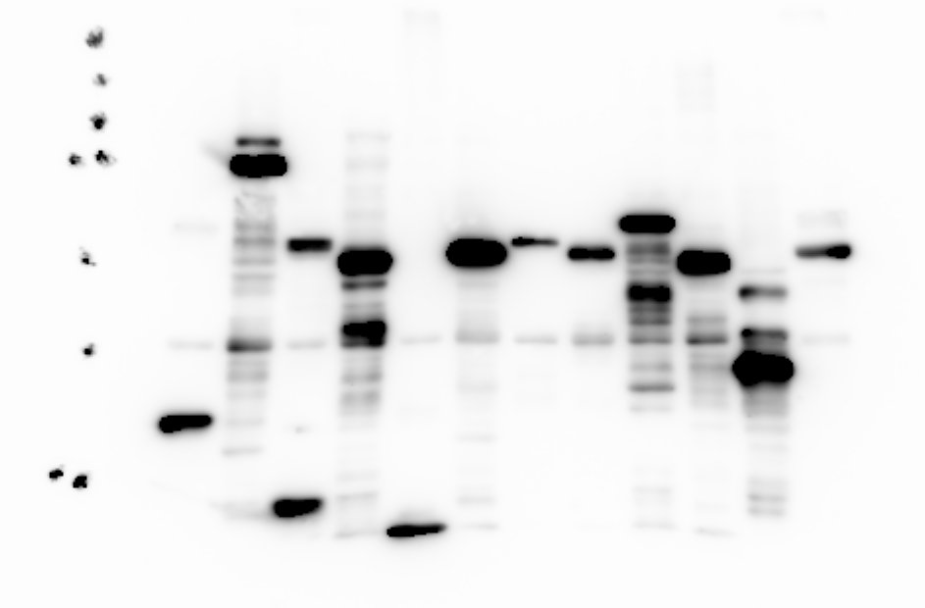
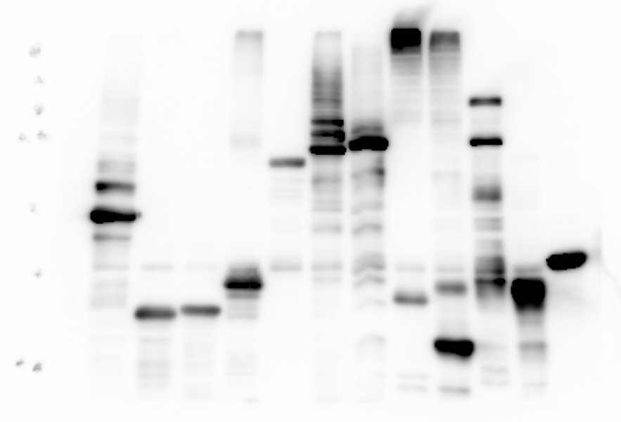
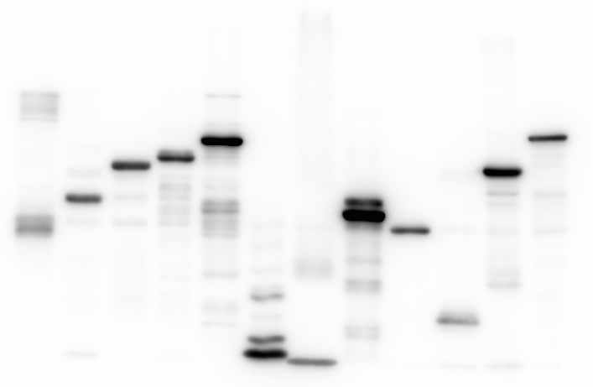
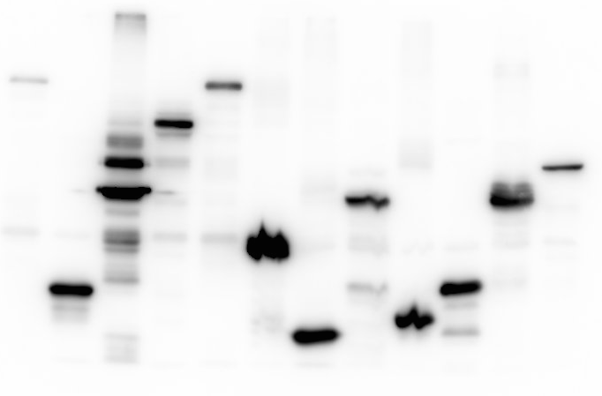
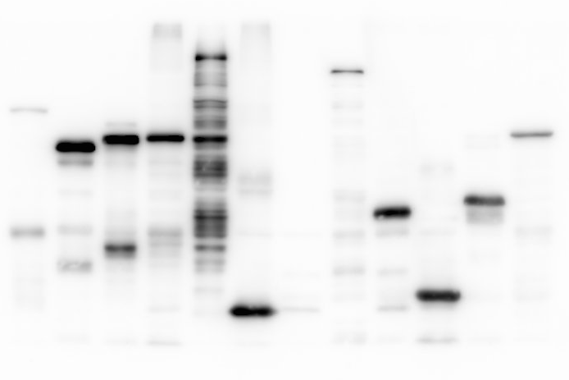
(A)
S1 fig
RNF113A
RNF114
RSPRY1
MARCH2
RNF141
RNF138
RNF175
RNF146
TRIM27
TRIM31
TRIM25
RNF148
TRIM69
TRIM21
MKRN2
TRIM43
RNF170
RNF168
TRIM17
TRIM22
MNAT1
RBCK1
RNF10
TRIM74
RAD18
RFPL3
RNF32
SYVN1
(kDa)
UNKL
RNF7
SIAH2
MID2
TRAF2
MIB2
RNF38
RNF41
250−
(kDa)
(kDa)
150−
250−
250−
100−
150−
150−
75−
100−
100−
75−
75−
50−
50−
50−
37−
37−
37−
25−
25−
25−
RNF144A
SH3RF1
RNF128
GTF2H2
ANAPC11
RNF149
RNF115
RNF139
RNF126
CNOT4
TRIM15
PCGF5
TRIM13
MKRN1
TRIM54
RNF24
FANCL
RING1
VPS11
MEX3B
TRAF4
SIAH1
BIRC3
ARIH1
TRIM9
BIRC8
ARIH2
PEX10
TRAIP
LNX2
CBLC
RNF5
PPIL2
MID1
PJA1
RBX1
(kDa)
(kDa)
(kDa)
250−
250−
250−
150−
150−
150−
100−
100−
100−
75−
75−
75−
50−
50−
50−
37−
37−
37−
25−
25−
25−
CCNB1IP1
SPRYD5
PRPF19
TRIM55
TRIM41
TRIM32
UBOX5
TRIM61
TRIM52
TRIM28
TRIM48
RAPSN
DCST1
RNF40
ZNRF1
PCGF1
PCGF2
DZIP3
RNF34
(kDa)
PML
BFAR
MYLIP
(kDa)
RNF8
DTX2
250−
250−
150−
150−
100−
100−
75−
75−
50−
50−
37−
37−
25−
25−
20−

Slide 2
S1 fig (continued)
MARCH9
PDZRN4
LONRF2
LRSAM1
NSMCE1
RNF19A
IBRDC2
TRIM56
RNF112
RNF208
RNF122
RNF183
RNF166
RNF167
RNF185
RNF111
TRIM35
TRIM62
TRIM47
TRAF7
MKRN3
TRIM11
TRAF3
VPS18
STUB1
NOSIP
RNF25
TRIM4
RNF26
BIRC7
MUL1
CHFR
TRIM5
MSL2
BMI1
NFX1
(kDa)
(kDa)
(kDa)
250−
250−
250−
150−
150−
150−
100−
100−
100−
75−
75−
75−
50−
50−
50−
37−
37−
37−
25−
25−
25−
20−
20−
20−
TRIM36
RFPL4B
RNF151
RNF130
SH3RF2
LONRF3
NHLRC1
NEURL2
RNF152
RNF19B
TRIM42
SHPRH
TRIML1
RNF180
RNF212
RNF150
RNF121
RNF135
BARD1
PCGF3
TRIM60
TRIM50
ZNF645
TRIM46
RFPL1
RKHD1
RNF14
TRIM49
CBLL1
BRCA1
RNF20
MDM4
DTX3
DTX4
DPF1
MIB1
(kDa)
(kDa)
(kDa)
250−
250−
150−
150−
250−
100−
100−
150−
75−
75−
100−
75−
50−
50−
50−
37−
37−
37−
25−
25−
25−
20−
TRIM59
RNF133
RNF217
MARCH8
UBE4A
NEURL
TRIM45
RNF219
UHRF1
TRIM24
TRIM37
RNF43
PARK2
ZNRF4
UHRF2
TRIM39
TRAF6
PEX12
PJA2
PHF7
BIRC2
RFFL
NFXL1
CBLB
(kDa)
(kDa)
250−
250−
150−
150−
100−
100−
75−
75−
50−
50−
37−
37−
25−
25−

Slide 3
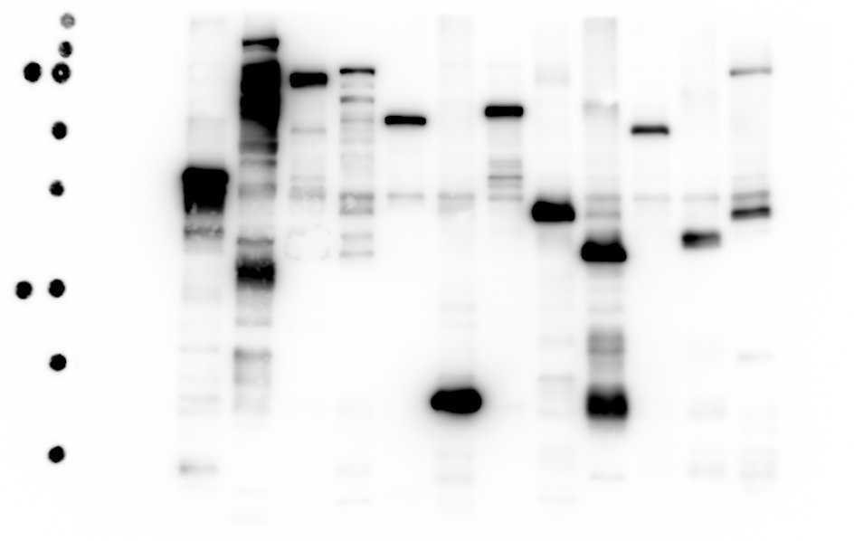
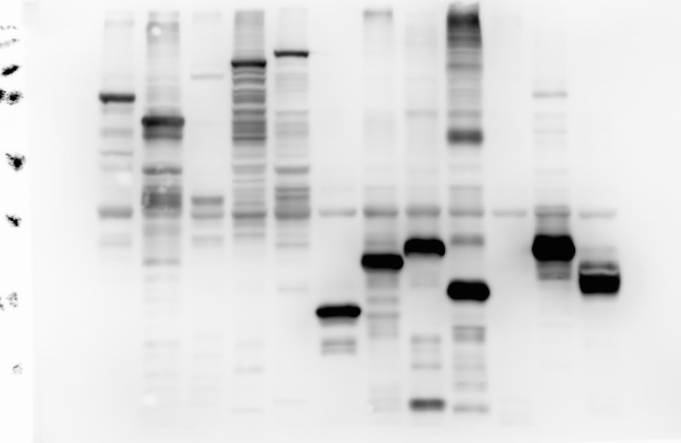
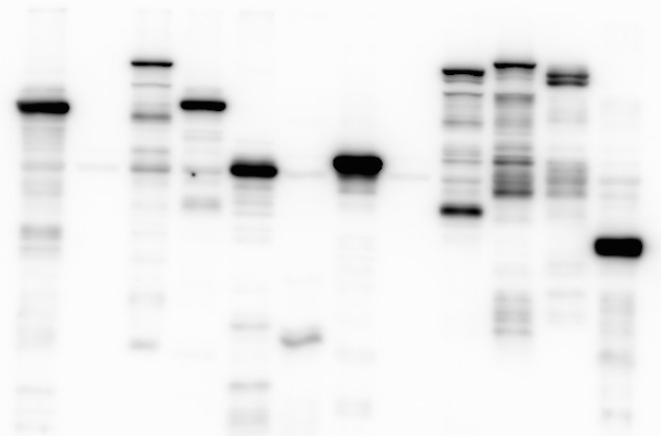
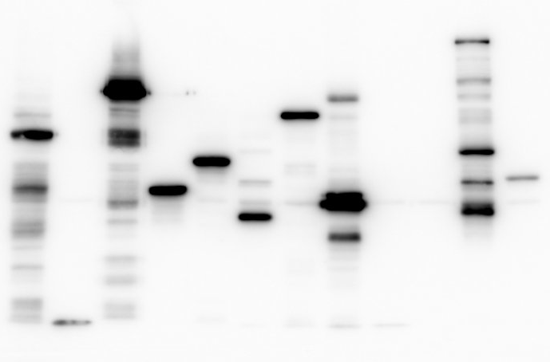
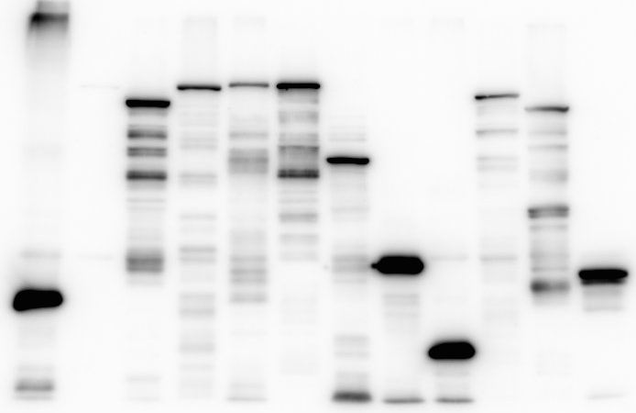
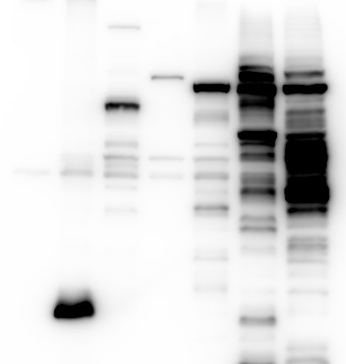
S1 fig (continued)
mPDZRN3
mRNF186
MARCH3
mRNF123
mANKIB1
mWHSC1
mOSTM1
ZSWIM2
mUHRF2
MARCH7
MARCH1
RNF103
RNF182
mATRX
(kDa)
mMDM2
mTRIM6
TRAF5
VPS41
RNF11
RCHY1
OSTM1
mCBL
(kDa)
RAG1
RNF4
250−
150−
250−
100−
150−
75−
100−
50−
75−
37−
50−
25−
37−
20−
25−
15−
20−
mMGRN1
mSMURF1
mHECTD2
mHECW1
mNEDD4
mHUWE1
RFWD2
CGRRF1
RNF125
mRNF44
mZFPL1
mUBE4B
mHACE1
mMNAT1
mBRAP
TRIM68
HERC3
TRIM65
TRIM10
TRIM34
RBBP6
PCGF6
UBE3A
RNF13
DTX3L
RNF12
TRIM7
RNF31
UBE3B
RNF2
RNF6
TRIM2
PEX2
WWP1
(kDa)
LNX1
(kDa)
XIAP
(kDa)
250−
250−
150−
150−
250−
100−
150−
75−
100−
100−
50−
75−
75−
37−
50−
50−
25−
37−
37−
20−
15−
25−
25−
20−
MARCH6
MARCH5
MGRN1
TRIM26
UBE3C
TRIM23
(kDa)
HTLF
250−
150−
100−
75−
50−
37−
25−
20−

Slide 4
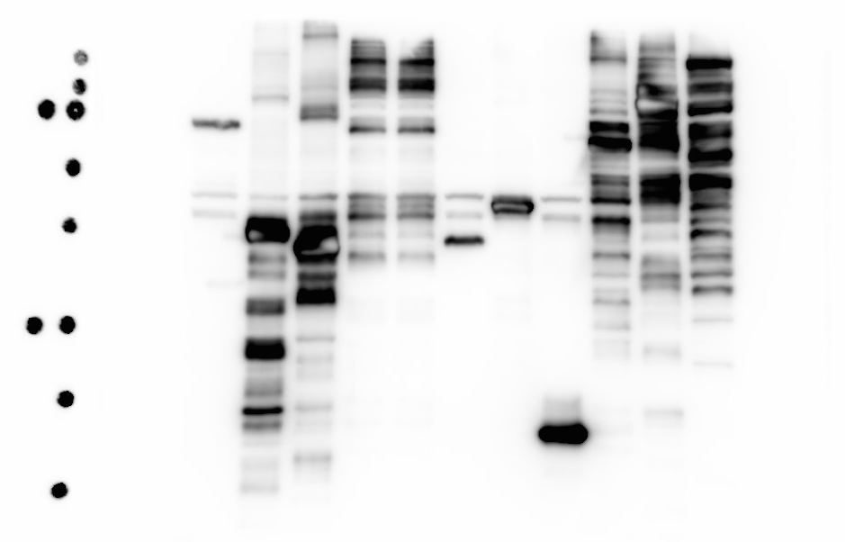
S1 fig (continued)
(B)
IBRDC2
OSTM1
RNF111
HERC3
UHRF2
MNAT1
RBBP6
RNF31
TRIM7
(kDa)
NFXL1
TRIM2
250−
150−
100−
75−
50−
37−
25−
20−
15−

