Slide 1
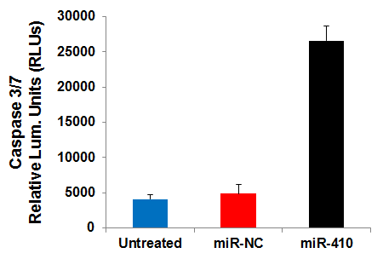
Figure S1.
Additional file 1: Figure S1. Increased apoptotic activity in xenograft tumors (day 35) treated with miR-410 relative to miR-NC, assessed by caspase 3/7 ELISA assay (Promega).

